Slide 1
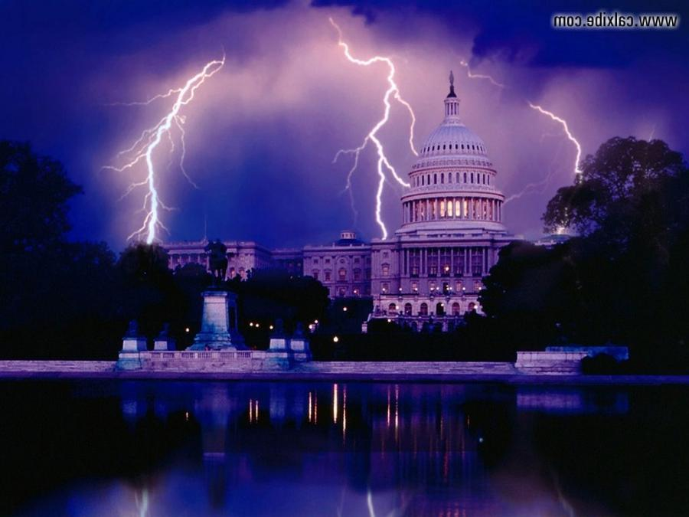
Current Events and Bible Prophecy

Slide 2
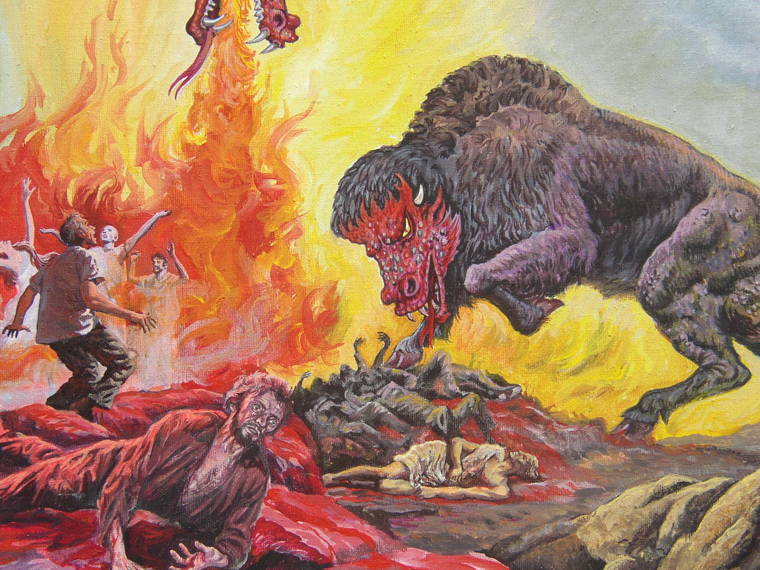
…he had two horns like a lamb, and he spake as a dragon.
Rev. 13:11.

Slide 3
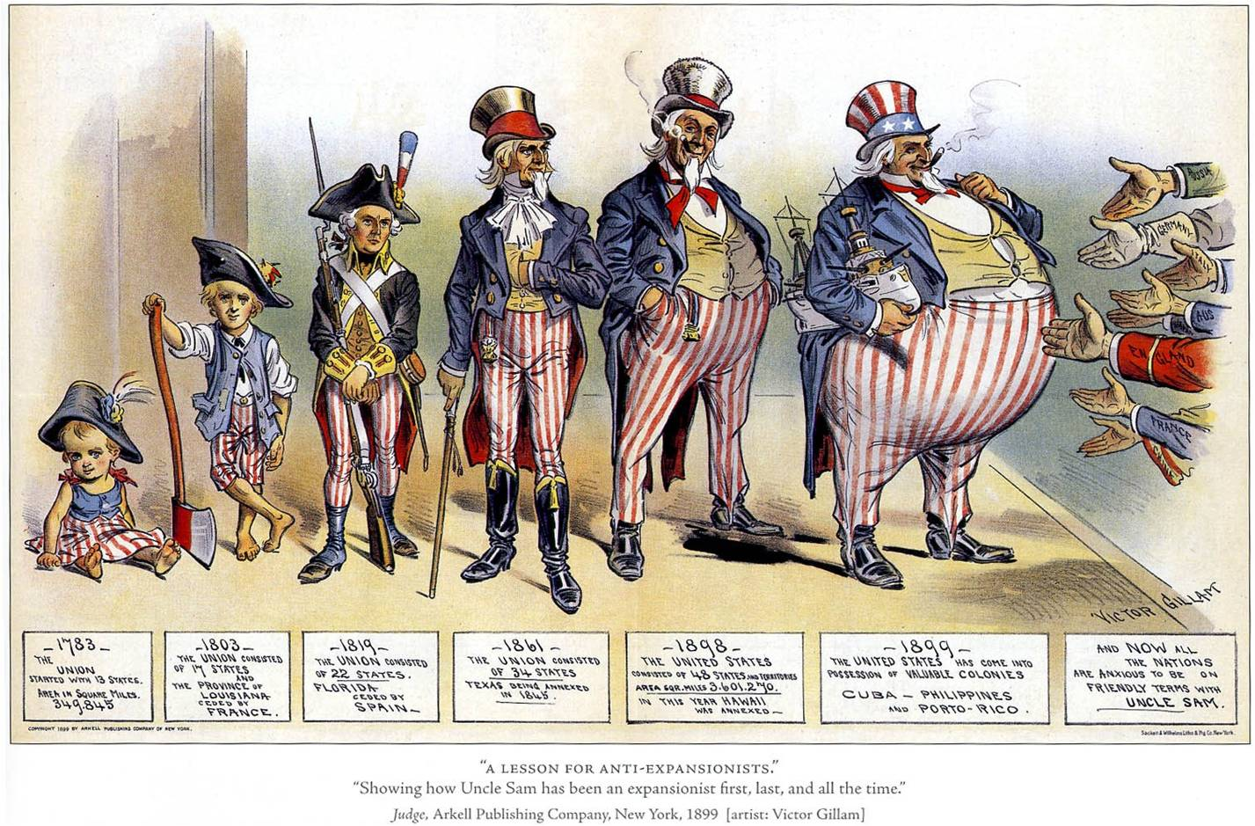

Slide 4
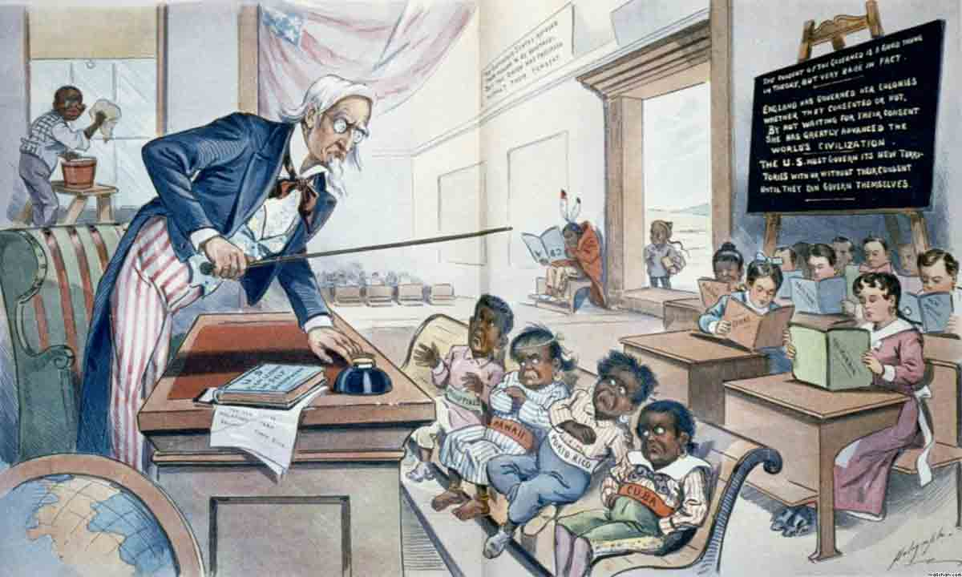

Slide 5
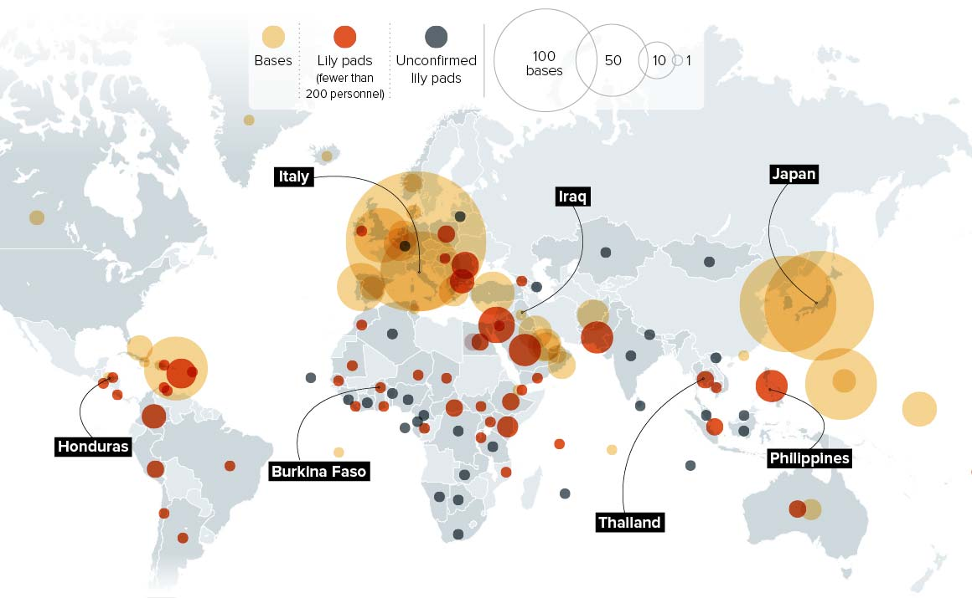

Slide 6
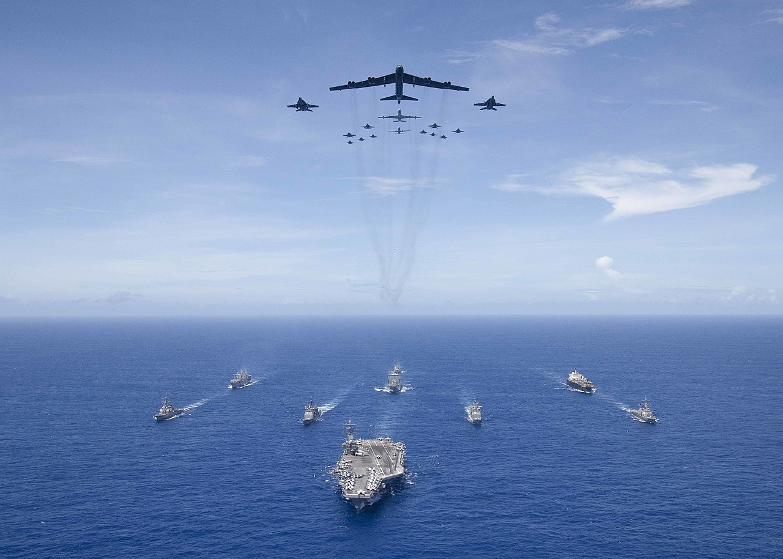

Slide 7
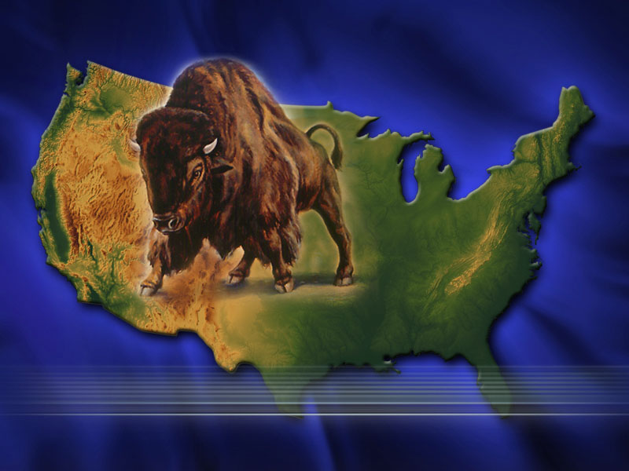
And he exerciseth all the power of the first beast before (on behalf of) him, and causeth the earth and them which dwell therein to worship the first beast,
whose deadly wound was healed.
Rev. 13:12.

Slide 8
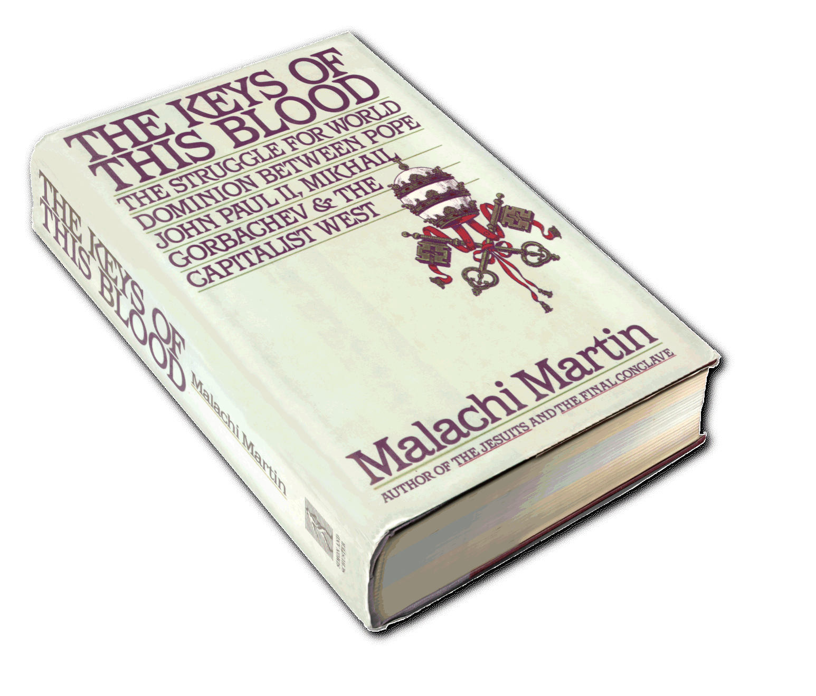
Catholicism will rule the world through America
Within twenty years this
country [USA] will rule the world.
Kings and emperors will soon pass
away, and the democracy of the
United States will take their place…
When the United States rules the world, the Catholic Church will rule the world. Archbishop Quigley, 1903, The Chicago Tribune. Romanism: A Menace to the Nation,
Jeremiah J.Crowley, (Aurora, Missouri:
The Menace Publishing Co., 1912) p. 573.

Slide 9
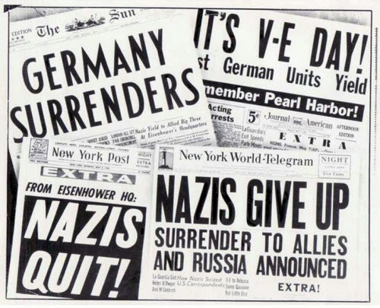

Slide 10
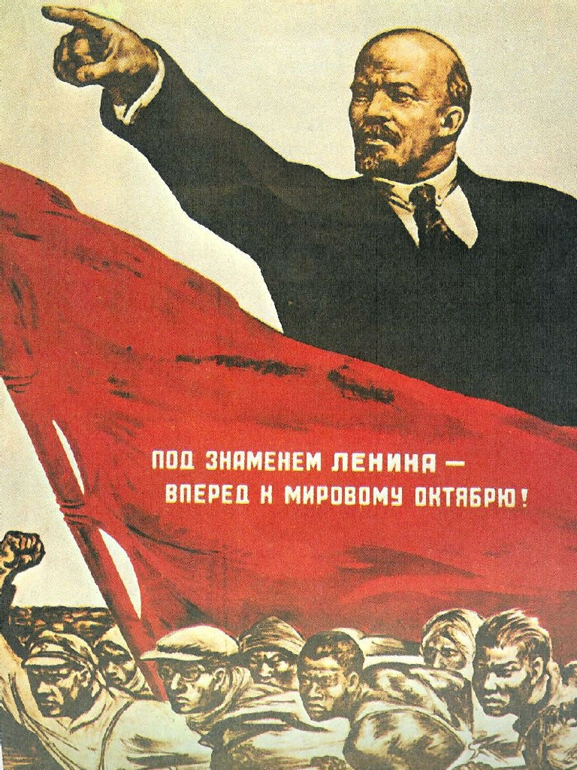
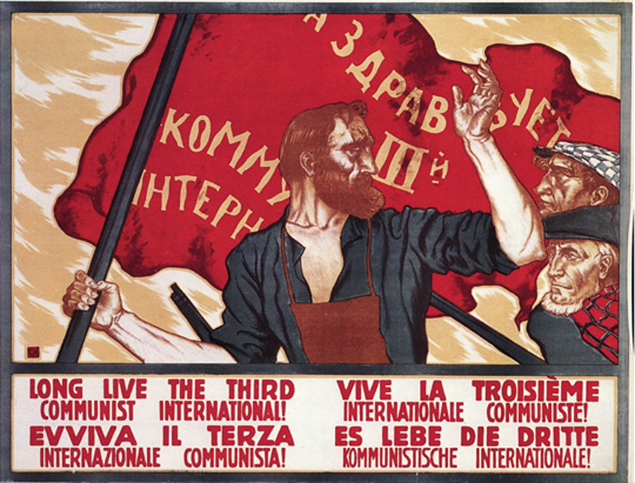
America and Catholicism had a common enemy

Slide 11
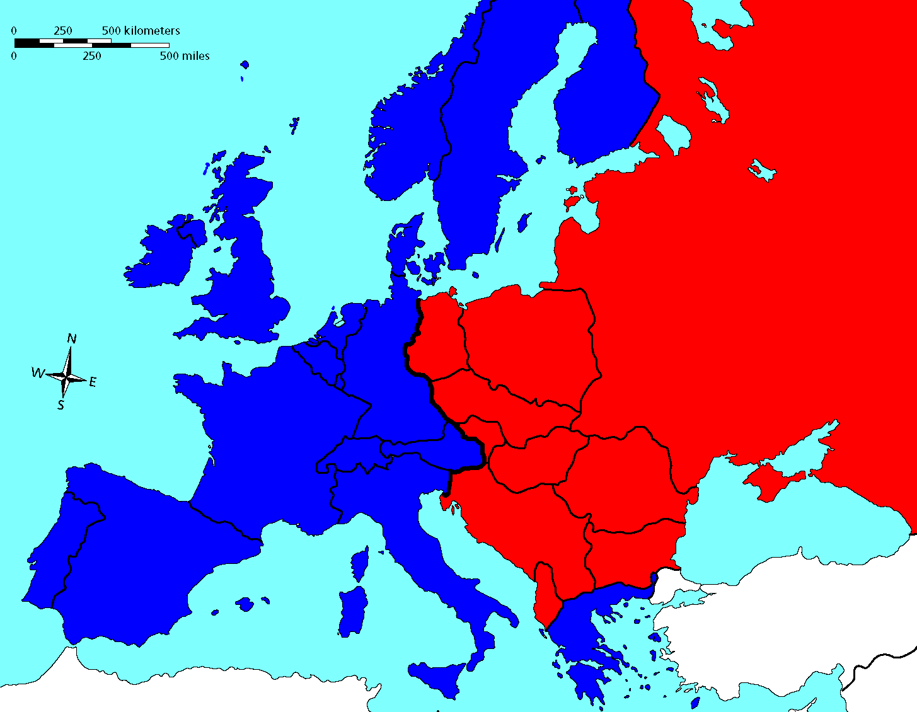

Slide 12
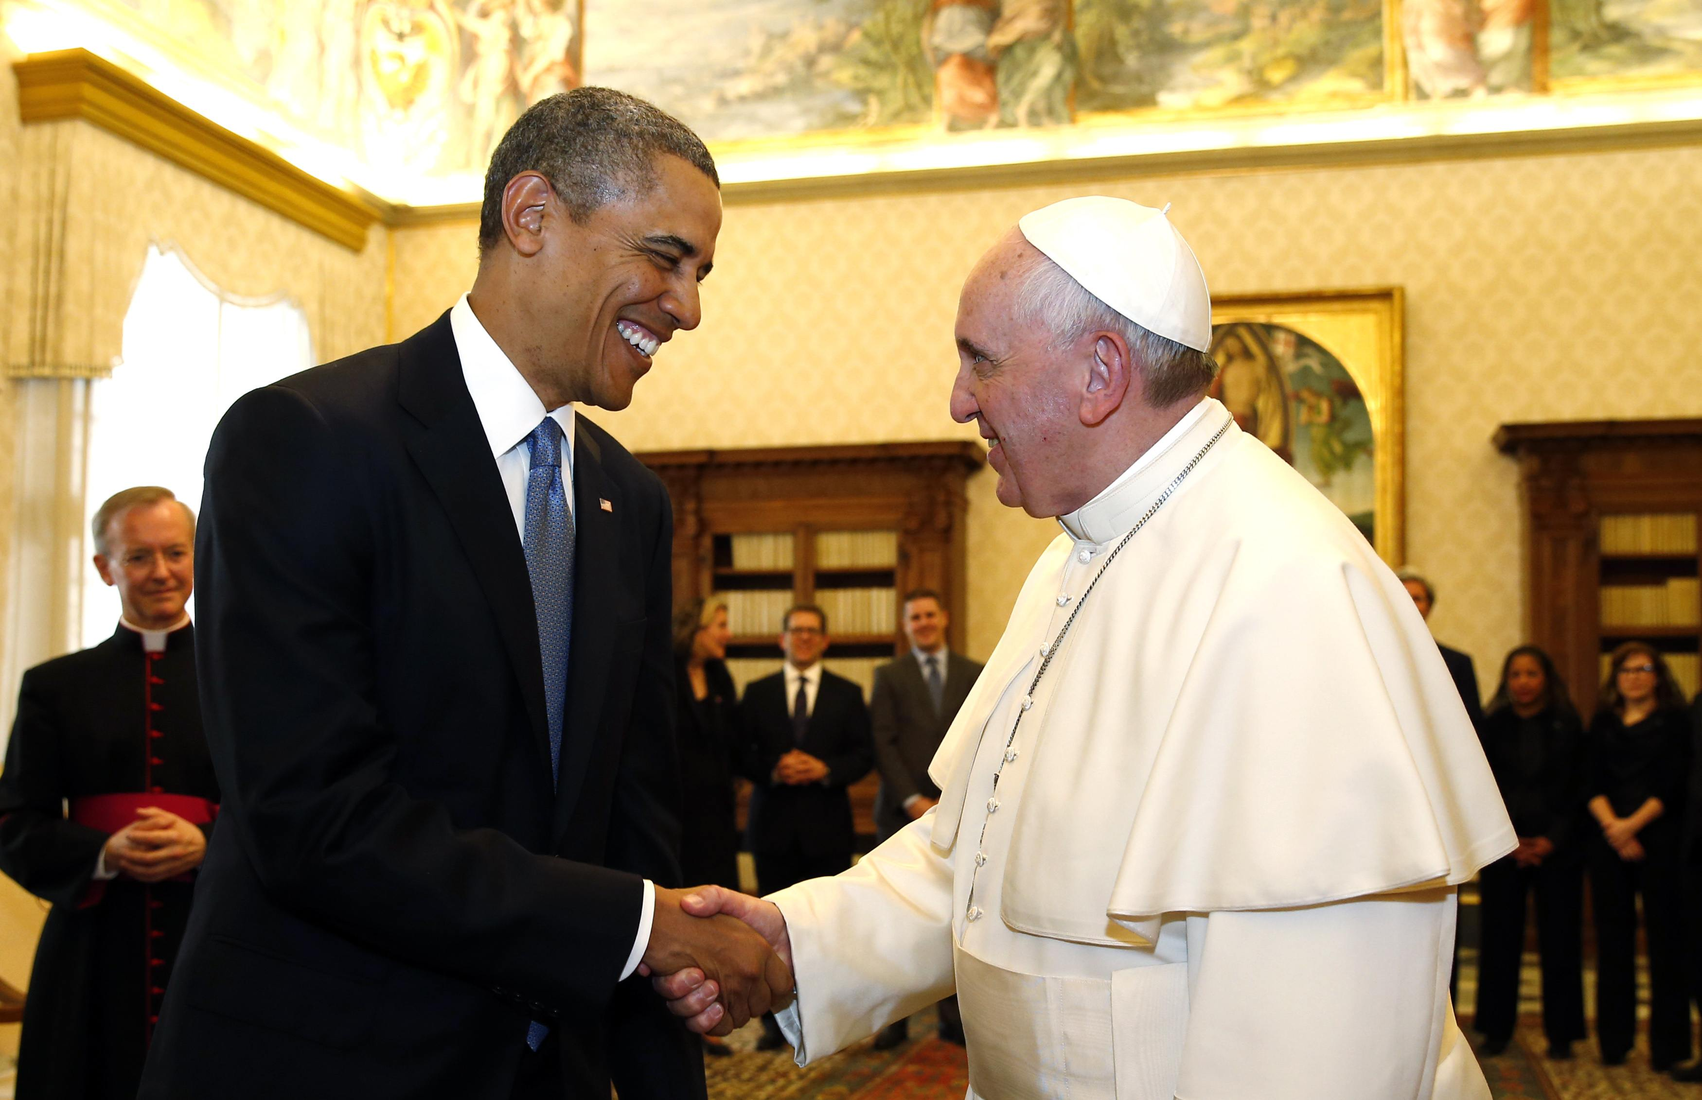
The Enemy of my enemy is
my friend

Slide 13
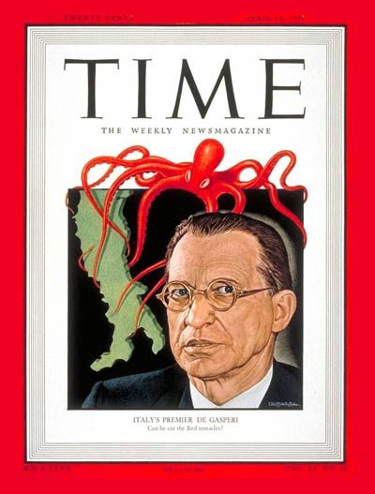
The CIA and Catholic Church defeat Communism
Italy 1947
…the CIA mounted a massive propaganda campaign in Italy… millions of dollars were pumped into the Christian Democrats and other non-communist parties… the defeat
of the communists at the polls is historically viewed by the CIA not only as their first
but as one of their most outstandingly successful covert operations.
Brian Freemantle, CIA the Honorable Company,
(The Rainbow Pub. Co., London, 1983) p. 29.

Slide 14
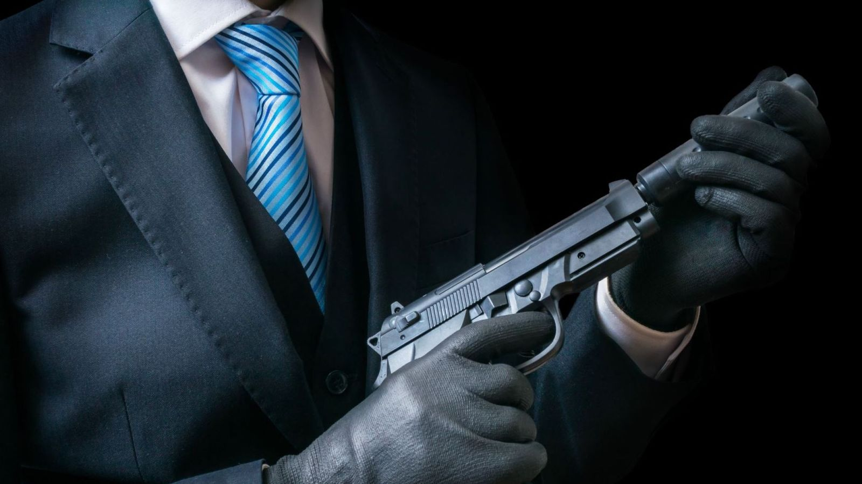
At that time, cooperation between the OSS [forerunner of CIA] and the Mafia was successful in turning the tide.
No serious historian, left or right,
who is familiar with the situation at that time can deny that had it not been for the Mafia the Communists would
now be in control of Italy,
and the world balance of power would be decisively in favor of the Soviets. Miles Copeland [ex CIA Agent],
Time, Aug 25, 1975.
CIA, Catholics and Mafia
defeat Communism in Italy
The Unholy Trinity

Slide 15
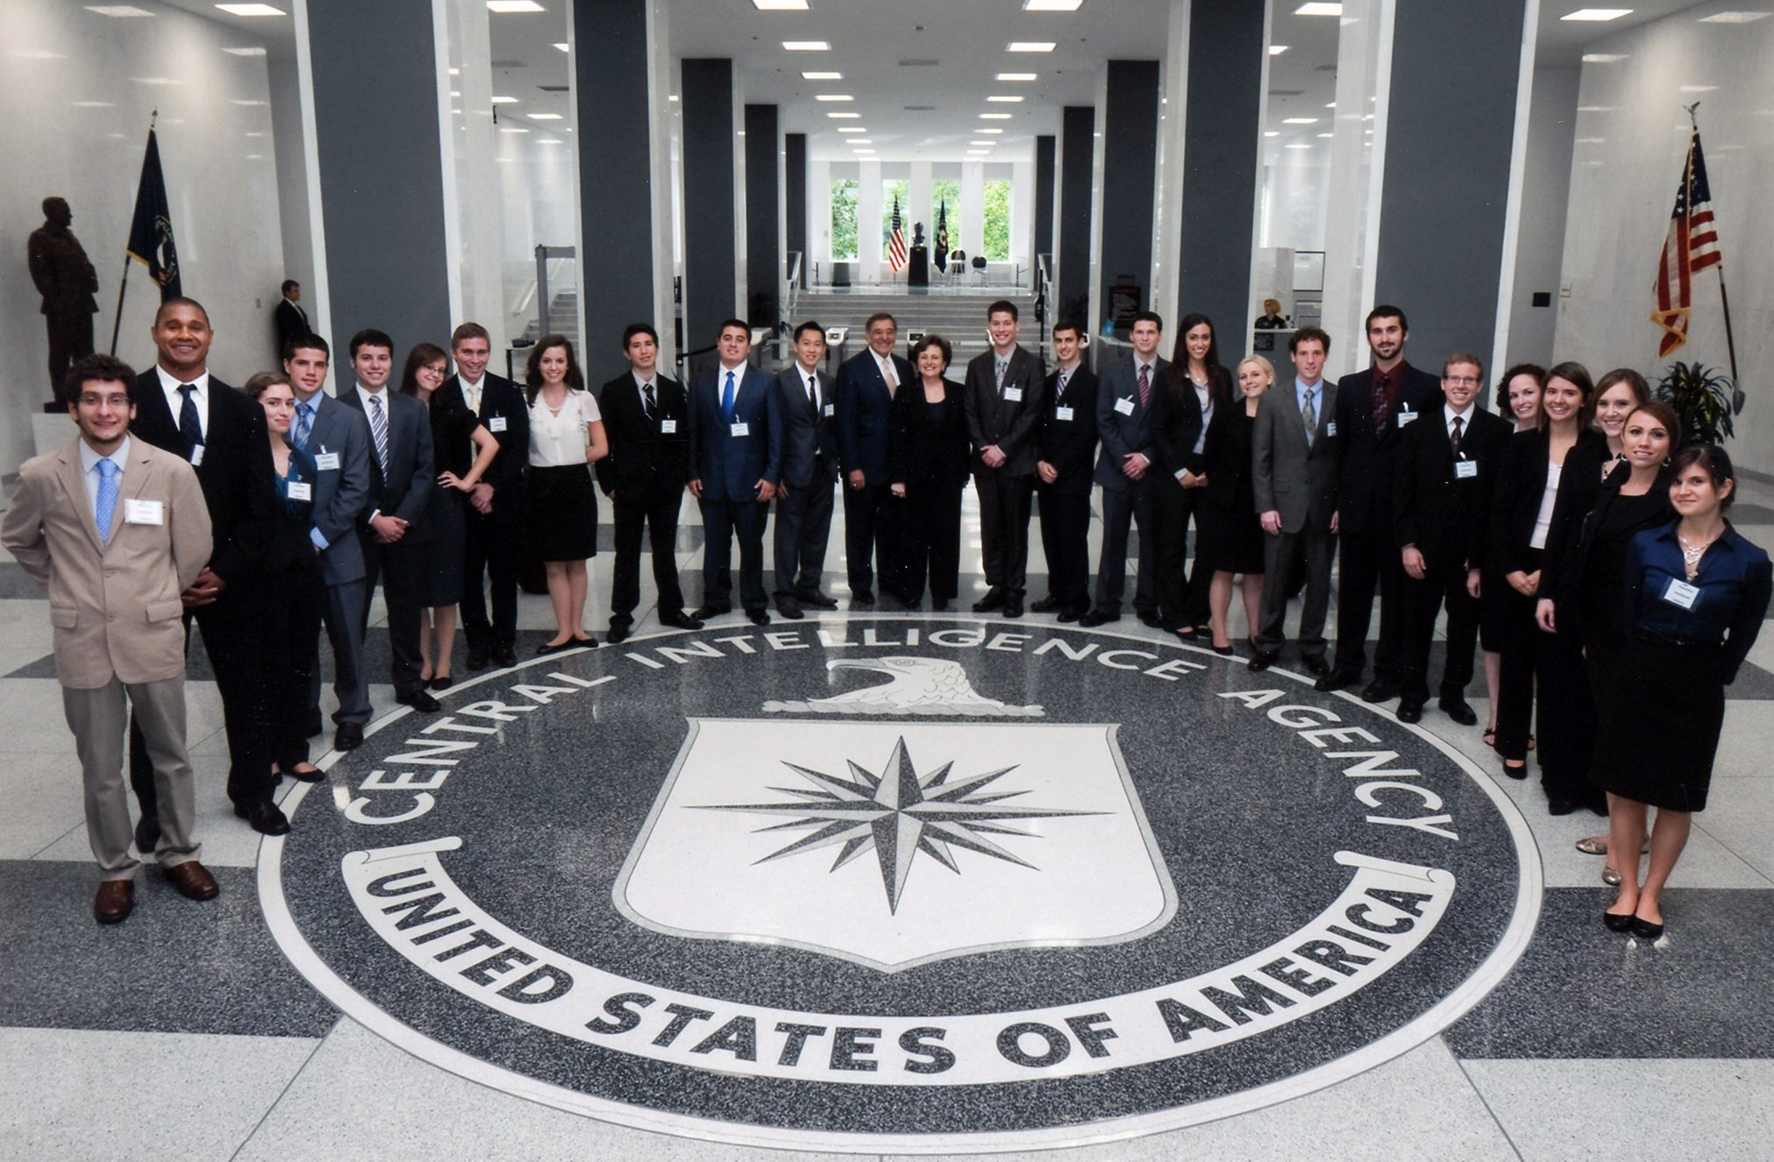

Slide 17
Devout Catholics Directors of the CIA

Slide 18
Devout Catholics Directors of the CIA

Slide 19
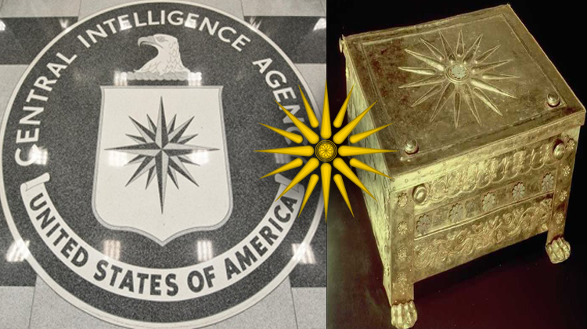
Vergina

Slide 20
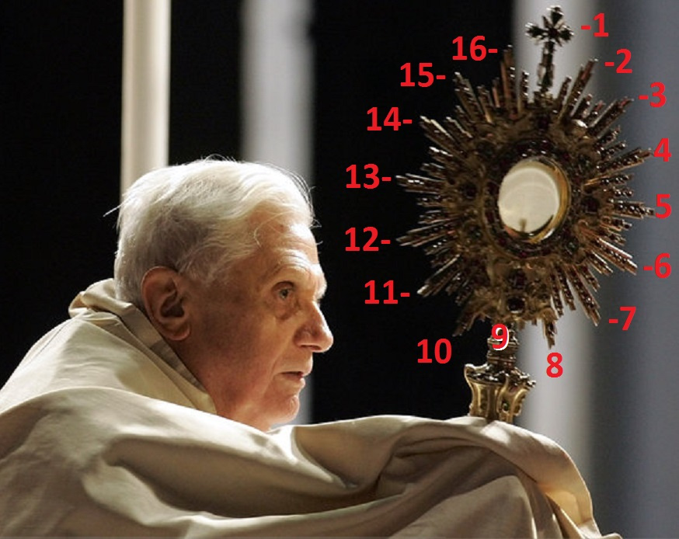

Slide 21
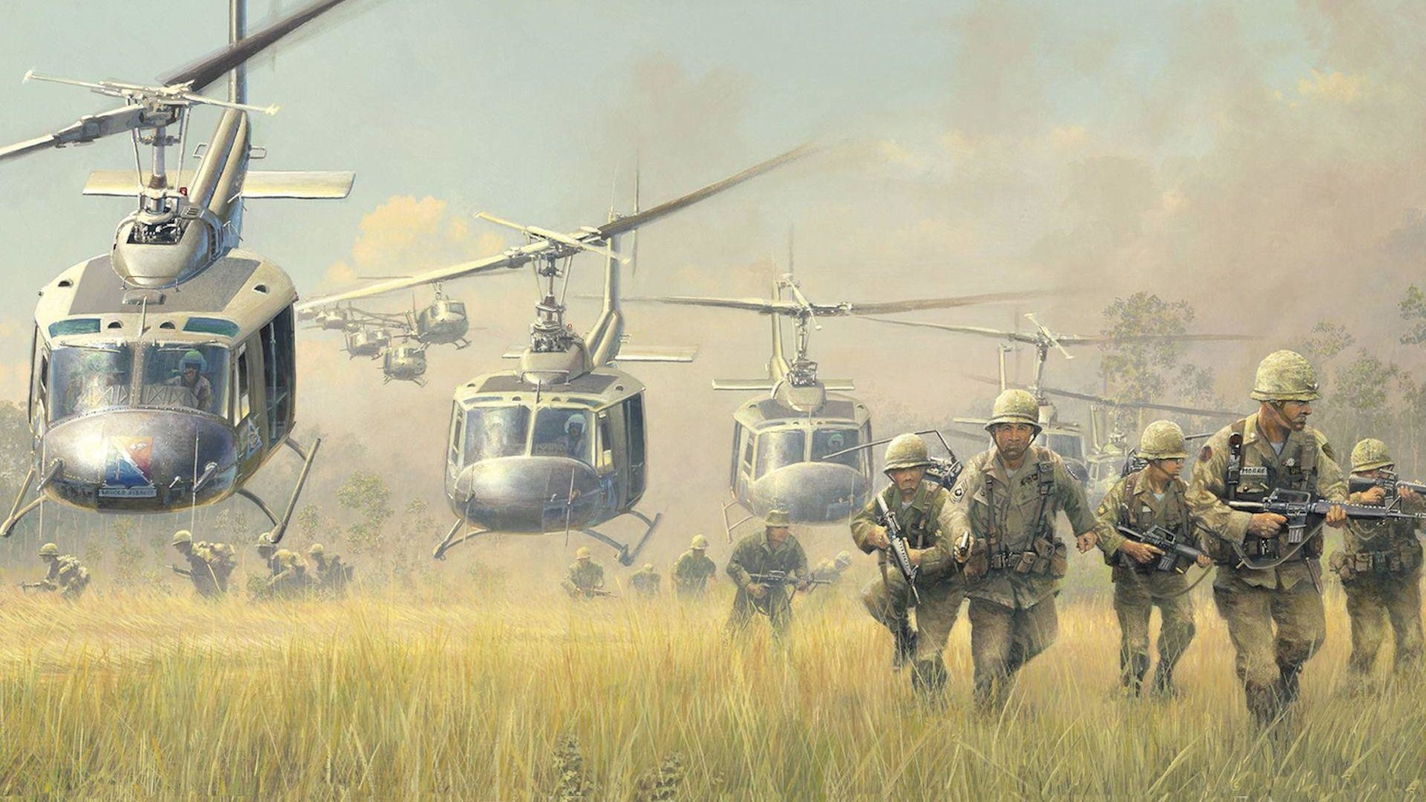
Vietnam War

Slide 22
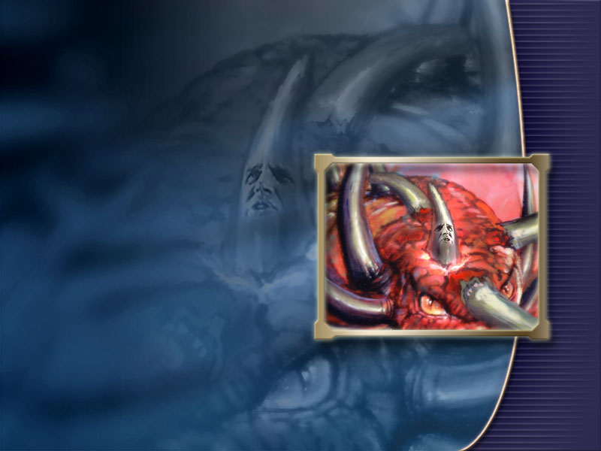
[The plan] was divided into three principle sub sections: the prevention of the elections, the setting up of a man who could rule with an iron fist, and the swift Catholicization of South Vietnam.
Avro Manhatten, Vietnam: why did we go?
Chick Publications, p. 55.
The Catholicization
of Vietnam
And his power shall be mighty,
but not by his own power:
and he shall destroy wonderfully,
and shall prosper, and practise,
and shall destroy the mighty
and the holy people.
Dan. 8:24.

Slide 23
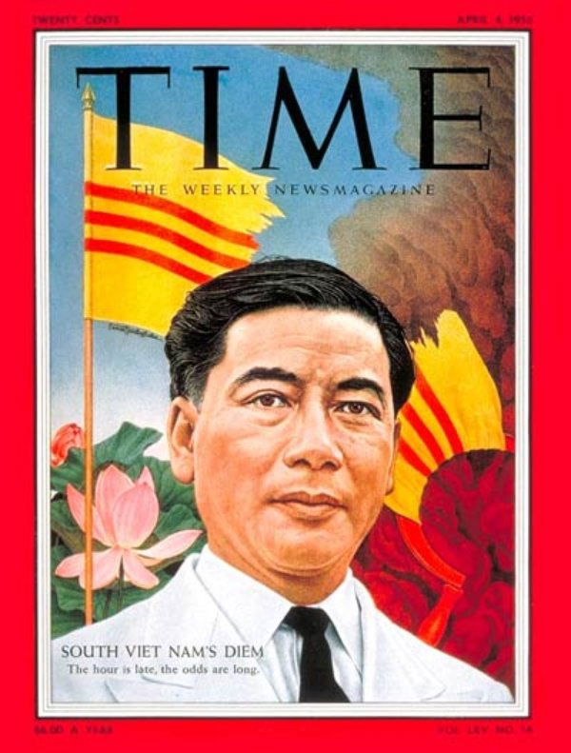
His discriminatory persecution of non-Catholics, particularly Buddhists, caused the disruption of the government and
mass desertions in the army.
This eventually led to U.S.
military intervention in South Vietnam. In this terrorization he was aided by his two Catholic brothers, the Chief of the Secret Police and the Archbishop of Hue. Vietnam Why did we go? p. 56.
‘The Iron Fist’
Ngo Duhn Diem

Slide 24
Catholic Persecution
in South Vietnam
President Ngo Dinh Diem was a practicing Catholic who ruled South Vietnam
with an iron fist… He transformed the
presidency into a virtual Catholic dictatorship,
ruthlessly crushing his religious and political opponents. Many Buddhist monks committed suicide by fire, burning themselves alive in protest against his religious persecutions.
Avro Manhattan, Vietnam why did we go? p. 56.

Slide 25
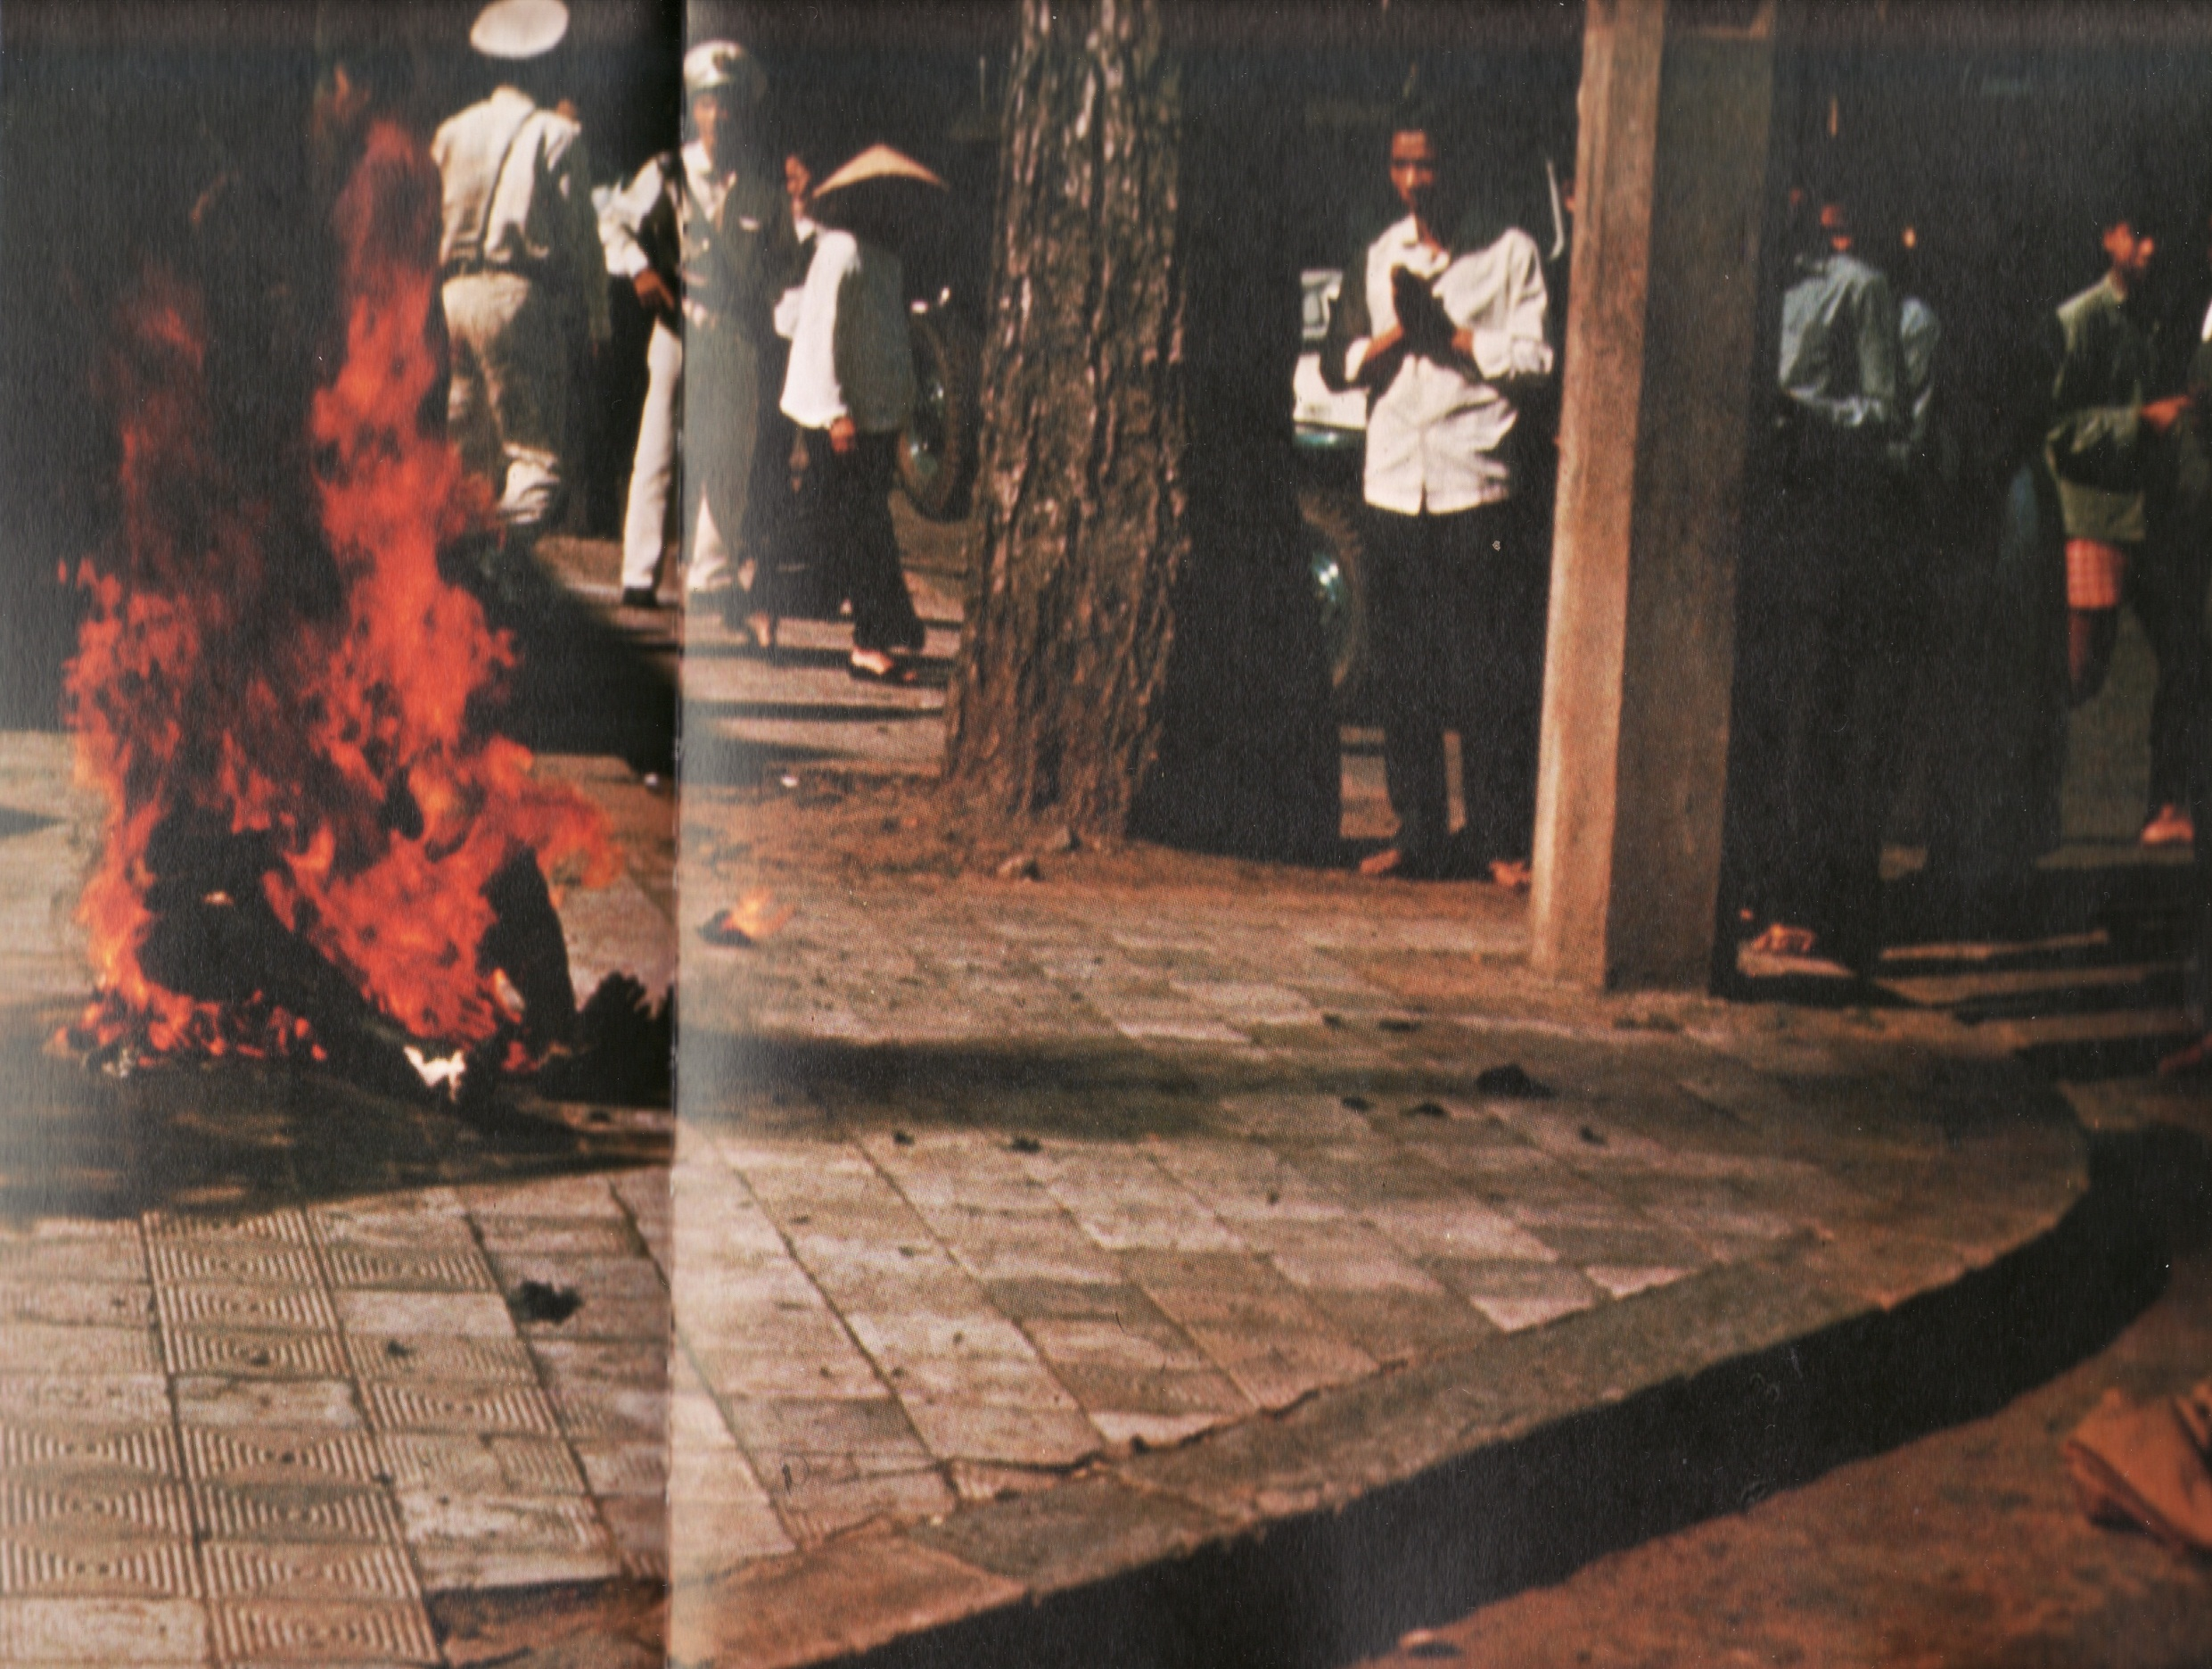
Discontent with Diệm's policies exploded following the Hue Phat Dan shootings of nine majority Buddhists who were protesting against the ban on the Buddhist flag on Vesak, the Buddha's birthday. This resulted in mass protests against discriminatory policies that gave privileges to the Catholic Church and its adherents.
Diệm's elder brother Ngo Dinh was the Archbishop of Huế and aggressively blurred the separation between church and state.
Wikipedia, art. Vietnam War.

Slide 26
Discontent with Diệm's policies exploded following the Hue Phat Dan shootings of nine majority Buddhists who were protesting against the ban on the Buddhist flag on Vesak, the Buddha's birthday. This resulted in mass protests against discriminatory policies that gave privileges to the Catholic Church and its adherents.
Diệm's elder brother Ngo Dinh was the Archbishop of Huế and aggressively blurred the separation between church and state.
Wikipedia, art. Vietnam War.

Slide 27
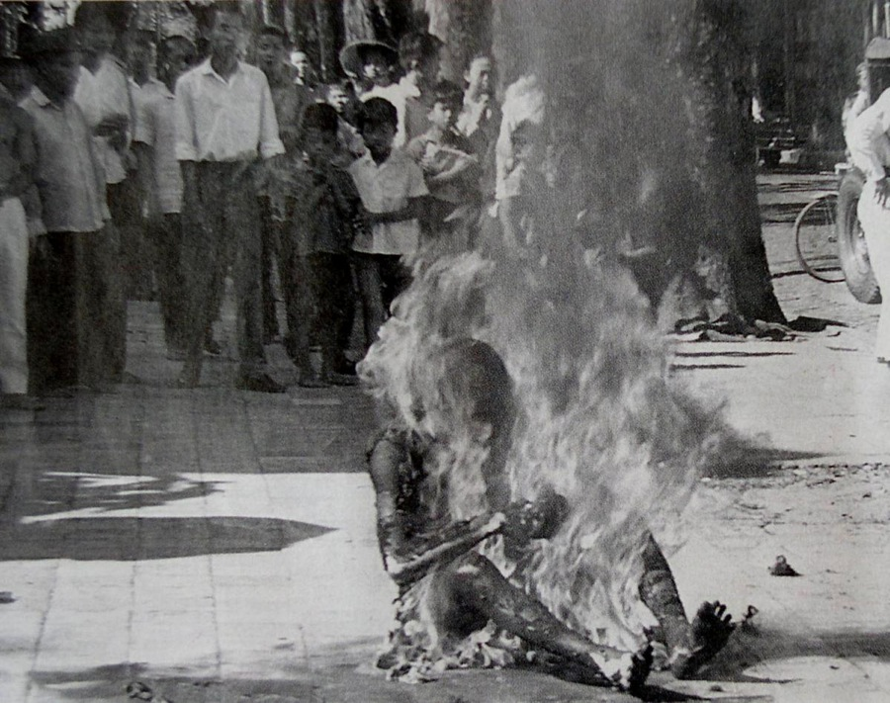

Slide 28
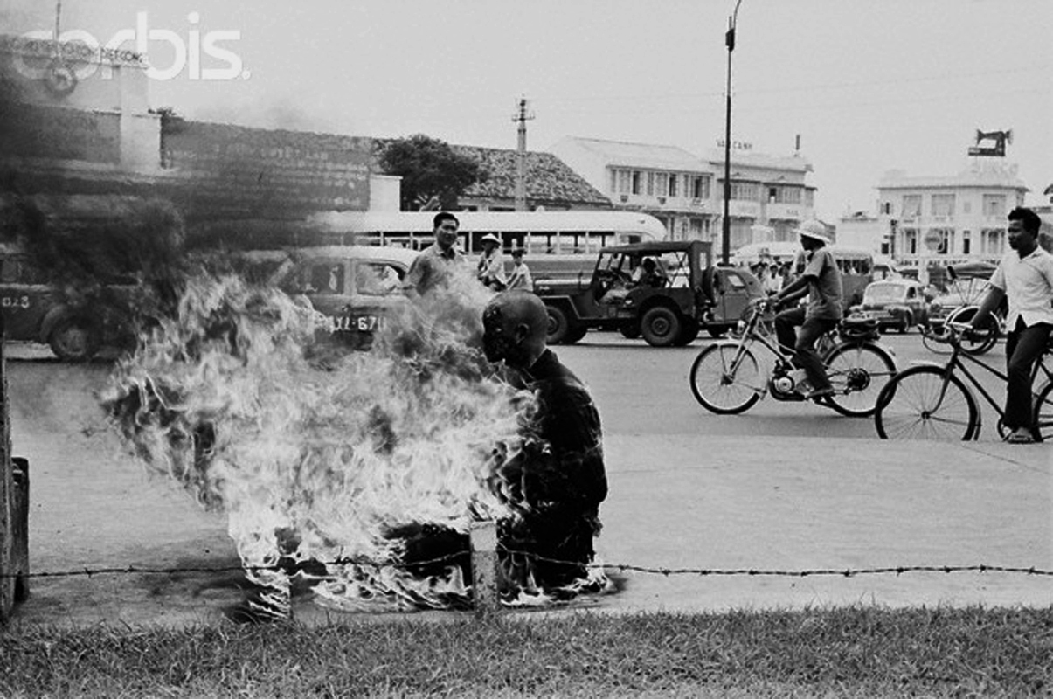

Slide 29
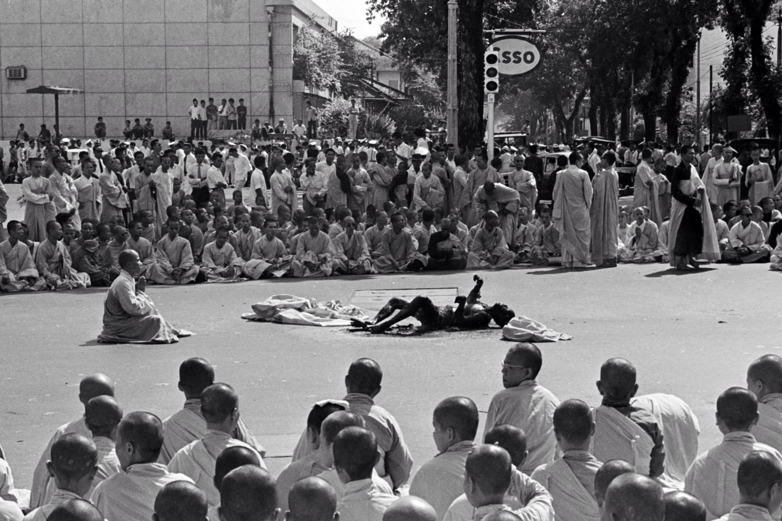

Slide 30
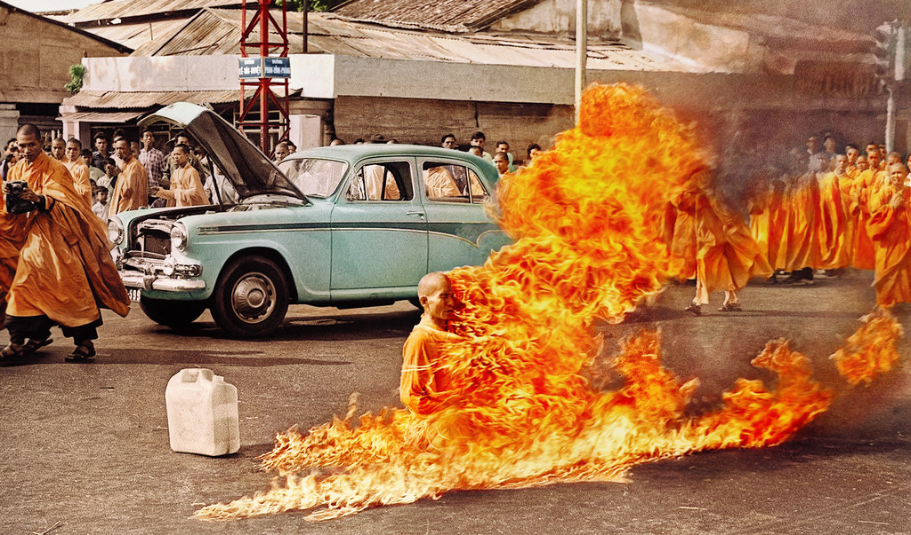

Slide 32
President and Pope conspire
to bring down the USSR Vatican Library June 7, 1982
In that meeting, Reagan and the Pope agreed to undertake a clandestine campaign to hasten the dissolution
of the communist empire.
Declares Richard Allen, Reagan’s
first National Security Advisor:
“This was one of the great
secret alliances of all time.”

Slide 33
Reagan’s top advisors were all Catholic
p. 9.
The key administration players were
all devout Roman Catholics
– CIA chief William Casey, Allen, Clark, Haig, Walters and William Wilson Reagan’s first ambassador to the Vatican.

Slide 34
The Holy Alliance
p. 9.
They regarded the U.S.- Vatican relationship as a holy alliance: the moral force of the Pope and the teachings of their church combined with their fierce anticommunism and their notion of American democracy. Yet the mission would have been impossible without the full support of Reagan,
who believed fervently in both the benefits and the practical applications of Washington’s relationship with the Vatican.
One of his earliest goals as President, Reagan says was to recognize the Vatican as a state “and make them an ally.”

Slide 35
America allies itself with the Catholic Church
p. 9.
They regarded the U.S.- Vatican relationship as a holy alliance: the moral force of the Pope and the teachings of their church combined with their fierce anticommunism and their notion of American democracy. Yet the mission would have been impossible without the full support of Reagan,
who believed fervently in both the benefits and the practical applications of Washington’s relationship with the Vatican.
One of his earliest goals as President, Reagan says was to recognize the Vatican as a state “and make them an ally.”

Slide 36
Reagan’s top advisors were all Catholic
p. 9.
The key administration players were
all devout Roman Catholics
– CIA chief William Casey, Allen, Clark, Haig, Walters and William Wilson Reagan’s first ambassador to the Vatican.

Slide 37
2000 Years of Conspiracy Experience
p. 10.
It was a very complex situation…
But I told Vernon [US ambassador at large] “Listen to the Holy Father.
We have 2000 years experience at this.” Papal Nuncio, Archbishop Pio Laghi.

Slide 38
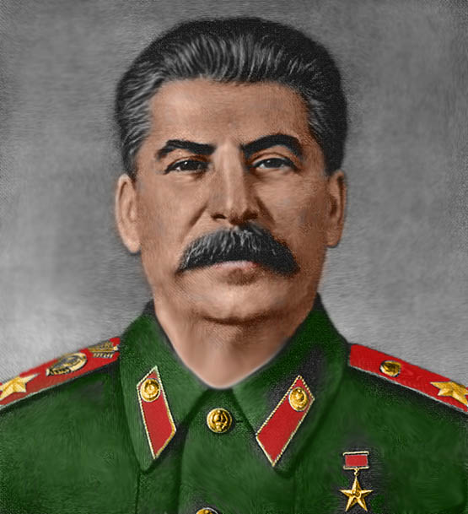
In 1935 Josef Stalin, absolute ruler
of the Soviet Union, was given some unsolicited advice. Make a propitiatory gesture to the Vatican, he was told.
Pushed too far, his country's Catholics
might become counterrevolutionary.
Stalin's great mustache amplified his sneer.
"The Pope. And how many divisions has he?" The answer then was that he has none.
The answer now is that he needs none.
The structures of Communism are
crumbling to the touch.
Life Magazine, December 1989.
Communism crumbling to
Pope’s touch

Slide 39
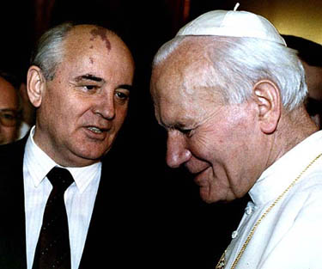
Gorbachev’s and Communism’s Canossa
When the Holy Roman Emperor Henry IV decided to seek pardon
of Pope Gregory VII in 1077,
he stood barefoot for three days
in the snow outside the papal quarters in Canossa, Italy. Gorbachev's concordat with
the church was no less
significant in its way.
Time, Dec. 11, 1989.

Slide 40
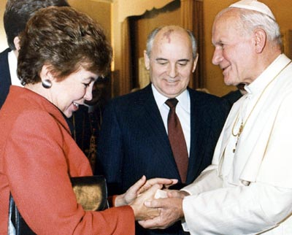
Pope John Paul II welcomes Soviet President Mikhail Gorbachev and his wife to the first meeting ever between a Kremlin chief and a Pope at the Vatican on Dec. 1, 1989.

Slide 41
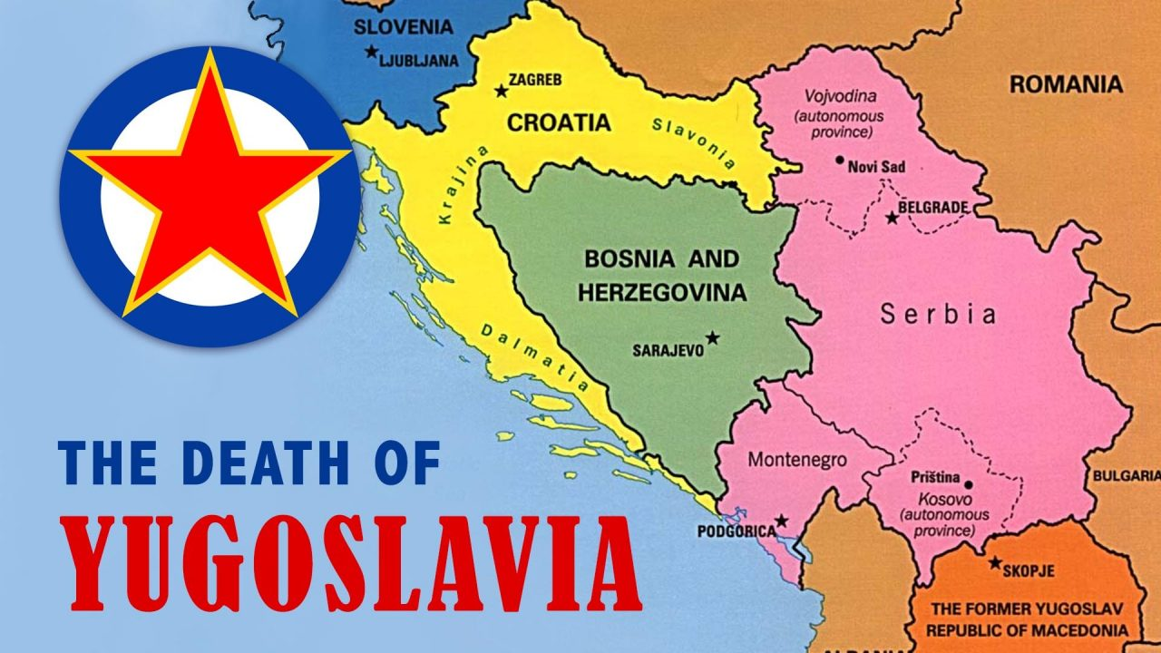

Slide 42
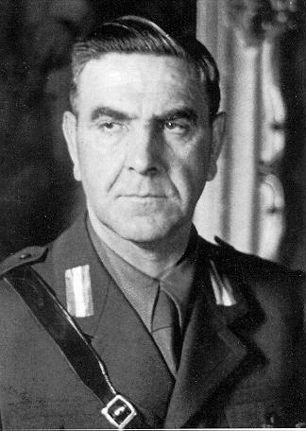
Ustashi Regime Commits Genocide against Serbs
The brutal regime he led was responsible for genocidal persecution of Serbs, Jews, and Romani living in the NDH (Croatia) including mass murdering several hundred thousand Serbs, and tens of thousands of Jews as well as Roma. These persecutions and killings have been described as the "single most disastrous episode in Yugoslav history". The racial policies of the NDH… fed the ranks of both the Chetniks and Partisans and caused even the German authorities to attempt to restrain Pavelić and his genocidal campaign. Wikipedia art. Ante Pavelić

Slide 44
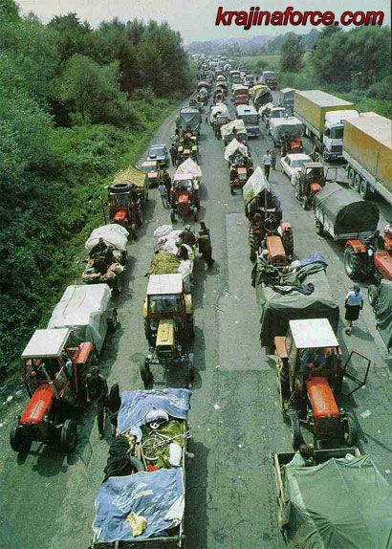
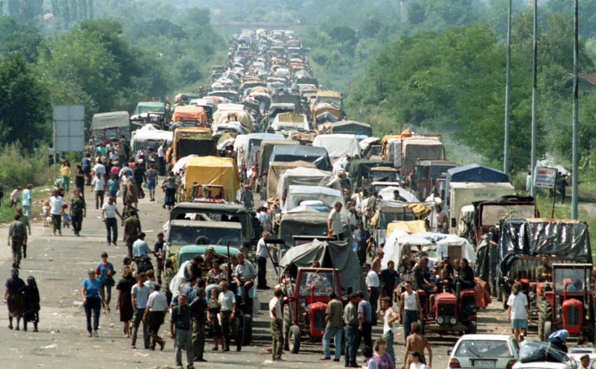
Serbs driven out of Krajina
Aug. 1995.

Slide 45
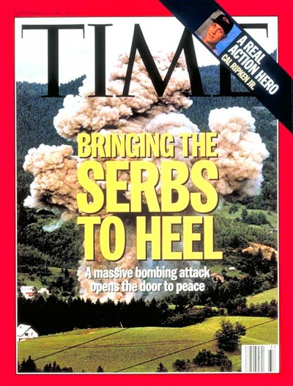
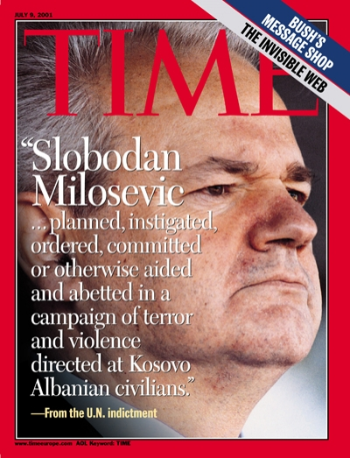

Slide 46
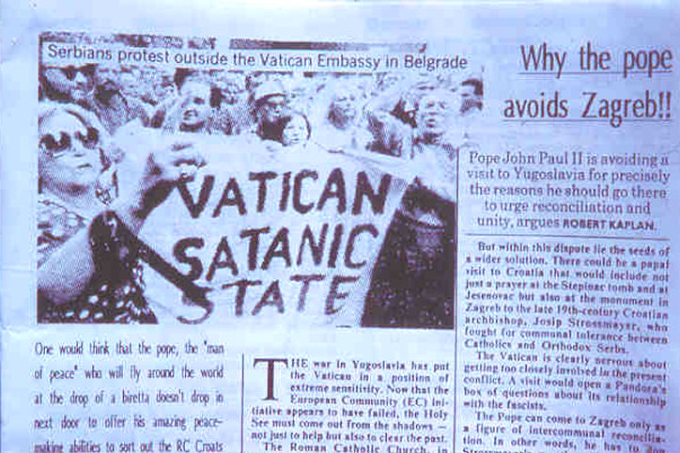

Slide 47
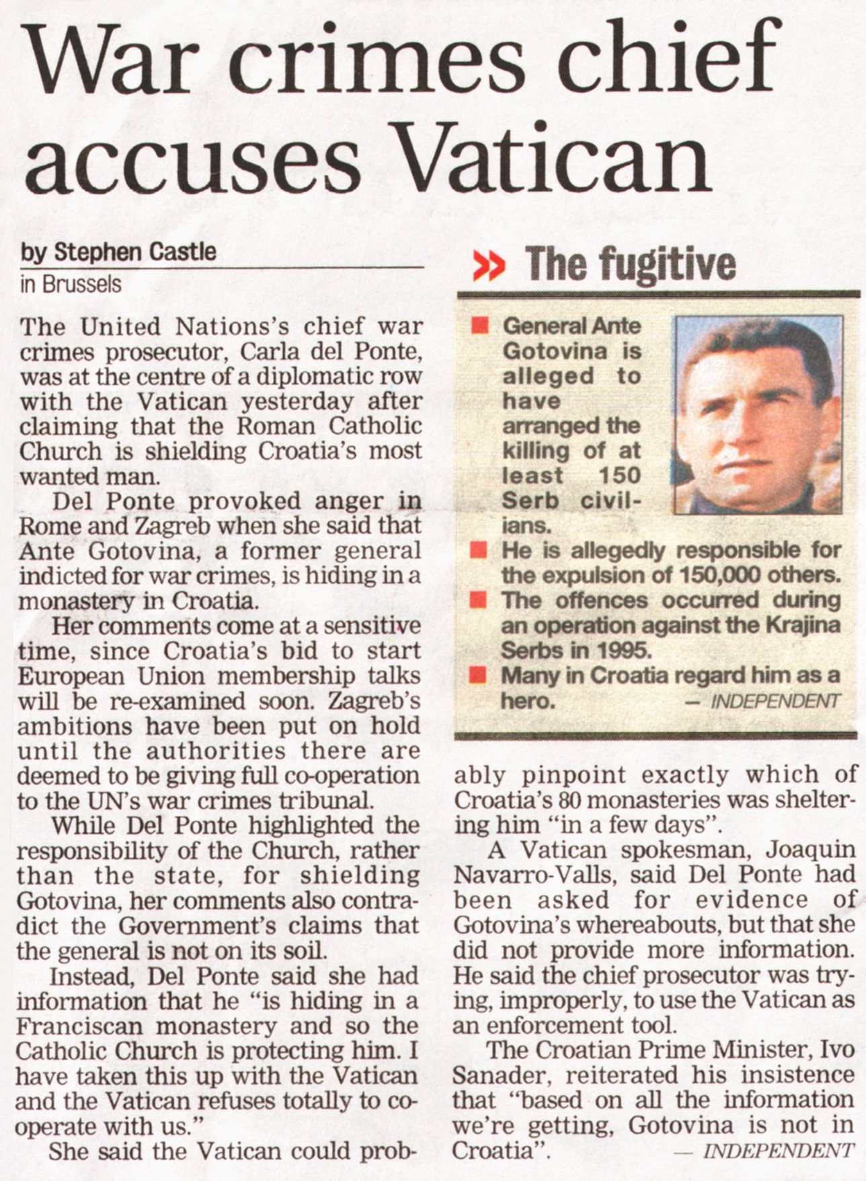

Slide 49
Identifying and dealing with the Opposition
Group 1: Islam.
Group 2: Adventists, Baptists, Evangelical sects, Christian Scientists, Jehovah’s Witnesses, Mormons, Unitarians.
Group 3: Eastern Orthodox, Anglican Church.
Group 4: Eastern Religions.
Group 5: Chinese, Japanese, Jews.
Group 6: Humanists, Mega-Religionists, New Age.
The Keys of This Blood, chapters 15, 16.

Slide 50
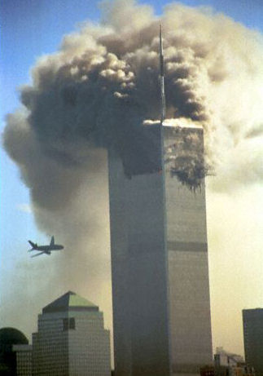
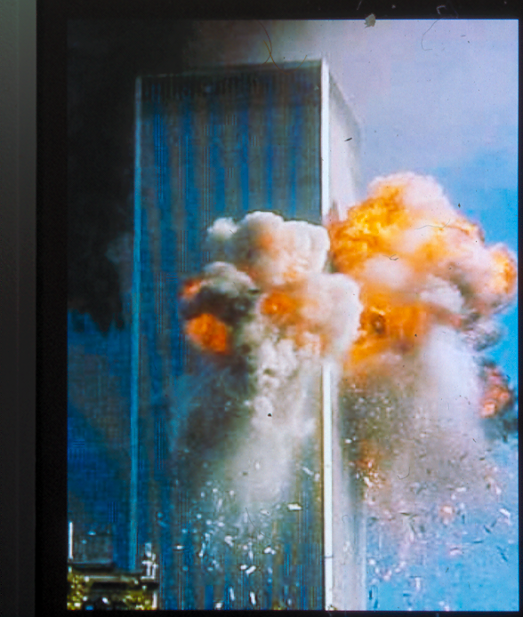
The enemy of my enemy is my friend

Slide 51
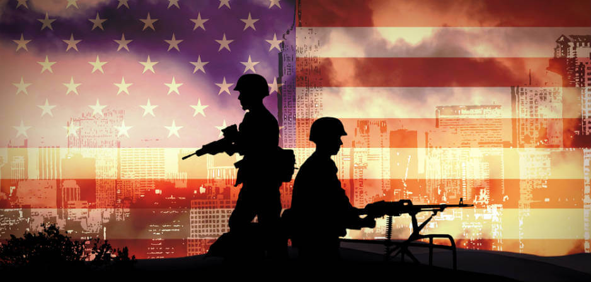
The War on Terror

Slide 52
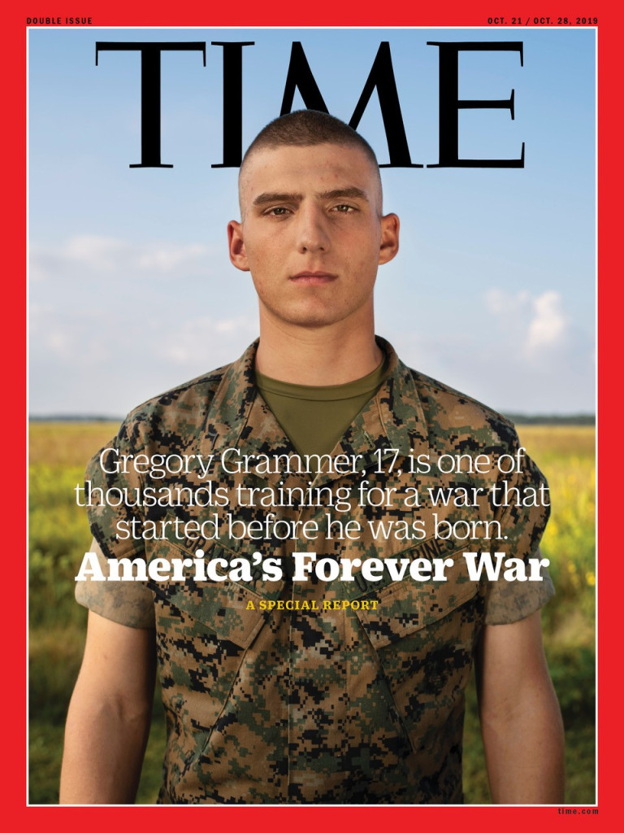
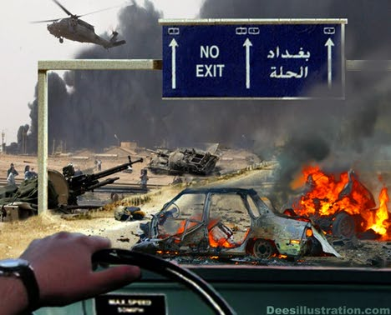

Slide 53
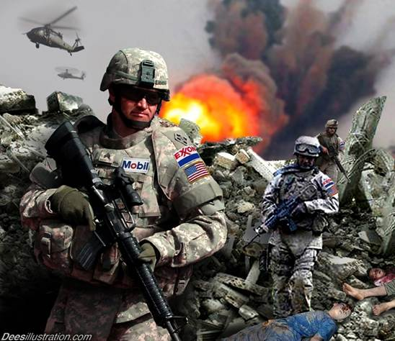

Slide 54
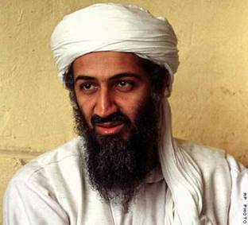

Slide 55
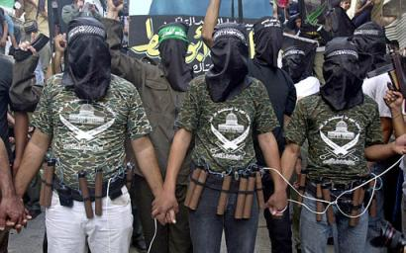

Slide 56
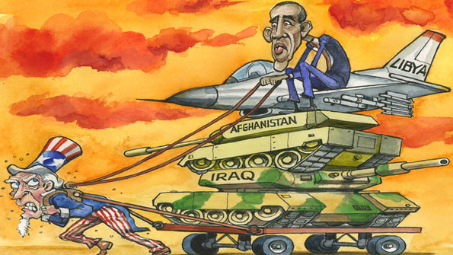

Slide 59
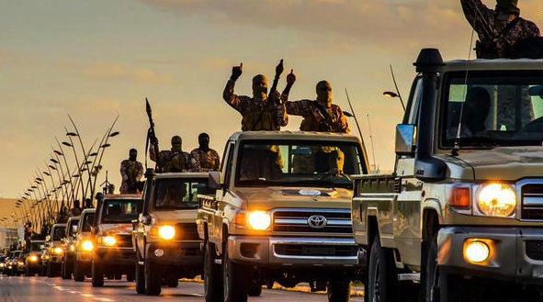

Slide 60
Cristina Fernandez Kirchner, Argentinian President
Today you pretend making a coalition against the Islamic State of Iraq and the Levant
(ISIL), but in fact
you’re their allies.
UN General
Assembly
Oct. 3, 2014.

Slide 61
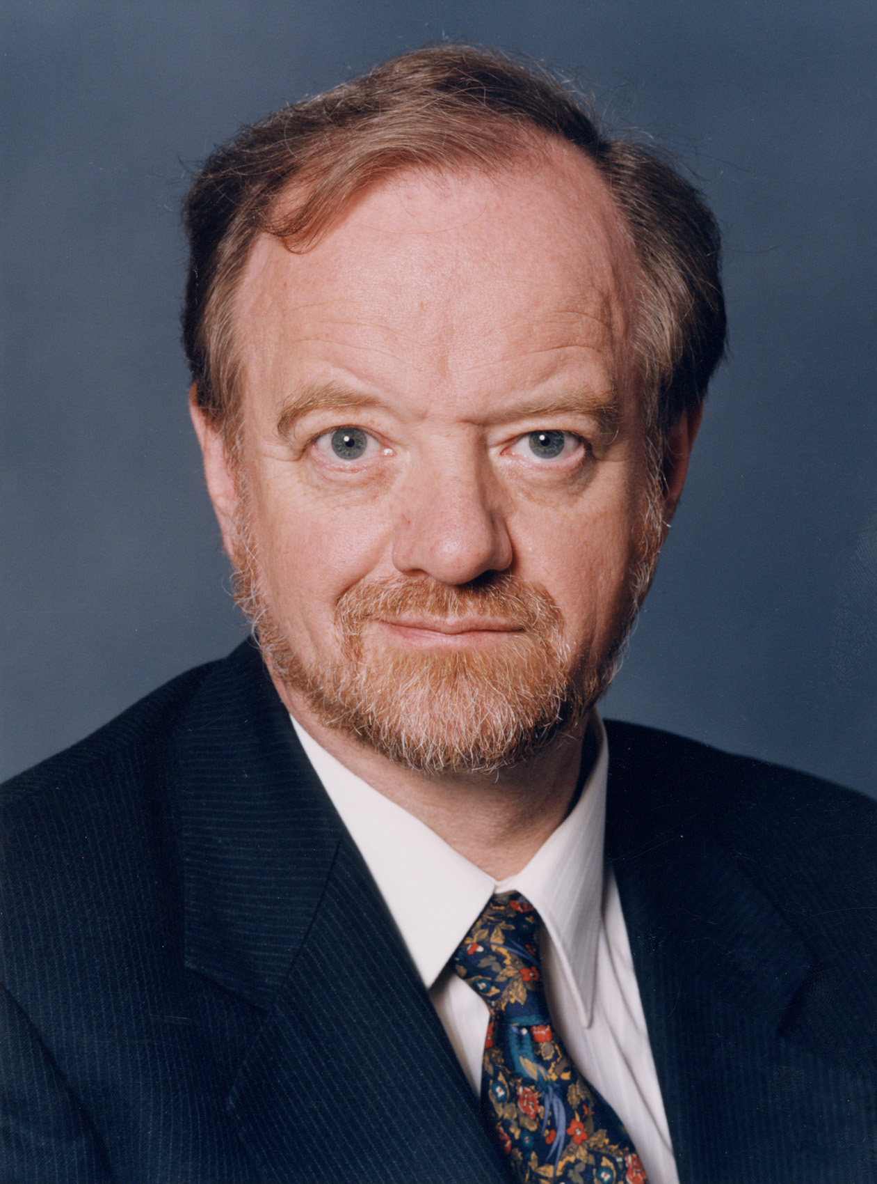
Al-Qaeda excuse for War on Terror
The truth is, there is no Islamic army or terrorist group called Al-Qaeda, and any informed intelligence officer knows this. But, there is a propaganda campaign to make the public believe in the presence of an intensified entity representing the ‘devil’ only in order to drive TV watchers to accept a unified international leadership for a war against terrorism. The country behind this propaganda
is the United States.
Robin Cook former
British Foreign Secretary

Slide 62
Muslim countries targeted
by intelligence agencies
using Jihadis
The so called al-Qaeda that we see are actually Kharjees along with Mossad CIA and RAW led and trained mercenary gangs like TTP (Taliban in Pakistan) who pose as Islamic jihadists and create justification for global information
war and propaganda
to launch a new war against
another Muslim country.
Robin Cook former
British Foreign Secretary

Slide 63
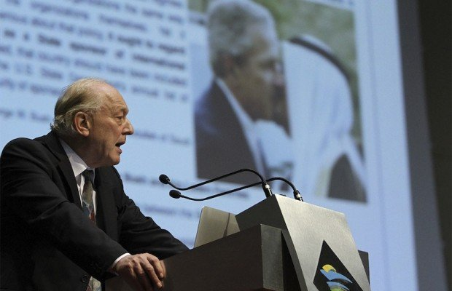
Al Qaeda and the Al Qaeda affiliated organizations,
including the Islamic State, are not independent organizations, they are sponsored,
and they are sponsored by
the United States and its allies.
It is documented that prior to 2011,
there was a process of recruitment of mujahideen
to fight in Syria, and this was coordinated by NATO
and the Turkish high command.
American sponsored terrorism

Slide 64
Confirmed by Israeli News Sources
This report is confirmed by Israeli news sources
and unequivocally, we are dealing with a
state-sponsorship of terrorism,
the recruitment of mercenaries,
the training and the financing of terrorism.
Dr. Michel Chossudovsky,
https://www.youtube.com/watch?v=lpQoOAZmrBQ

Slide 65
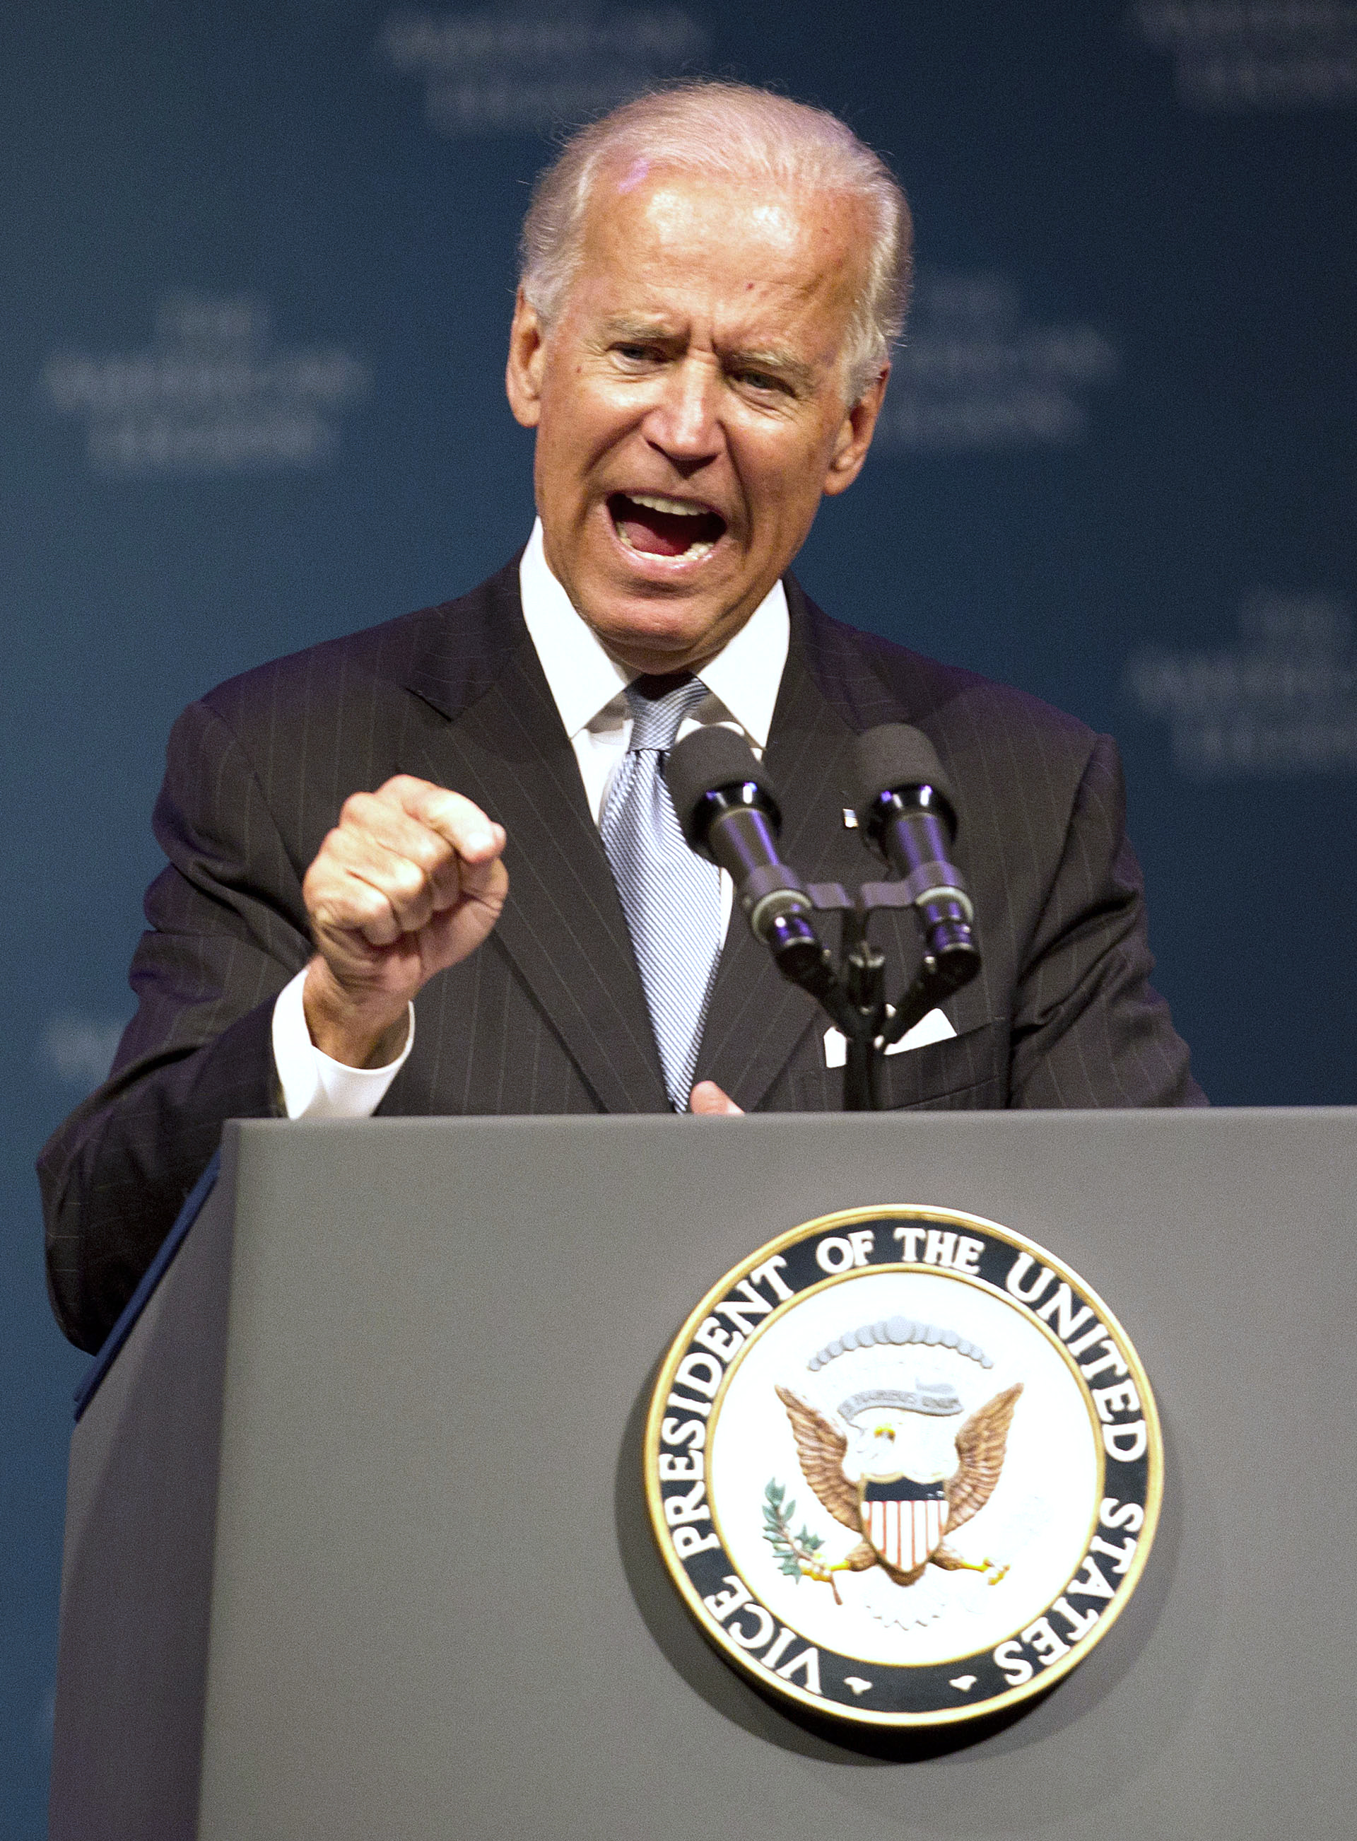
American allies supplied ISIS
Turkey, Saudi Arabia and the United Arab Emirates had poured hundreds of millions of dollars and tens of thousands of tons of weapons into anyone who would fight against Al-Assad, except that the people who were being supplied were al-Nusra, and al Qaeda, and the extremist elements of jihadis coming from other parts of the world.
Joe Biden is the Only Honest Man in Washington, Foreign Policy, Oct. 7, 2014.

Slide 66
False flag terrorists
Most terrorists are false flag terrorists,
or are created by our own security services. In the United States, every single terrorist incident we have had has been a false flag, or has been an informant pushed on by the FBI. In fact, we now have citizens taking out restraining orders against FBI informants
that are trying to incite terrorism.
We’ve become a lunatic asylum.
David Steele, ex-Marine Corps intelligence officer. https://www.youtube.com/watch?t=749&v=GrFnFflv1Lg

Slide 69
Catholic/Jesuit Control of U.S. Government

Slide 71
An interesting proof of Jesuit prestige and power in this country is the existence, in the shadow of the Capital, at Washington, of the Jesuit School for Foreign Service, opened a few years ago through the instrumentality of an Irish-American, Fr. Edmund Walsh, S.J. At this school of diplomatic service, said to be the largest of its kind in America, young Americans are trained to guide the future fortunes of the Republic…
Georgetown University Prestigious School
for training of US Government Officials

Slide 72
There is no small irony in this situation…
It is quite within the power of the General to dictate the principles and theories to
be taught by the Jesuits at Washington…
one cannot forget the words of the Pope, Clement XIV, who accused them of ‘rising up against the very kings who admitted them into their countries…
Boyd Barrett [Irish ex-Jesuit],
The Jesuit Enigma, (Boni and Liveright,
New York, 1927), p.32.
Ex-Jesuit warns that the school will teach principles and theories of the Jesuits

Slide 73
Robert Drinan Congressman
1971-1981
First Jesuit Priest elected to Congress

Slide 74
Huge Shift in Public Opinion about the Catholic Church
In 1960, John Kennedy went from Washington down to Texas to assure Protestant preachers that he would not obey the pope.
In 2001 George Bush came from Texas up to Washington
to assure a group of Catholic bishops that he would.
Professor Robert George, The Washington Post, April 16, 2001.

Slide 75
It was a historical event when the Senate, on September 22, 1983, voted to repeal the 1867 ban on diplomatic relations with the Vatican, thus opening the way for President Reagan to appoint William A. Wilson as the first ambassador, not to the state of Vatican City re-established in 1929, but to the Holy See itself.
This new relationship is significant
not only in itself, but also as an
indication of a shift in ideology and
public opinion and policy, especially in the area of the American doctrine of separation of church and state.
V. Norskov Olsen, Papal Supremacy and American Doctrine, (Loma Linda University Press, Loma Linda, CA) p. 63.
America Embraces
the Beast

Slide 84
Bush recommends Papal policy to America
The best way to honor Pope John Paul II, truly one of the great men, is to take his teaching seriously; is to listen to his words and put his words and teachings
into action here in America.
This is a challenge we must accept.
But you know something about our country? With the right focus and the right leadership, it's a challenge this nation will accept... President Bush, March 22, 2001.

Slide 85
Unprecedented honor and acclaim given to Pope Benedict XVI during visit to America, April 2008.
Dan Froomkin,
Washington Post,
April 14, 2008.

Slide 86
…we have good reason to fear Mr. Bush and his dual loyalty. For we have evidence that tends to prove President Bush Jnr. is a secret Catholic!

Slide 87
We saw his submission to Pope Benedict XVI
in April 2008 when he pulled out all the stops:

Slide 88
driving out to a suburban military base to meet Pope Benedict XVI’s plane

Slide 89
Bush [had] never before given a visiting leader the honor of picking him up at the airport…

Slide 90
bringing a giant audience to the South Lawn and hosting a fancy East Room dinner.

Slide 91
Catholic influence over Bush
This Protestant President has surrounded himself with Roman Catholic intellectuals, speech writers, professors, priests, bishops and politicians. These Catholic – and
thus Catholic social teaching – have for the past eight years been shaping Bush’s speeches, policies and legacy…
Daniel Burke, The Washington Post,
April 13, 2008.

Slide 92
Bush’s Catholic policies
George W. Bush could well be the nation’s first Catholic President…
Yes, there was John F. Kennedy.
But where Kennedy sought to divorce his religion from his office, Bush has welcomed Roman Catholic doctrine and teachings into the White House and based many important
domestic policy decisions on them!
Bush’s policies are Catholic!”

Slide 93
Former Bush speechwriter Michael Gerson, an evangelical with an affinity for Catholic teaching,
says that the key to understanding Bush’s domestic policy is to view
it through the lens of Rome.
Paul Weyrich, and architect of the religious right, goes even further.
He says he detects in Bush the same mindset as former British Prime Minister Tony Blair, who converted to Catholicism in 2007.
“I think he is a secret believer,” says Weyrich.

Slide 94
George Bush
Secret Catholic?
Similarly, John DiIulio, Bush’s first director of faith-based initiatives, has called Bush a “closet Catholic.”

Slide 95
To which Bush replied immediately and without hesitation: “God.”
Eternal Word Television Network [EWTN, a Catholic station].
EWTN anchor Raymond Arroyo asked Bush
concerning the Apostolic Visit of the Pope,
“When you look into Pope Benedict XVI’s eyes what do you see?”
EWTN News Feature, April 11, 2008.

Slide 96
Bush Family attending Catholic Mass

Slide 97
Bush family participate in Catholic ritual of
Ash Wednesday
Clinton receives wafer at Catholic Mass

Slide 98
Jesuit Priest, Stephen A. Privett (President, San Francisco University) opening 110th Congress, 2007.
Nancy Pelosi
Speaker of the House

Slide 99
Celebrating with the Congress Chaplain (Catholic Priest, Daniel P. Chaplain)

Slide 100
Newt Gingrich converts
to Catholicism
The joyful and radiating presence of the Holy Father was a moment of confirmation of the many things I had
been thinking and experiencing over
the last several years. ttp://www.npr.org/2011/12/22/144080998/gingrichs-catholic-journey-began-with-third-wife

Slide 101
Change we can believe in

Slide 102
Change we can believe in
Nothing Changed

Slide 103
No change here

Slide 104
President Barack Obama meets with Director of National Intelligence James Clapper, right
(Alma Mater, St. Mary's University, Texas), in the Oval Office, Sept. 9, 2010. Also attending are, clockwise from left, Robert Cardillo, DIA deputy Director (and now Director of National intelligence for intelligence integration and schooled at Jesuit Georgetown University. Deputy National Security Advisor Tom Donilon (Donillon attended la Salle Academy, earned a B.A. at:
The Catholic University of America in 1977 and is connected personally to the Biden family).

Slide 105
Rodney Snyder, Special Assistant to the President and Senior Director for Intelligence at the White House, (former CIA executive). John Brennan, Assistant
to the President for Homeland Security and Counter terrorism, is Alma mater
at Jesuit Fordham University (former CIA Director). Gen. James L. Jones
National Security Advisor (Alma Mater Jesuit Georgetown University).

Slide 106
Rodney Snyder, Special Assistant to the President and Senior Director for Intelligence at the White House, (former CIA executive). John Brennan, Assistant
to the President for Homeland Security and Counter terrorism, is Alma mater
at Jesuit Fordham University (former CIA Director). Gen. James L. Jones
National Security Advisor (Alma Mater Jesuit Georgetown University).

Slide 107
We must not waste a good crises
Emanuel Rahm, Chief of Staff
Obama Administration

Slide 111
Obama signs National Defence Authorisation Act Dec. 31, 2011.

Slide 114
Globalism back in
the ascendency
The tide is turning
back to globalists.
George Soros,
New York Times,
Oct. 25, 2019.

Slide 115
Come hither; I will shew
unto thee the judgment
of the great whore
that sitteth upon
many waters.
Rev. 17:1.

Slide 116
Illegal Union
With whom the kings of the earth
have committed fornication…
Rev. 17:2.

Slide 117
The people of the earth cannot think straight
…and the inhabitants of the earth have been made drunk with the wine of her fornication.
Rev. 17:2.

Slide 120
Babylon responsible for all that is wrong in the world
And upon her forehead was
a name written, Mystery, Babylon The Great,
The Mother Of Harlots
And Abominations Of The Earth. Rev. 17:5.

Slide 121
The seven heads are seven mountains, on which the woman sitteth.
Rev. 17:9.
The Woman ‘sits’
on everything

Slide 123
And the ten horns which thou sawest are ten kings which have received no kingdom as yet; but receive power as kings one hour with the beast.
Rev. 17:12.
Ten ‘Kings’ to come
unite with the Beast

Slide 125
Globalism Triumphs
the whole world
united
These have one mind, and shall give their power and strength unto the beast.
Rev. 17:13.

Slide 126
And he doeth great wonders,
so that he maketh fire
come down from heaven
on the earth in the
sight of men.
Rev. 13:13.

Slide 127
And deceiveth them that
dwell on the earth by
the means of those
miracles which
he had power
to do…
Rev. 13:14.

Slide 128
These shall make war with the Lamb,
and the Lamb shall overcome them:
for he is Lord of lords, and King of kings:
and they that are with him
are called, and chosen, and faithful.
Rev. 17:14.

Slide 129
Lion to the wicked – Lamb to the saved
AA 589
The Saviour is presented before John under the symbols of
“the Lion of the tribe of Judah” and of “a Lamb as it had been slain.” Rev. 5:5,6. These symbols represent the union of
omnipotent power and self-sacrificing love.
The Lion of Judah, so terrible to the rejecters of His grace,
will be the Lamb of God to the obedient and faithful.

Slide 130
And the woman which thou sawest is that great city, which reigneth over the kings of the earth.
Rev. 17:18.

Slide 131
Religious Power
Political Power
Military Power
Economic Power
…for thy merchants
were the great
men of the earth…
Rev. 18:23.

Slide 132
I decided to follow the money and it led me to the Vatican Bank and the Jesuits

Slide 133
The money first goes to London which takes a cut of 40% - the rest 60% is forwarded on to the Vatican
https://www.youtube.com/watch?v=IOg-HnGcPzk

Slide 134
The Babylonian system does not work
9T 13
They are struggling in vain to place business operations on a
more secure basis.

Slide 137
And the kings of the earth,
who have committed fornication
and lived deliciously with her,
shall bewail her, and lament for her, when they shall see the
smoke of her burning…
Rev. 18:9.

Slide 138
Standing afar off for the fear of her torment, saying, Alas, alas that great city Babylon,
that mighty city!
for in one hour is
thy judgment come.
Rev. 18:10.

Slide 139
And the merchants of the earth shall weep and mourn
over her; for no man buyeth their merchandise any more.
Rev. 18:11.

Slide 140
Babylon controls the
economy of the world
The merchandise of…
beasts, and sheep, and horses,
and chariots, and slaves,
and souls of men.
Rev. 18:13.

Slide 141
The rich rule over the poor, and a borrower is a slave
to the lender.
Prov. 22:7.

Slide 142
Debt Slavery

Slide 143
John Adams
US President
1797-1801
There are two ways to conquer and enslave a country.
One is by the sword.
The other is by debt.

Slide 145
Cristina Fernandez Kirchner Argentinian President
She referred to the western financial system as
‘economic terrorism.’
UN General
Assembly
Oct. 3, 2014.

Slide 146
Spiritual Slavery
…and beasts,
and sheep, and horses,
and chariots, and slaves, and souls of men.
Rev. 18:13.

Slide 147
…for by thy sorceries were all nations deceived. Rev. 18:23.

Slide 148
And in her was found the blood of prophets,
and of saints, and of all that were slain upon the earth. Rev. 18:24.

Slide 149
There will be a universal bond of union, one great harmony, a confederacy of Satan's forces. Maranatha p. 187.
But when they persecute you in this city, flee ye into another… Matt. 10:23.

Slide 150
He shall dwell on high: his place of defence shall be the munitions of rocks: bread shall be given him;
his waters shall be sure.
Isa. 33:16.

