Slide 1
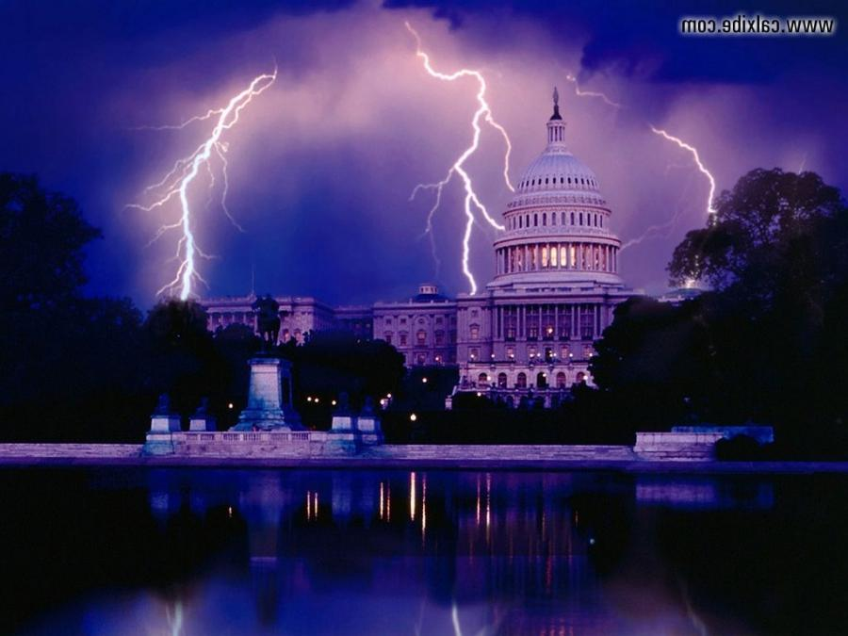
Current Events and Bible Prophecy

Slide 2
Summary
Satan’s plan is to kill God’s people.
Satan’s allies are the elites of the earth.
Satan’s plan is to de-populate the earth.
His agenda motivated by fear.
Roman Catholicism best suited for this agenda.

Slide 3
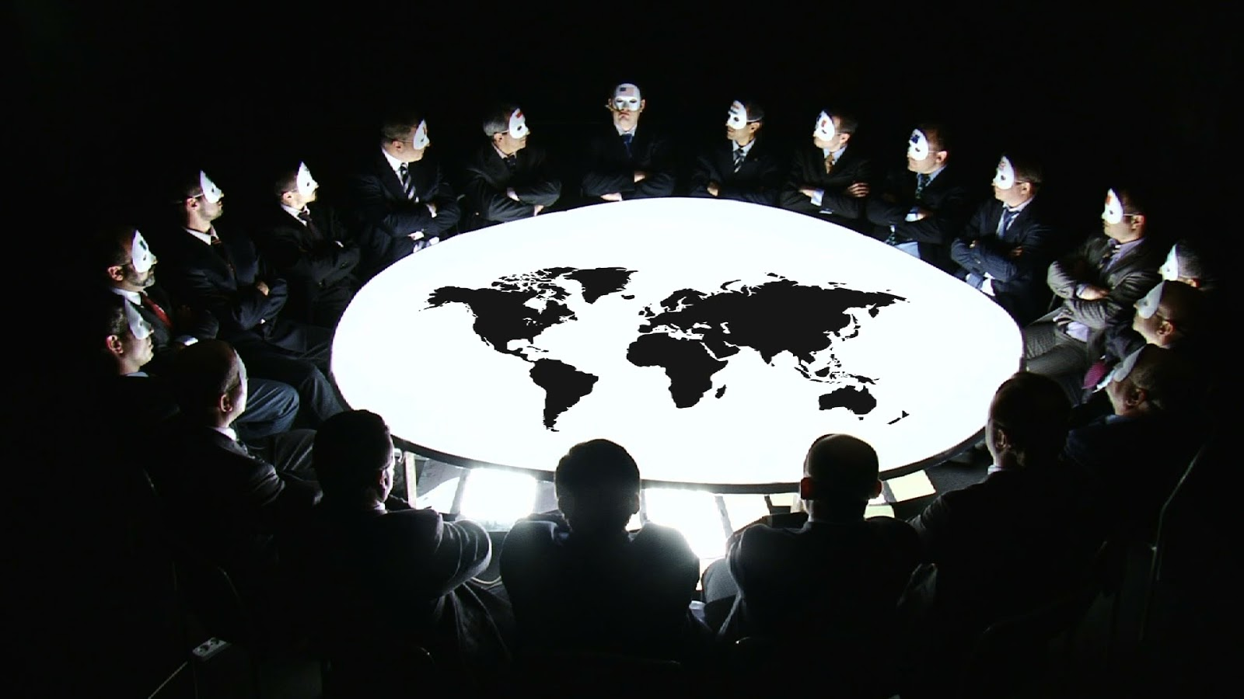
How are the Elites achieving their agenda?

Slide 4
Globalism

Slide 5
Apostates separate from God’s People
PP 188
For a time the descendants of Noah continued to dwell
among the mountains where the ark had rested.
As their numbers increased, apostasy soon led to division.
Those who desired to forget their Creator
and to cast off the restraints of His law felt a
constant annoyance from the teaching
and example of their God-fearing associates,
and after a time they decided to separate
from the worshippers of God.

Slide 6
Apostates move to plains of Shinar (Babylon)
PP 188
Accordingly they journeyed to the plain of Shinar, on the banks of the river Euphrates.
The beauty of the situation and the
fertility of the soil attracted them,
and upon this plain they
determined to make their home.

Slide 7
Apostates begin to build city of Babylon
PP 188
Here they decided to build a city,
and in it a tower of such stupendous height as should render it the wonder of the world. These enterprises were designed to
prevent the people from scattering
abroad in colonies.

Slide 8
Babylon the beginning of a universal monarchy
PP 189
God had directed men to disperse throughout the earth, to replenish and subdue it; but these Babel builders determined to keep their community
united in one body, and to found
a monarchy that should eventually embrace the whole earth.

Slide 9
Babylon intended to be a universal empire
PP 189
Thus their city would become the metropolis of a universal empire;
its glory would command the admiration and homage of the world and render
the founders illustrious.

Slide 10
Babylonian agenda realized
in the Last Days
And the woman which thou sawest is that great city, which reigneth over the kings of the earth.
Rev. 17:8.

Slide 11
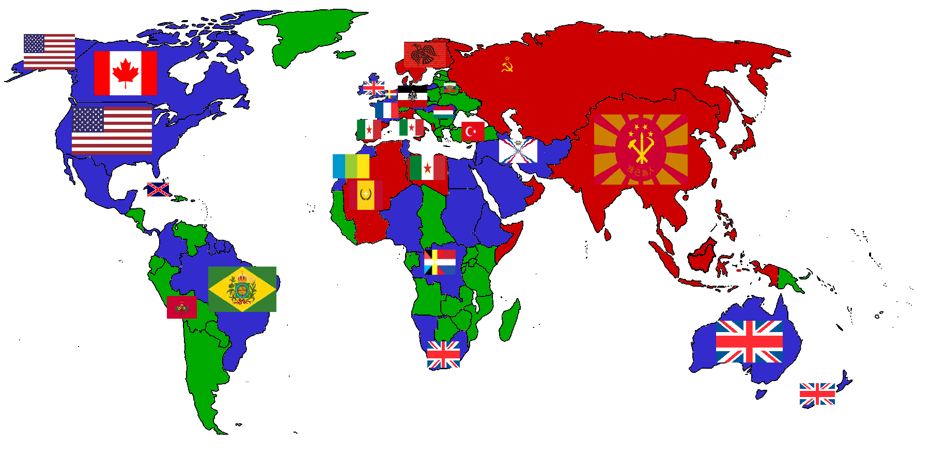
God’s preventative measure – national states

Slide 12
God’s separated the people into different nations
When the Most High divided to the nations their inheritance, when he separated the sons of Adam,
he set the bounds of the people
according to the number of the children of Israel.
Deut. 32:8.

Slide 13
Separate nations with boundaries
And hath made of one blood all nations of
men for to dwell on all the face of the earth,
and hath determined the times before appointed, and the bounds of their habitation…
Acts 17:26.

Slide 14
God separated the nations that they might be saved
That they should seek the Lord,
if haply they might feel after him,
and find him, though he be not far
from every one of us…
Acts 17:27.

Slide 19
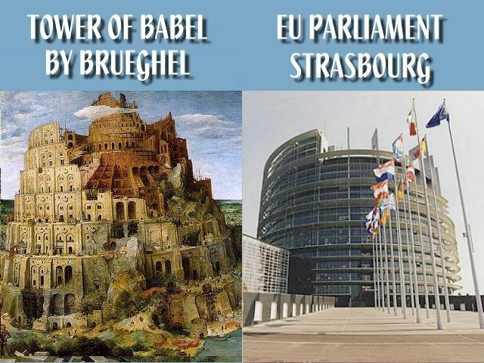

Slide 20
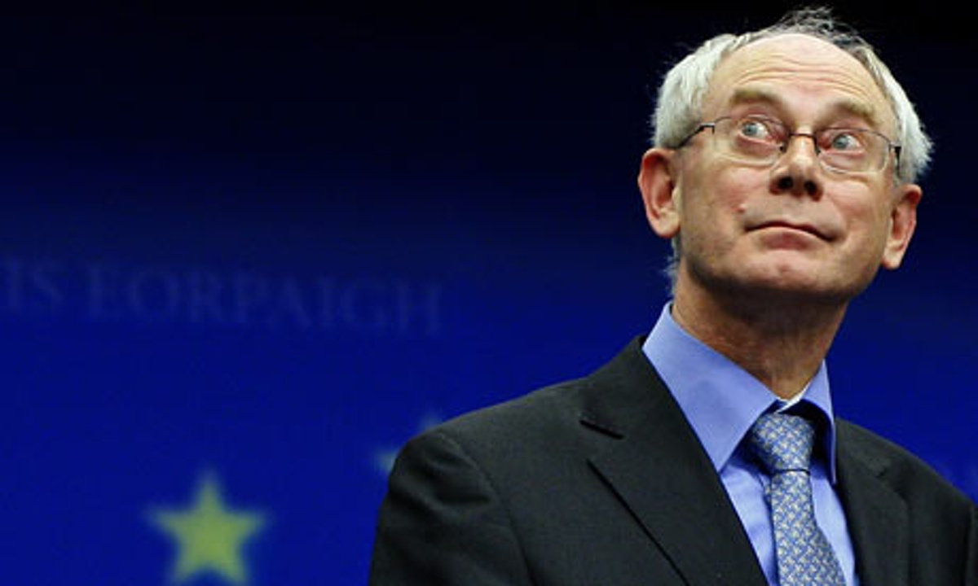
There is something that
binds the leaders of the
European Union together
it creates unbreakable ties.
Herman van Rompuy
President of the European Council,
Interreligious Dialogue,
Florence, Sept. 2012.

Slide 21
We are all Jesuits.
Herman van Rompuy
President of the European Council,
Interreligious Dialogue,
Florence, Sept. 2012.

Slide 22
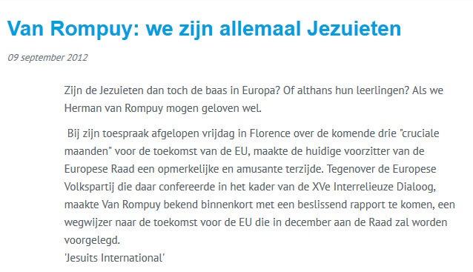

Slide 24
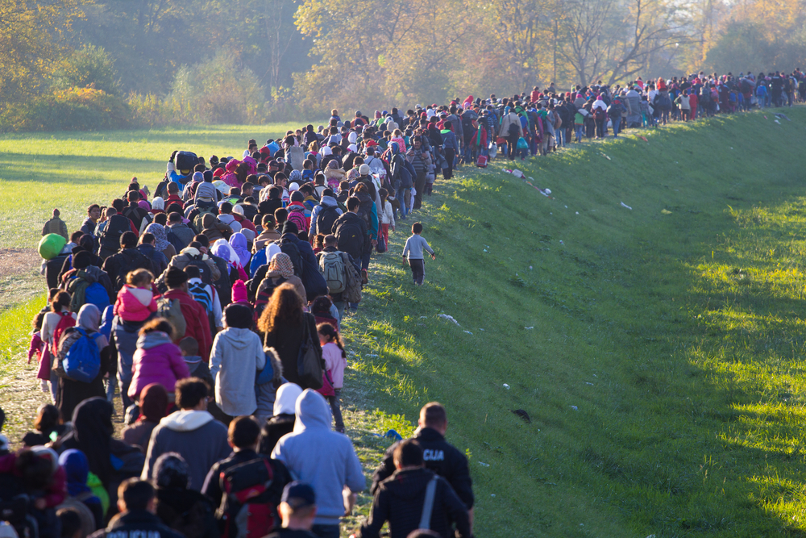
Mass
Migration

Slide 25
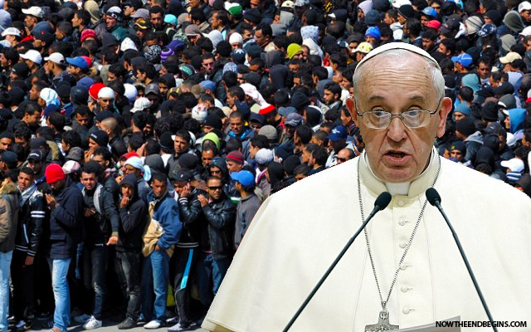
I appeal to the parishes,
the religious communities,
the monasteries and sanctuaries of all Europe to… take in one family
of refugees. Huffington Post,
Sept.6, 2015.

Slide 27
Multiculturalism

Slide 29
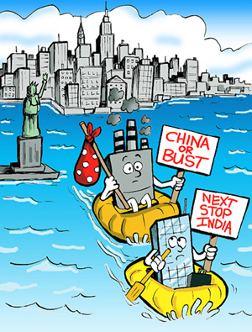
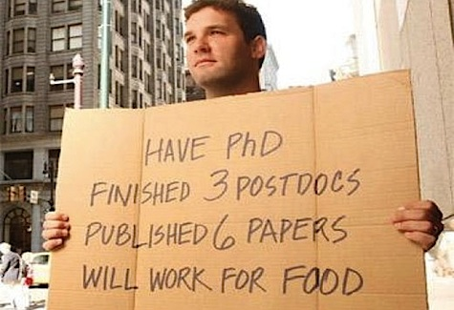
‘Outsourcing’
The jobs go overseas
Unemployment at home

Slide 30
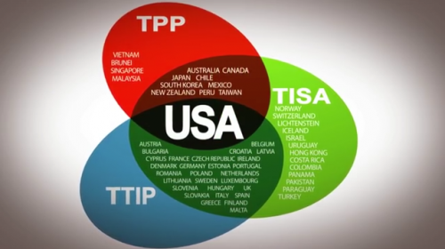
Free Trade Agreements

Slide 31
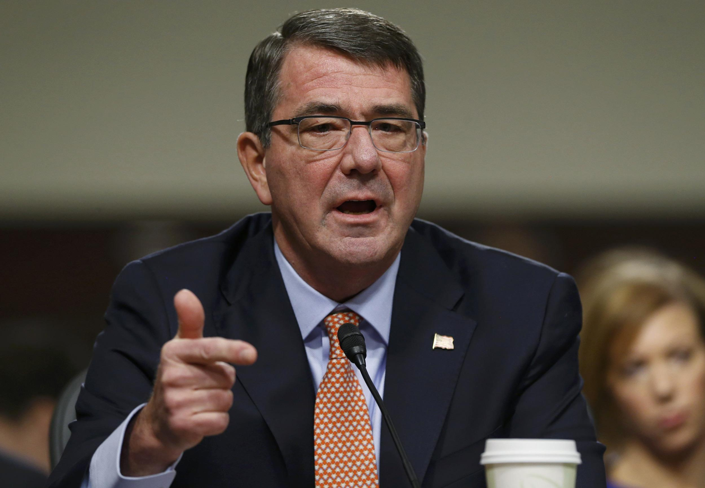
As important to me as another aircraft carrier. Ashton Carter,
US Secretary of Defence, NYT, Oct. 6, 2015.
The Trans Pacific Partnership

Slide 33
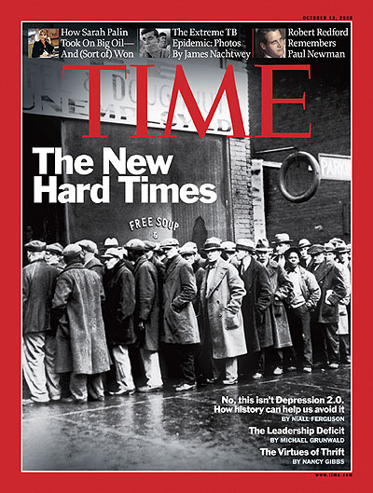

Slide 34
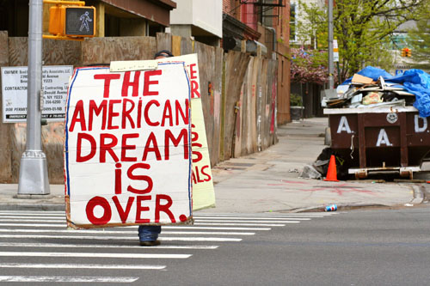

Slide 35
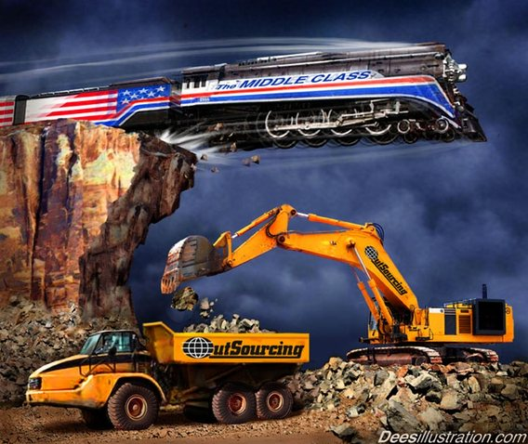
This is fantastic for every rich person,
this is the biggest redistribution of wealth from
the middle class and the poor to the rich ever.
Stanley Druckenmiller, billionaire hedge fund manager.

Slide 36
This is the biggest transfer of wealth in history. Steve Keen, economist.

Slide 38
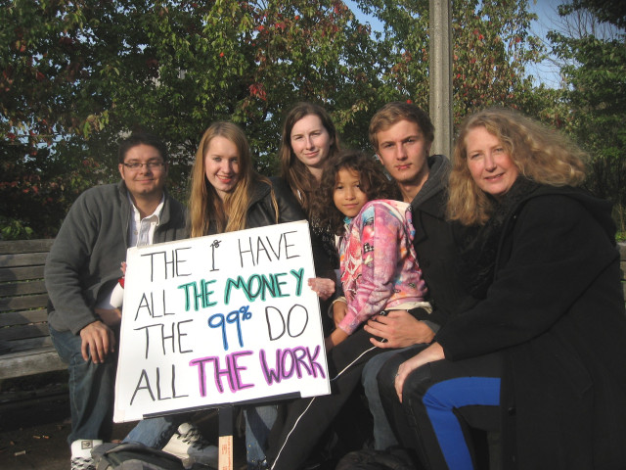

Slide 39
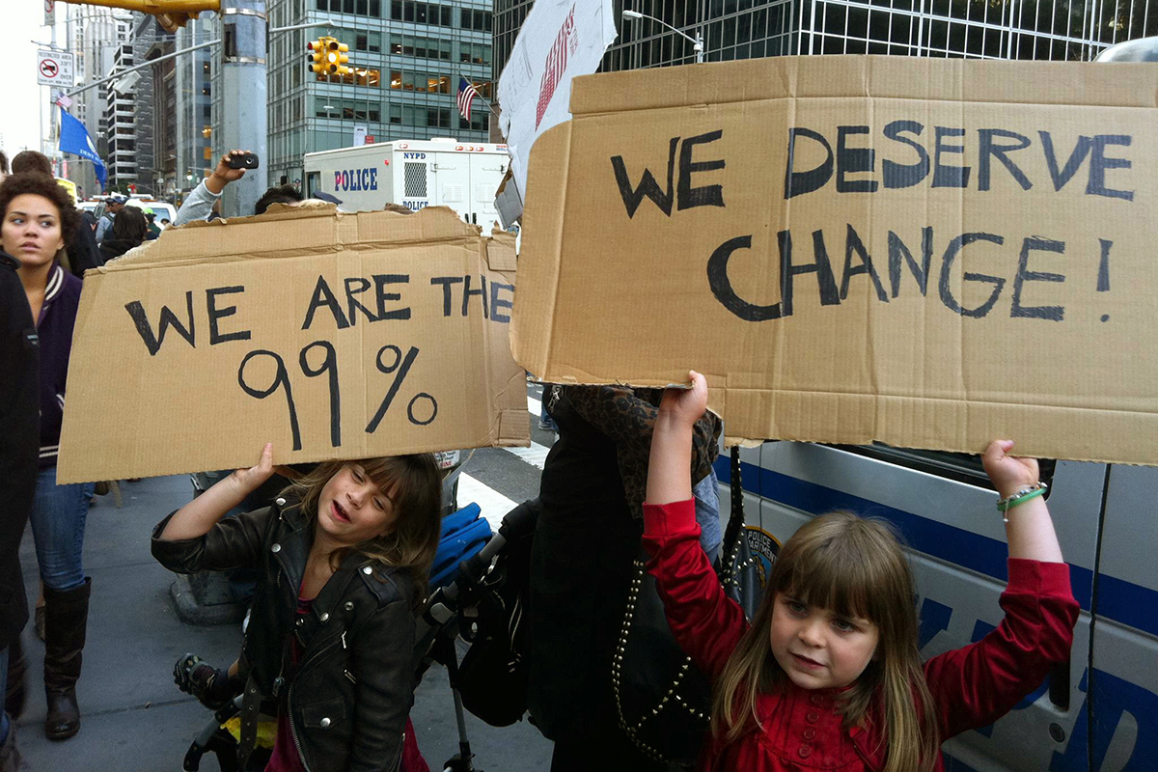

Slide 41
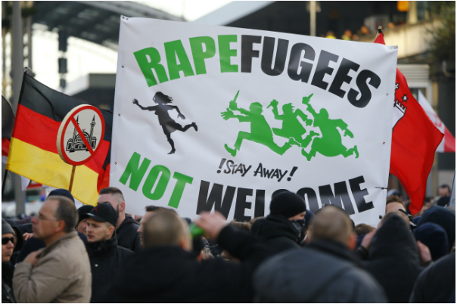

Slide 42
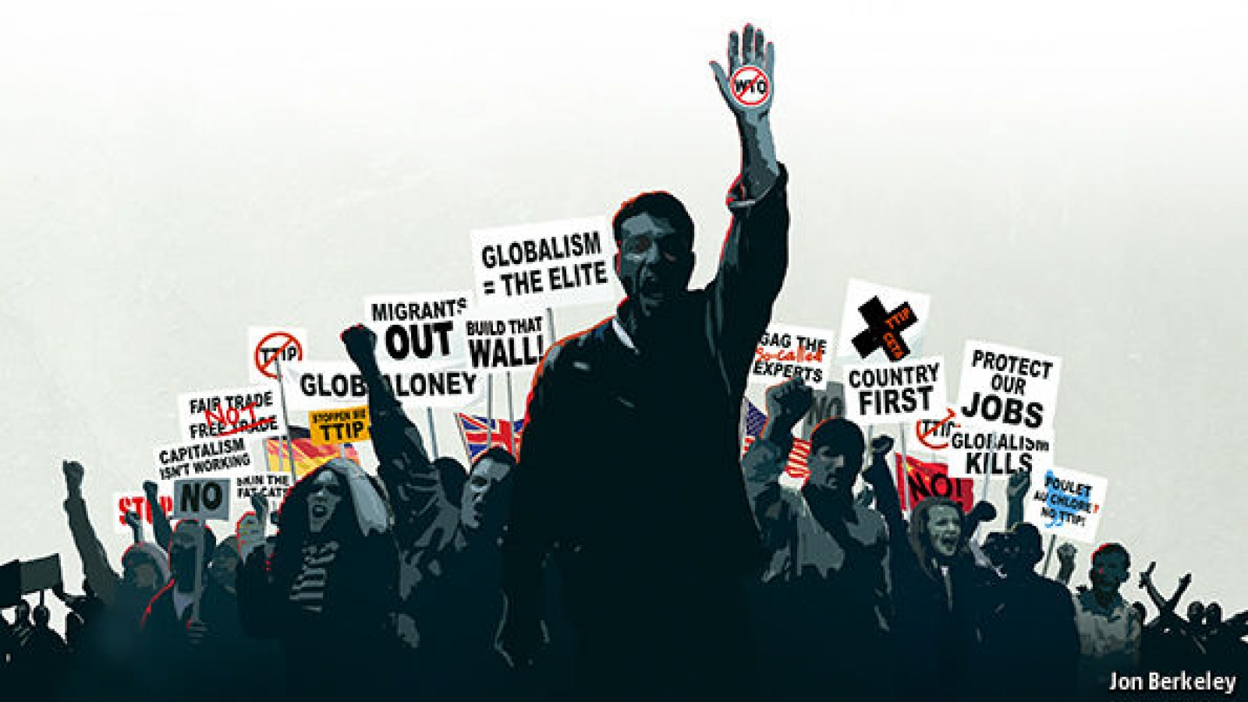

Slide 43
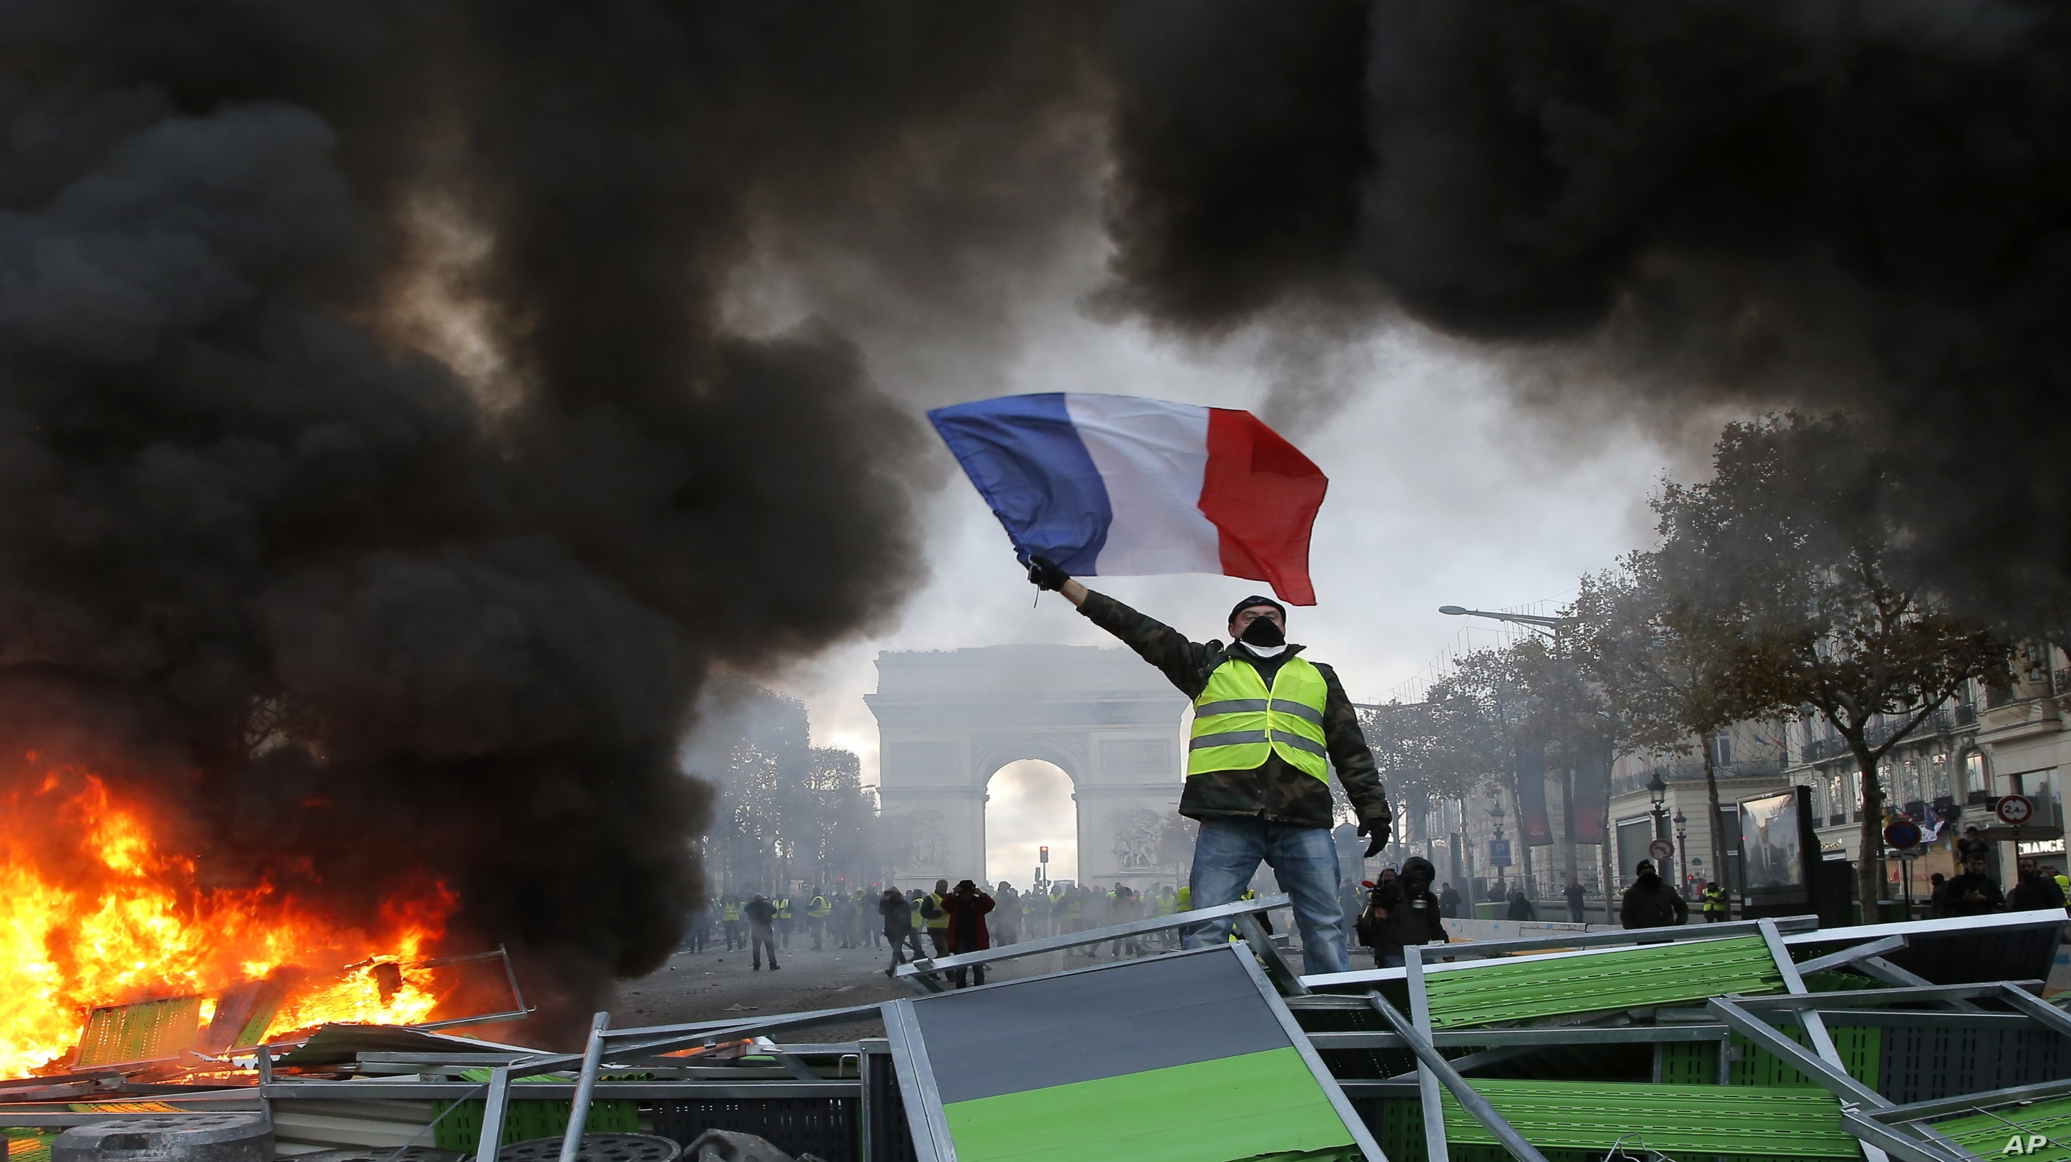

Slide 45
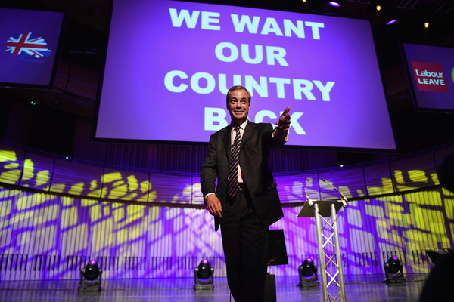

Slide 46
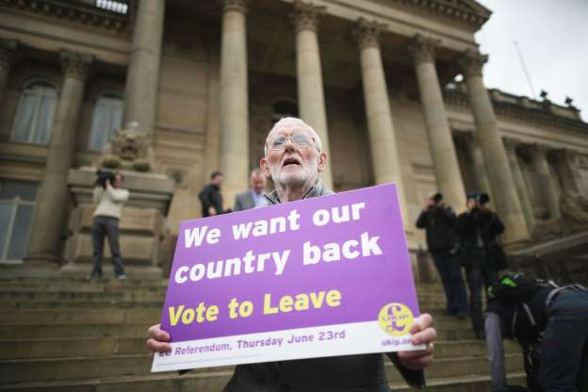

Slide 47
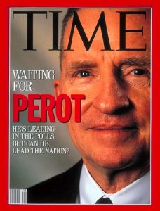

Slide 49
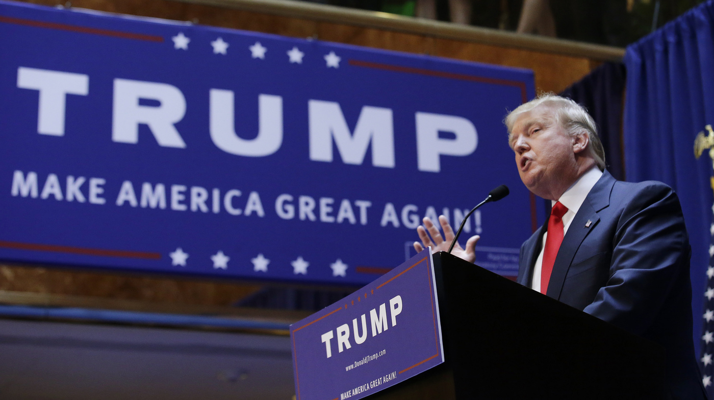

Slide 51
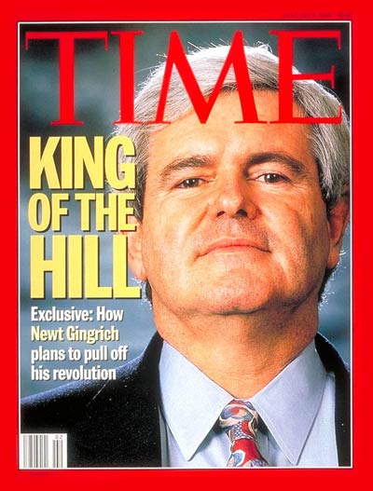
Newt Gingrich interview:
‘Why does the Republican Party Elite hate Donald Trump?’
They’re faced with the very real prospect of Donald Trump becoming the leader of the party and it absolutely drives them crazy and they just cannot imagine sharing…

Slide 52
Donald Trump is not considered elite enough for the elite
…because he is an outsider, he’s not them he’s
not part of the club,
he’s uncontrollable…

Slide 53
Trump is not a member of the elite secret societies
…he hasn’t been through
the initiation rites,
he didn’t belong to
the secret society.
They have no idea how
to relate to him.
http://www.infowars.com/gingrich
-trump-rejected-for-not-being-part
-of-the-club/

Slide 54
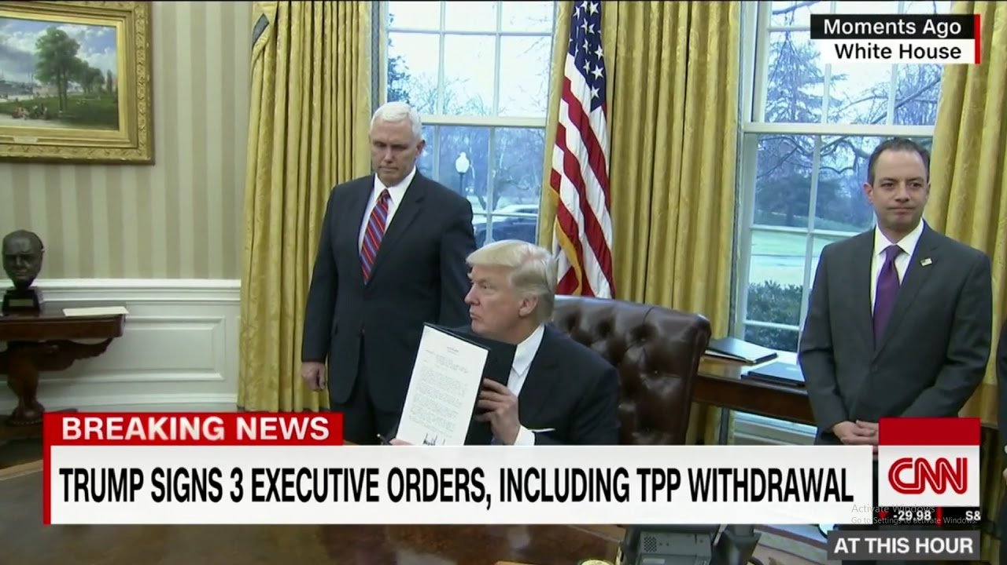

Slide 55
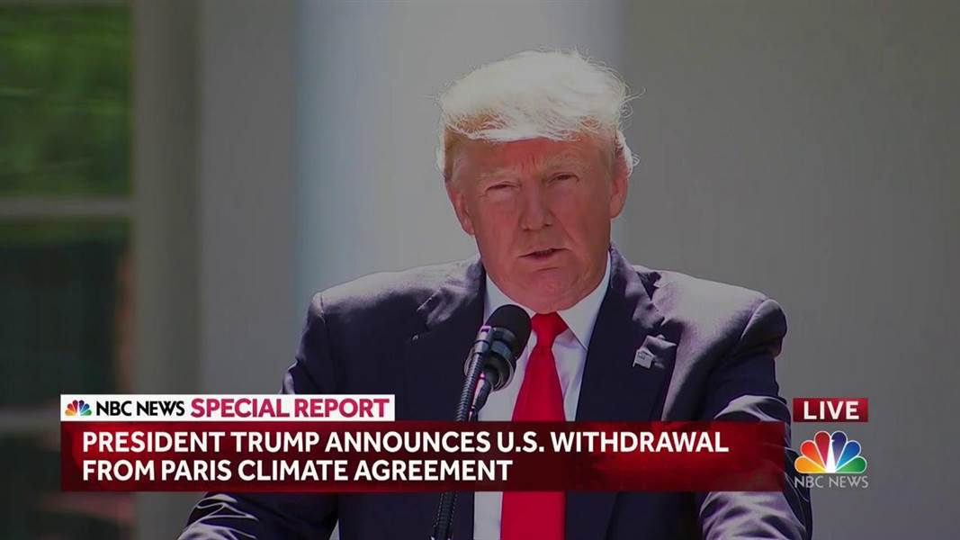

Slide 56
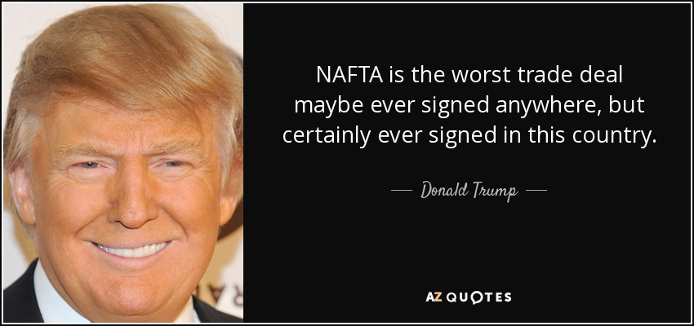

Slide 58
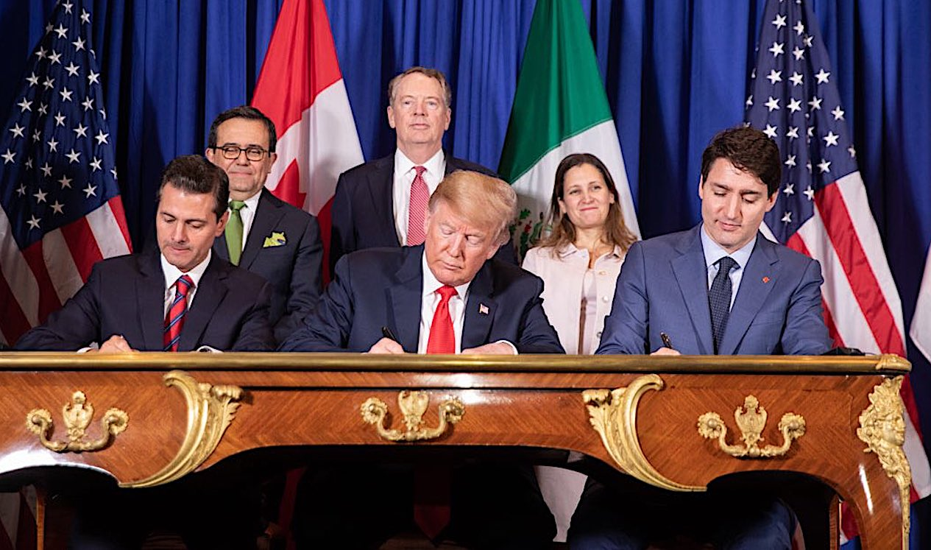

Slide 60
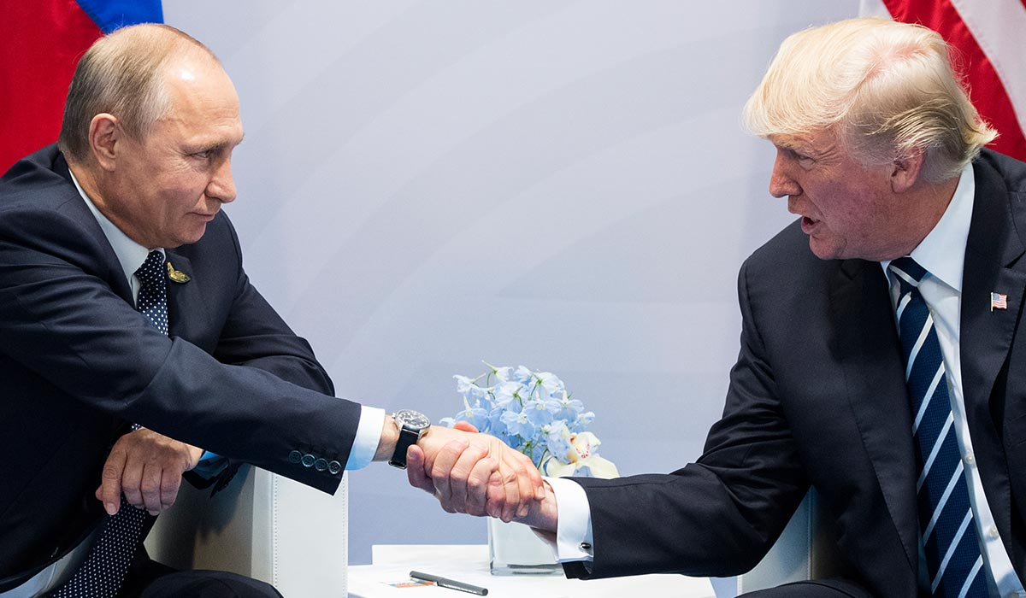

Slide 64
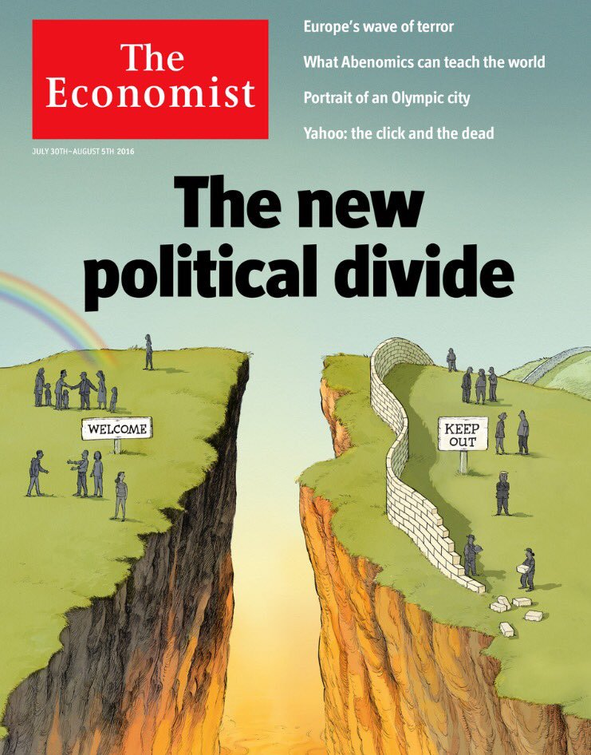

Slide 66
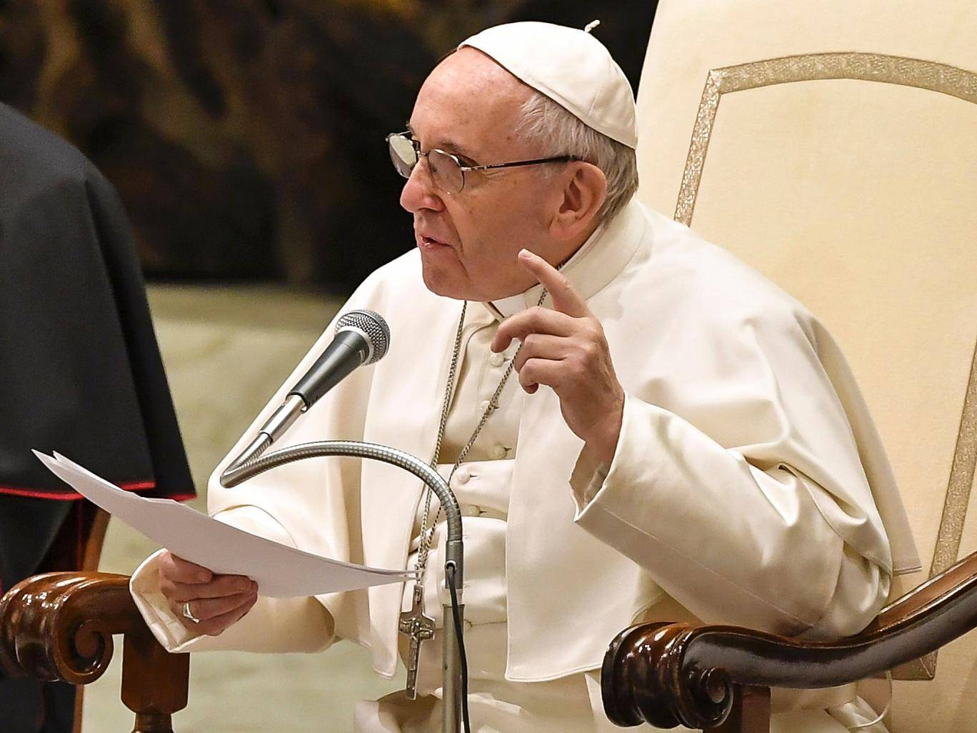

Slide 67
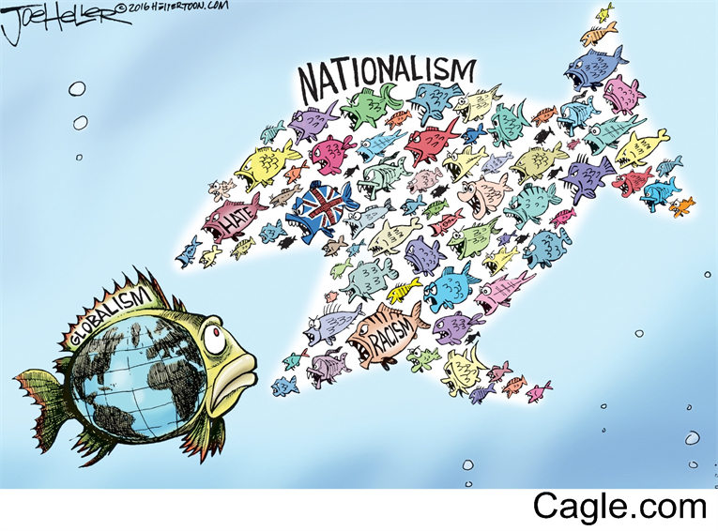

Slide 68
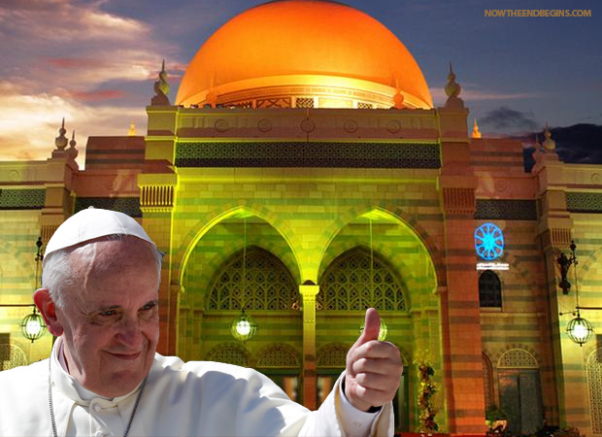
Chrislam

Slide 69
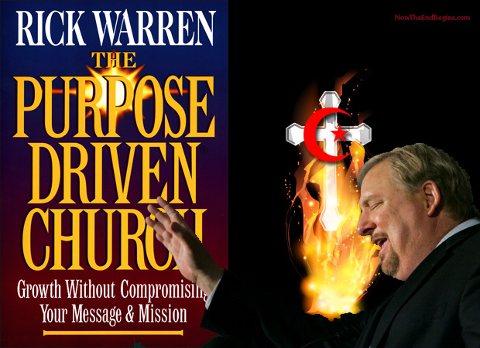
Chrislam

Slide 70
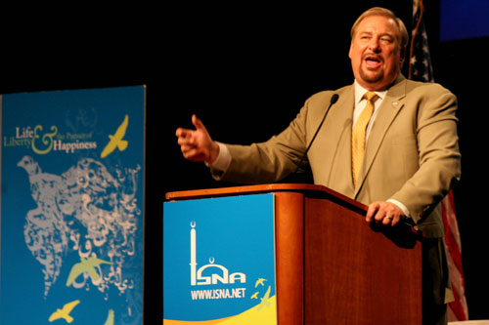
Rick Warren at the 46th annual
Islamic Society of North America
(ISNA) convention July 4, 2009.

Slide 71
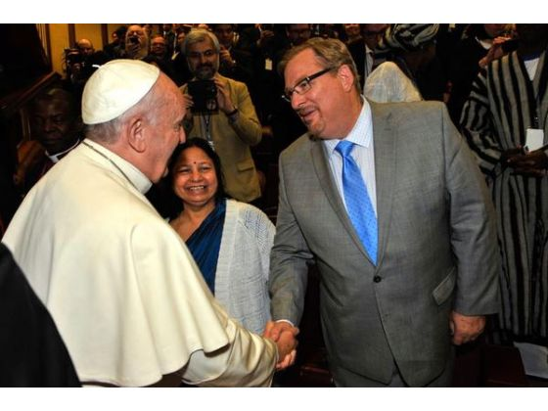

Slide 72
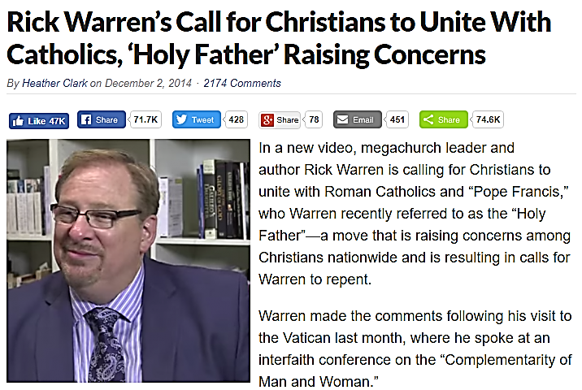

Slide 73
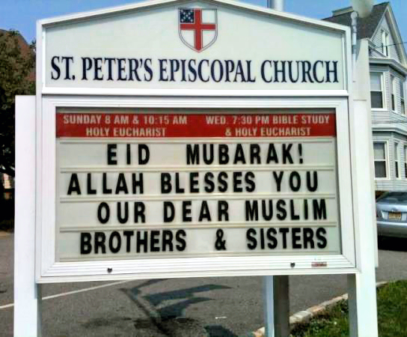

Slide 74
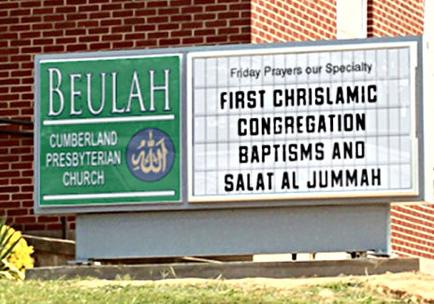

Slide 75
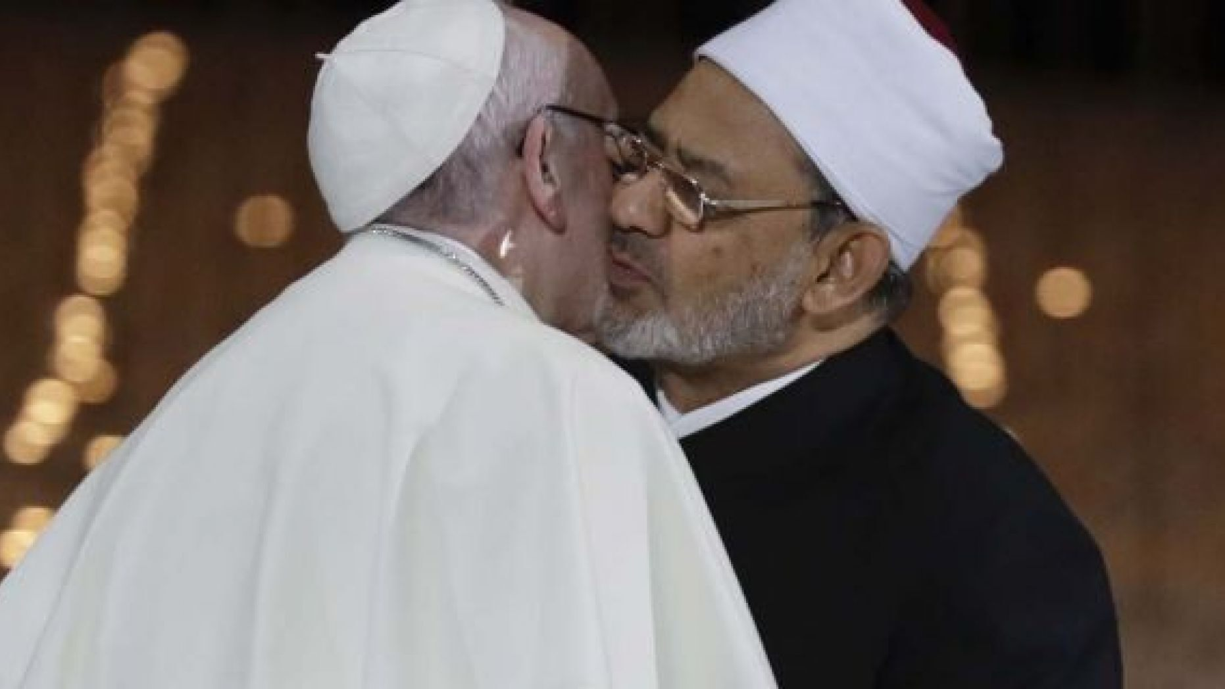

Slide 76
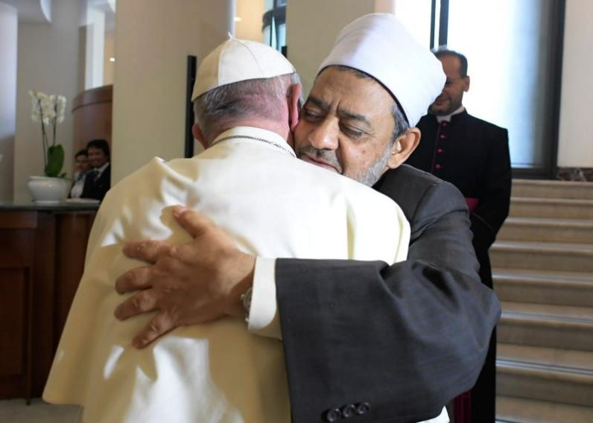
The meeting is
the message
It is true that the idea of conquest is inherent in the
soul of Islam, however, it is also possible to interpret the objective in Matthew's Gospel, where Jesus sends His disciples to all nations, in terms of the same idea of conquest.
Pope Francis
Pope Francis welcomes Sheikh Ahmed al-Tayeb, the grand imam of Al-Azhar and the highest religious authority of the Sunni Muslims,
to the Vatican on May 23, 2016

Slide 77
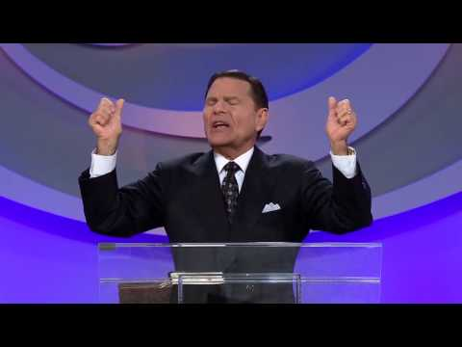
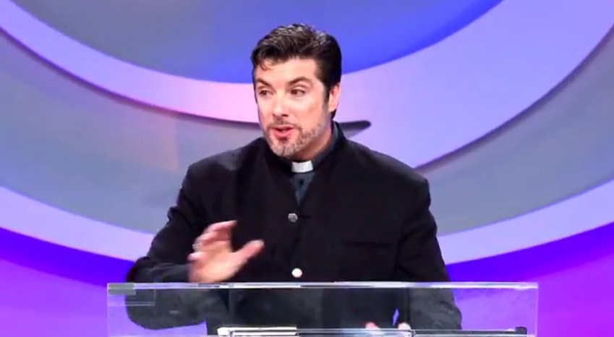
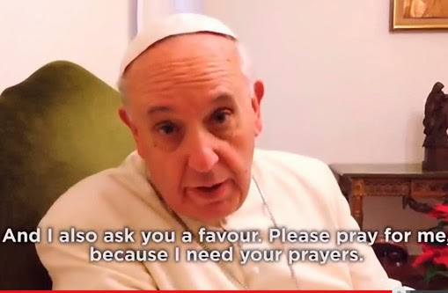
The Protest is over

Slide 78
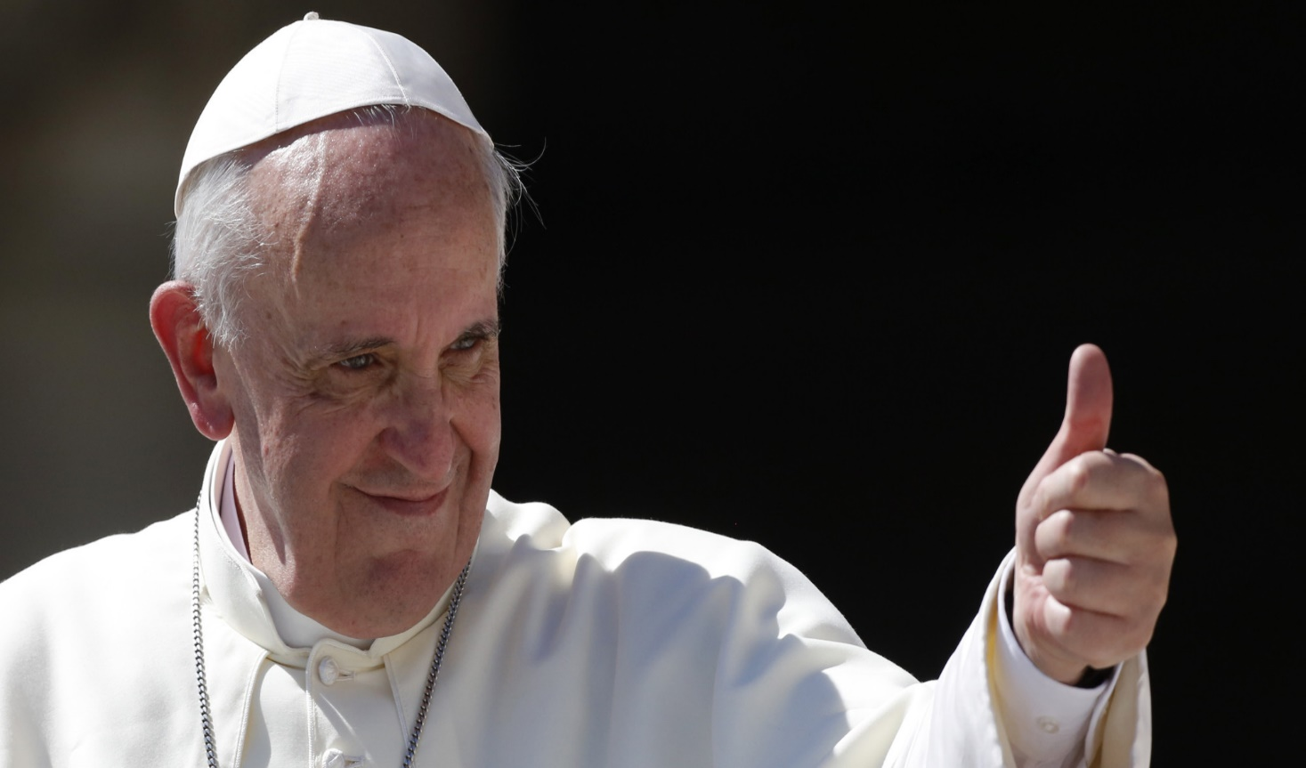
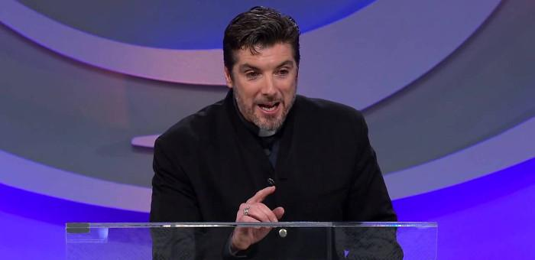
Is the Protestant Reformation Over??
Brothers and sisters, Luther's protest is over. Is yours?
Bishop Tony Palmer Pentecostal
leaders meeting
Feb. 21, 2014.

Slide 79
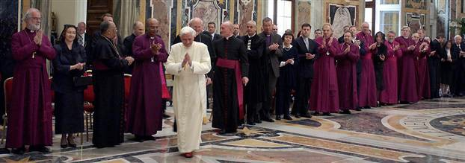
…and all the world wondered after the beast. Rev.13:3.
World religious leaders applaud Pope Benedict XVI during a meeting in the Sala Clementina, the Vatican, April 25, 2005

Slide 80
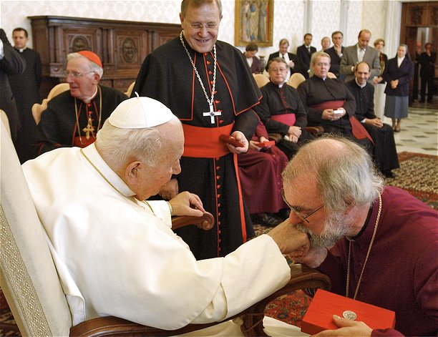
…and they worshipped the beast… Rev.13:4.

Slide 81
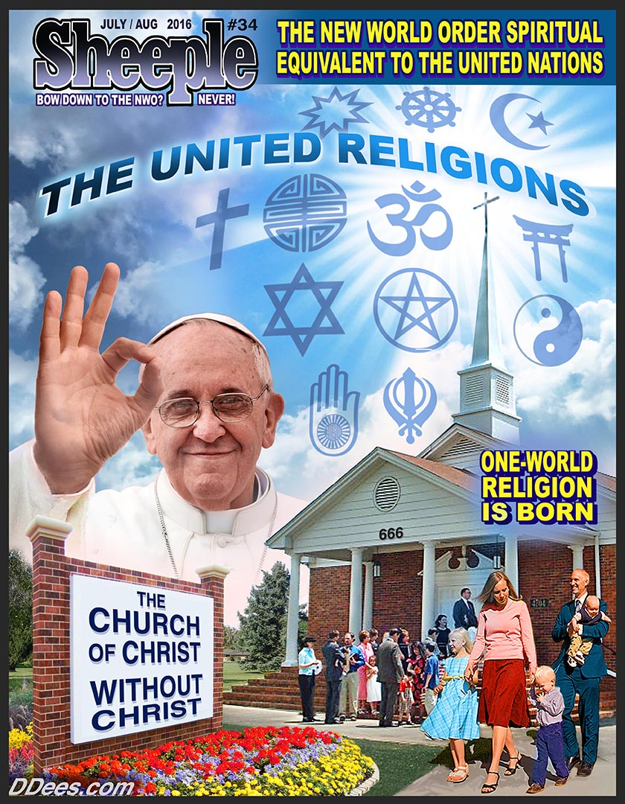

Slide 82
Global Warming

Slide 83
Global Warming
Climate Change
Climate Emergency

Slide 85
Catholic Church United Nations Uniting over Agenda 2030

Slide 89
A leading solution to
global warming includes extreme depopulation…

Slide 90
We can definitely change those [population] numbers and really should make every effort to change the numbers because we
are already today, exceeding the
planetary carrying capacity.
Christiana Figueres, Executive Secretary of the
UN Framework Convention on Climate Change, April 2015.

Slide 91
It must be stated that a true right of the environment does exist.

Slide 92
Mankind has the priority
And God blessed them, and God said unto them, Be fruitful, and multiply, and replenish the earth, and subdue it: and have dominion over the fish of the sea, and over the fowl of the air, and over every living thing that moveth upon the earth. Gen. 1:28.

Slide 93
We Christians, together with the other monotheistic religions, believe that the universe is the fruit of a loving decision by the Creator, who permits man respectfully to use creation for the good of his fellow men and for the glory of the Creator.

Slide 94
I am similarly confident that the Paris Conference
on Climatic Change will secure fundamental
and effective
agreements.
The adoption of the 2030
Agenda for Sustainable
Development at
the World Summit,
which opens today,
is an important
sign of hope.

Slide 95
The Catholic ‘Common Good’ will save
the Planet
If the representatives of the States can set aside partisan and ideological interests, and sincerely strive to serve the common good.
I pray to Almighty God that this will be the case, and I assure you of
my support and my prayers, and the support and prayers
of all the faithful of the Catholic Church…

Slide 96
The Catholic ‘Common Good’ will save
the Planet
…that this Institution, all its member States, and each of its officials,
will always render an effective service to mankind, a service respectful of diversity and capable of bringing out, for sake of the common good, the best in each people and in every individual.

Slide 102
Resting on Sunday is a perfect fit with Agenda 2030
Resting on Sunday will eventually evolve into keeping Sunday Holy

Slide 107
Globalism needs Global Warming
This Paris climate accord is not just some accord or the other.
It is a central accord in defining the contours of globalization.
Angela Merkel, press conference,
G7, Italy, May 28, 2017.

Slide 108
The United Nations agrees with
Angela Meckel
Basically it's a big mistake to discuss climate policy
separately from the major themes of globalization.
Ottmar Edenhofer, UN IPCC Official, NZZ Online Sunday, www.nzz.ch/klimapolitik_verteilt_das_weltvermoegen_neu-1.8373227

Slide 109
We've got to ride this global warming issue.
Even if the theory of global warming is wrong,
we will be doing the right thing in terms
of economic and environmental policy.
Timothy Wirth, director of UN Foundation,
quoted by, Michael Fumento,
in Science Under Siege.
Timothy Wirth former US Senator

Slide 110
But one must say clearly that we redistribute
de facto the world's wealth by climate policy.

Slide 111
Obviously, the owners of coal and oil
will not be enthusiastic about this.

Slide 112
One has to free oneself from the illusion that
international climate policy is environmental policy.

Slide 113
This has almost nothing to do with environmental policy anymore.
Ottmar Edenhofer ‘Climate policy is redistributing the world’s wealth’
Interview with Bernard Potter, whatsupwiththat.com, Nov. 10, 2010.

Slide 115
A global warming treaty must be implemented even if there is no scientific evidence to back the greenhouse effect. Richard Benedick,
Deputy Assistant of State,
Rio Summit, 1992.

Slide 116
The threat of environmental crisis will be the international disaster key to unlock
the New World Order.
Mikhail Gorbachev, former
Soviet Union President, 1996.

Slide 120
But when they persecute you in this city,
flee ye into another…
Matt. 10:23.
God’s people survived by fleeing from one place to another

Slide 121
Satan does not want to make the same mistake
There will be a universal bond of union,
one great harmony,
a confederacy
of Satan's forces.
Maranatha p. 187.

