Slide 1
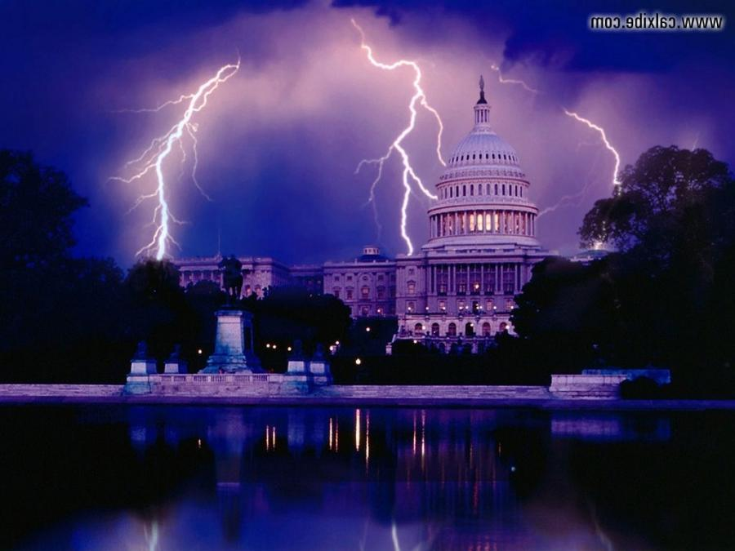
Current Events and Bible Prophecy

Slide 2
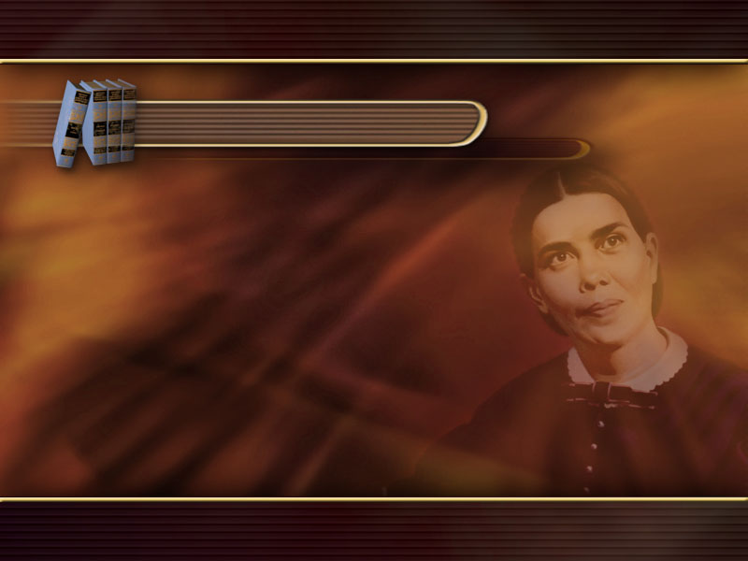
The Signs of the Times
Ed 179
Today the signs of the times declare
that we are standing on the threshold
of great and solemn events.
Everything in our world is in agitation.

Slide 3
The Signs of the Times
Ed 179
The present is a time of overwhelming interest to all living.
Rulers and statesmen, men who occupy
positions of trust and authority,
thinking men and women of all classes,
have their attention fixed upon
the events taking place about us.

Slide 4
The Signs of the Times
Ed 179
They are watching the strained,
restless relations that exist among the nations. They observe the intensity that is taking possession of every earthly element,
and they recognize that something great
and decisive is about to take place–
that the world is on the verge
of a stupendous crisis.

Slide 5
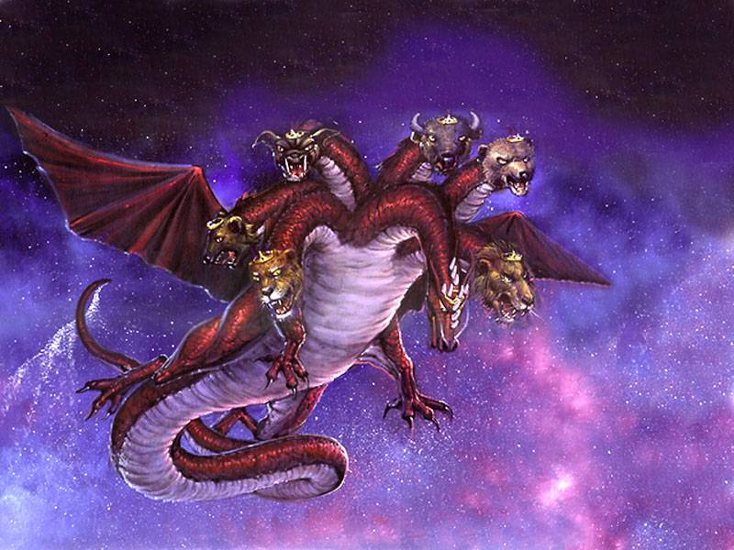
And the great dragon was cast out,
that old serpent, called the Devil,
and Satan…
Satan cast out
of Heaven

Slide 6
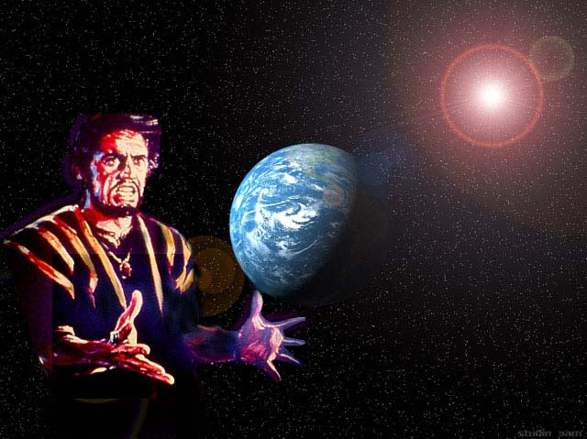
All the World Deceived
which deceiveth
the whole world…
Rev. 12:9.

Slide 7
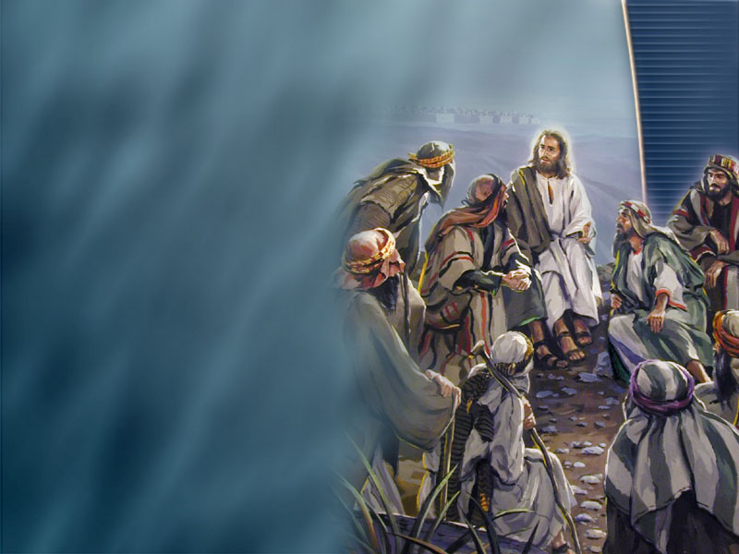
Jesus warns us against deception
Take heed that no
man deceive you…
Matt 24:4.

Slide 8
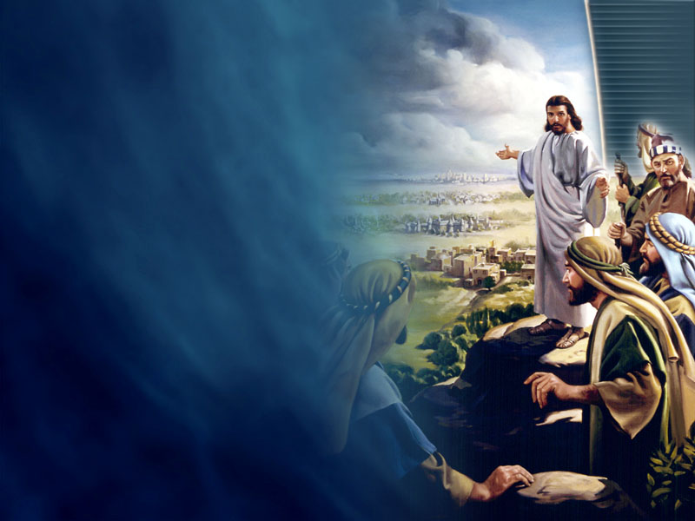
Only the Elect Escape
For there shall arise false Christs, and false prophets,
and shall shew great
signs and wonders;
insomuch that,
if it were possible,
they shall deceive
the very elect.
Matt. 24:24.

Slide 9
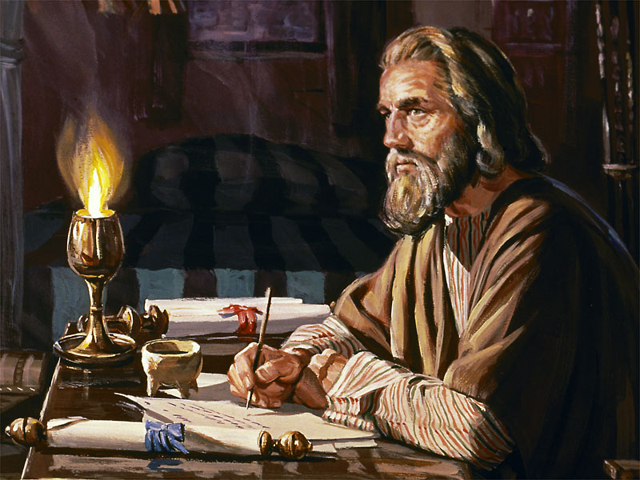
Peter, an apostle of Jesus Christ, to the strangers scattered throughout Pontus,
Galatia, Cappadocia,
Asia, and Bithynia,

Slide 10
elect according
to the foreknowledge
of God the Father,

Slide 11
through sanctification
of the Spirit,
unto obedience

Slide 12
and sprinkling
of the blood of
Jesus Christ…
1 Pet. 1, 2.

Slide 13
Who are
the Elect?

Slide 14
Sanctification by the Spirit
Obedience
Blood of Christ

Slide 15
What saves the Laodicean Church from Deception?
5T 233
The gold is faith and love.
The raiment is the righteousness of Christ.
The eye salve is the spiritual discernment,
which will enable you to see the wiles of Satan,
to detect sin and abhor it, to see truth and obey it.

Slide 16
We are not aware of the enemies tactics
3T 196
It is a lamentable fact that God's servants are not half as
much awake to the wiles of Satan as they should be.
And instead of resisting the devil that he may flee from them,
many are inclined to make a compromise
with the powers of darkness.

Slide 17
Little awareness and resistance because of ignorance
GC 507
There is little enmity against Satan and his works, because there is so great ignorance concerning
his power and malice, and the vast extent of
his warfare against Christ and His church. Multitudes are deluded here.

Slide 18
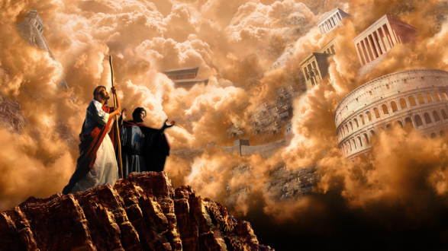
Satan has Usurped Control of the World
…for that is delivered
unto me…
Lu. 4:6.

Slide 19
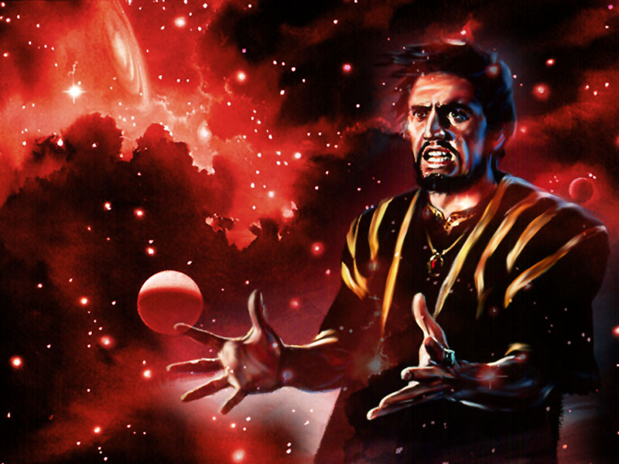
…the prince
of this world…
Jn. 14:30.

Slide 20
Why does Satan rule the World?
Know ye not, that to whom ye yield yourselves servants to obey, his servants ye are
to whom ye obey;
whether of sin unto death,
or of obedience
unto righteousness?
Rom. 6:16.

Slide 21
We give our allegiance to Satan
While they promise them liberty, they themselves are the
servants of corruption:
for of whom a man is overcome, of the same is he
brought in bondage.
2 Pet. 2:19.

Slide 22
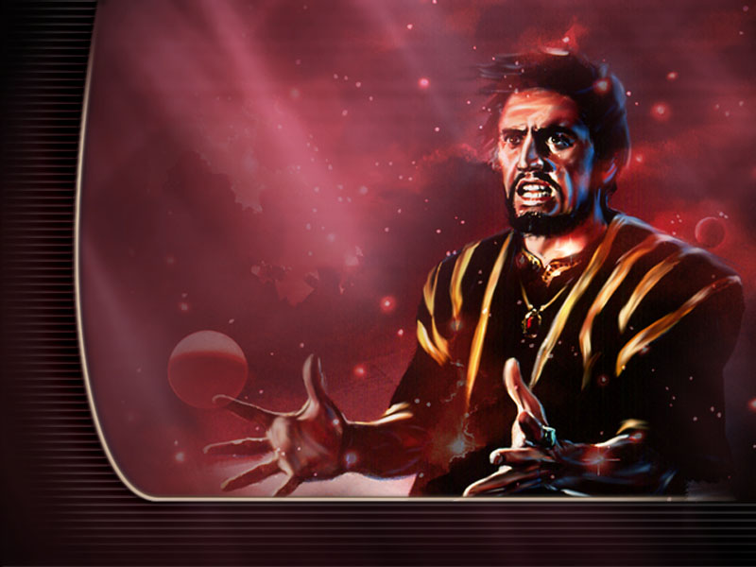
He numbers the world as his subjects;

Slide 23
He numbers the world as his subjects;
but the little company who keep the commandments
of God are resisting
his supremacy.

Slide 24
If he could blot them
from the earth,
his triumph would
be complete.
GC 618.

Slide 25
If he could blot them
from the earth,
his triumph would
be complete.
GC 618.

Slide 26
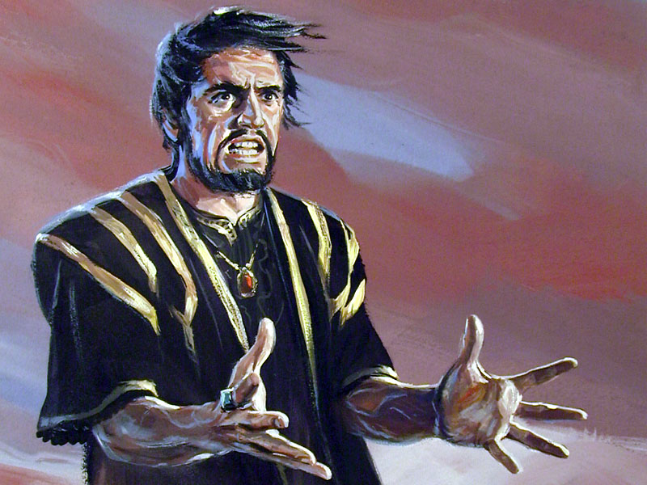
How is Satan going to destroy God’s People?

Slide 27
For thousands of years this chief of conspiracy has palmed off falsehood for truth.
GC 670.

Slide 28
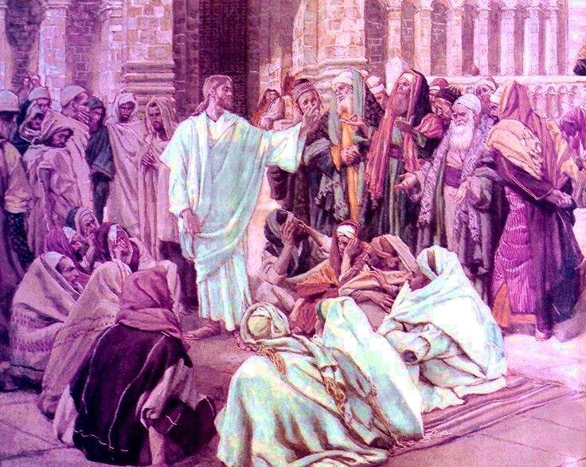
Jesus believed in Conspiracies
Why are you planning to kill me? Jn. 7:19.

Slide 29
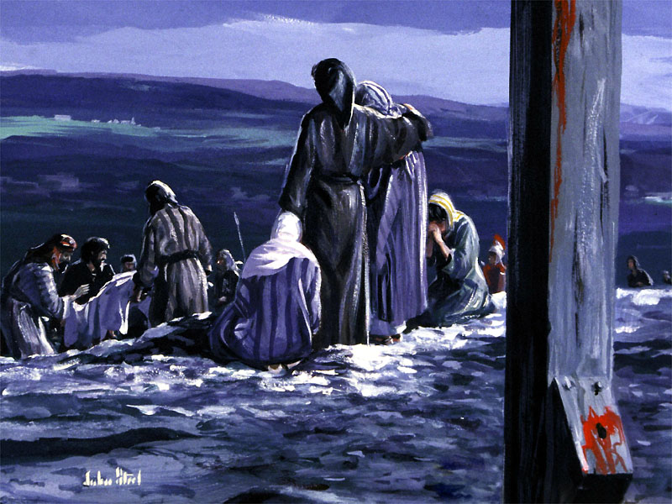
Satan, evil angels and men conspired against Christ
His life of self-denial and sinless devotion was a perpetual reproof to a proud, sensual people.
It was this that evoked enmity against the Son of God.
Satan and evil angels joined with evil men.
All the energies of apostasy conspired against
the Champion of truth.
GC 506.

Slide 30
Human history interwoven with spiritual agencies
DA 511
The connection of the visible with the invisible world, the ministration of angels of God,
and the agency of evil spirits,
are plainly revealed in the Scriptures,
and inseparably interwoven with human history.

Slide 31
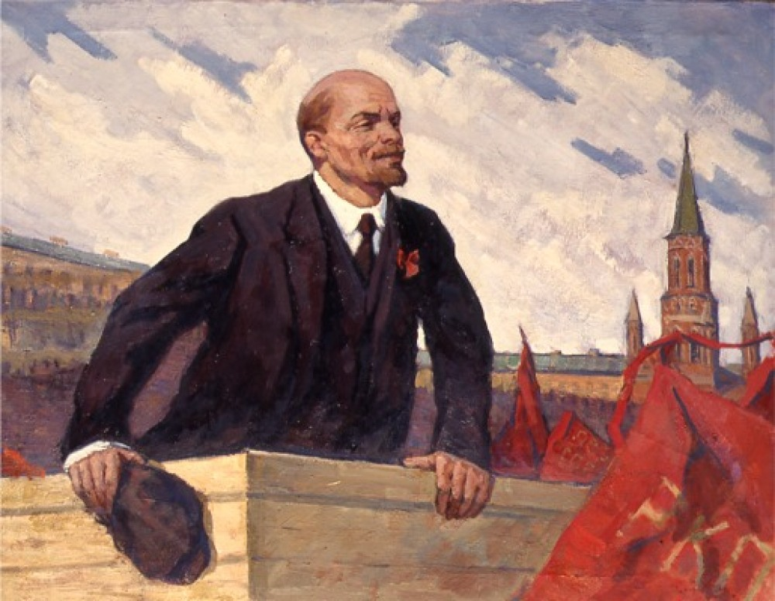
Vladimir Lenin founder of the Soviet Union
Conspiracy is so essential a condition of an organisation of this kind that all other conditions… must be made to conform with it.
Quoted in, What Is to Be Done, (1902),
The Communist Party, USA. What It Is, How It Works:
Senate Document No. 117, 84th Congress, p. 8.

Slide 32
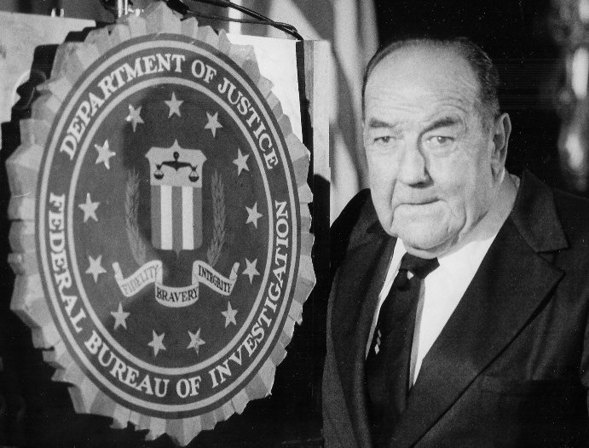
Conspiracies
so evil they are unbelievable
The individual is handicapped by coming
face to face with a conspiracy so monstrous he cannot believe it exists. J. Edgar Hoover, FBI Director.

Slide 33
Satan’s conspiracies directed against God’s People
Maranatha 203
The church, soon to enter upon her most severe conflict,
will be the object most dear to God upon earth.
The conspiracy of evil will be stirred with power from beneath,
and Satan will cast all the reproach possible upon the chosen ones whom he cannot deceive and delude with his satanic
inventions and falsehoods.

Slide 34
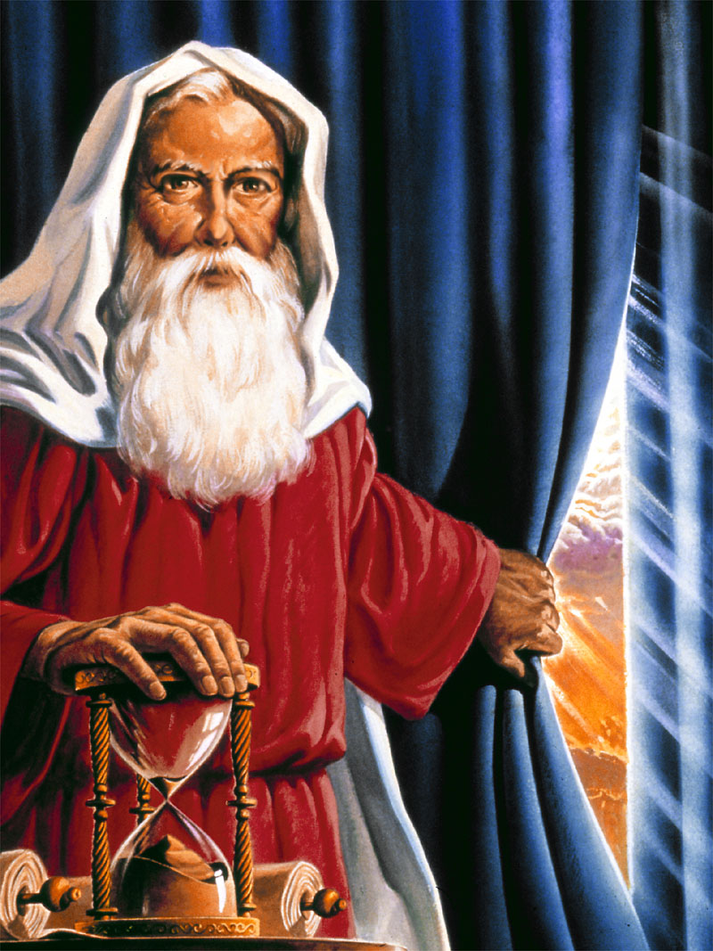
Satan Fears Exposure
There is nothing that the great deceiver fears so much as that we shall become acquainted with his devices. GC 516.
And have no fellowship with
the unfruitful works of darkness,
but rather reprove them.
Eph. 5:11.

Slide 35
Who does Satan Conspire with?

Slide 36
Satan uses the wealthy and powerful – the Elite
EW 282
I saw the leading men of the earth consulting together, and Satan and his angels busy around them.

Slide 37
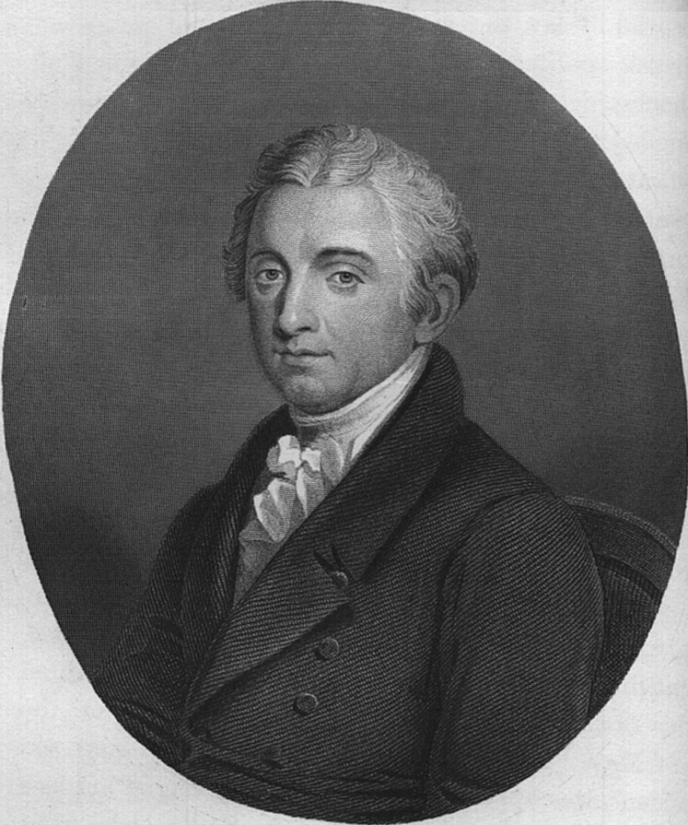
The rich will strive to establish their dominion
and enslave the rest. They always did.
They always will... They will have the
same effect here as elsewhere,
if we do not,
(by the power of government),
keep them in their proper spheres.
Letter from Gouverneur Morris to James Madison, 1787.
The Rich (the Elite) dominate and enslave

Slide 38
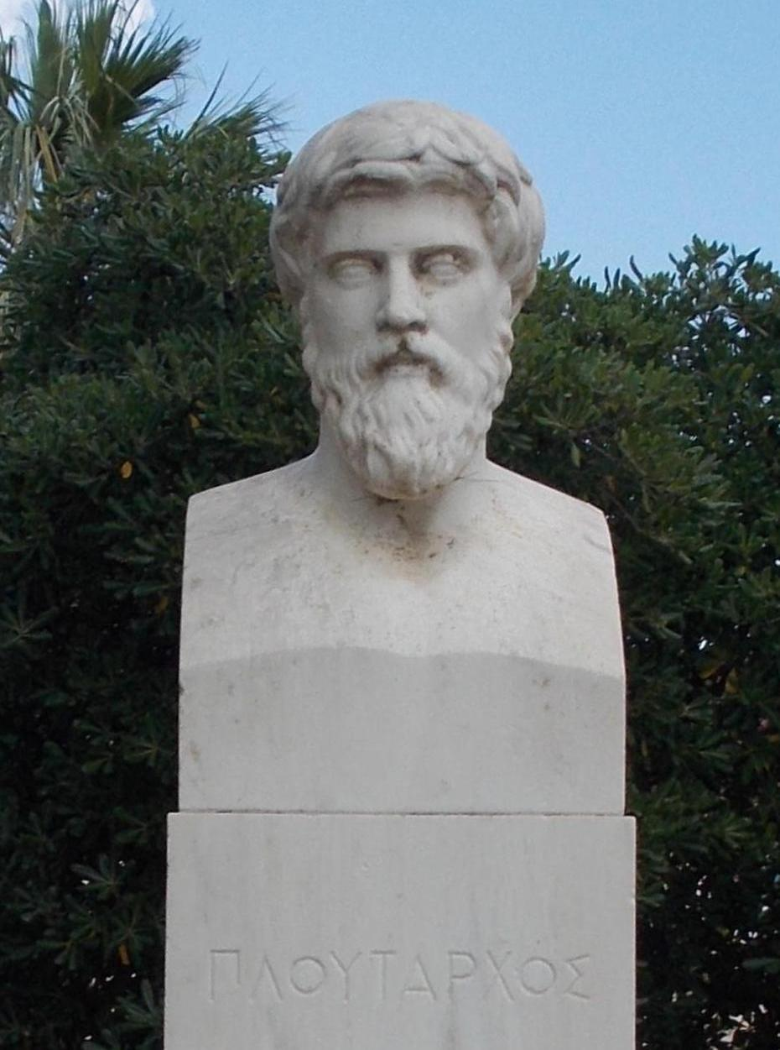
Elite use their Wealth
to Corrupt Society
The abuse of buying and selling votes
crept in and money began to play an important part in determining elections.
Later on, this process of corruption
spread to the law courts.
And then to the army, and finally
the Republic was subjected to
the rule of emperors.
Plutarch, Historian of the Roman Republic.

Slide 39
Go to now, ye rich men, weep and howl for your miseries that shall come upon you. Your riches are corrupted,
and your garments are motheaten.
Your gold and silver is cankered;
and the rust of them shall be a
witness against you, and shall eat your flesh as it were fire. Ye have heaped treasure together for the last days.
The Elite will lose their wealth

Slide 40
Riches obtained illegally
Behold, the hire of the labourers
who have reaped down your fields, which is of you kept back by fraud, crieth: and the cries of them which have reaped are entered into the
ears of the Lord of sabaoth.
Ye have lived in pleasure on the earth, and been wanton; ye have nourished your hearts, as in a day of slaughter.

Slide 41
Guilty of murdering opponents and opposition
Ye have condemned and killed the just; and he doth not resist you.
James 5:1-6.

Slide 42
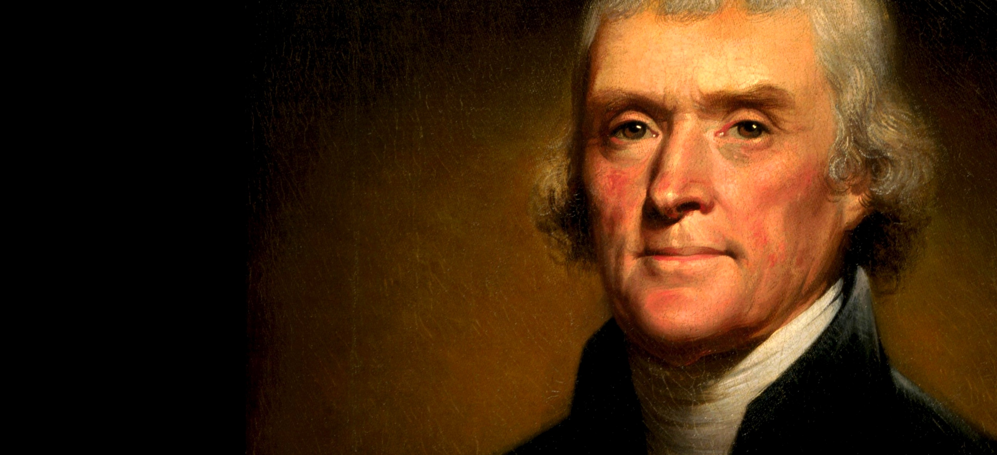
Govern or be Governed
The issue today is
the same as it has been throughout all history,
whether man shall be
allowed to govern himself
or be ruled by a small elite.
Thomas Jefferson.

Slide 43
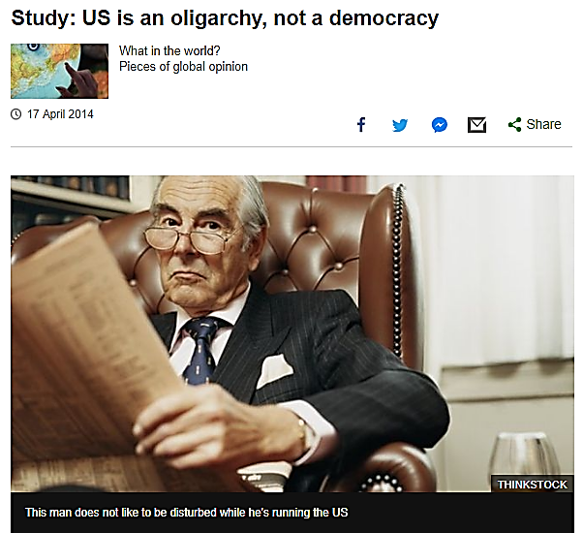

Slide 44
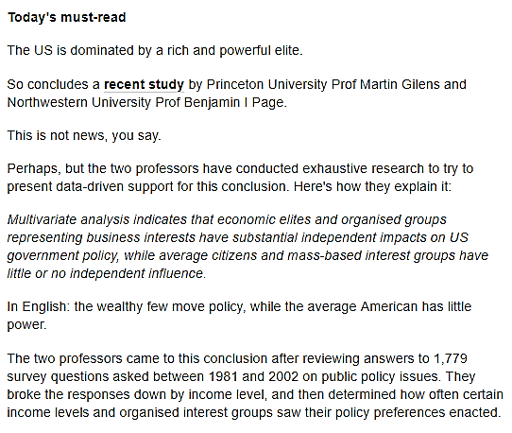

Slide 45
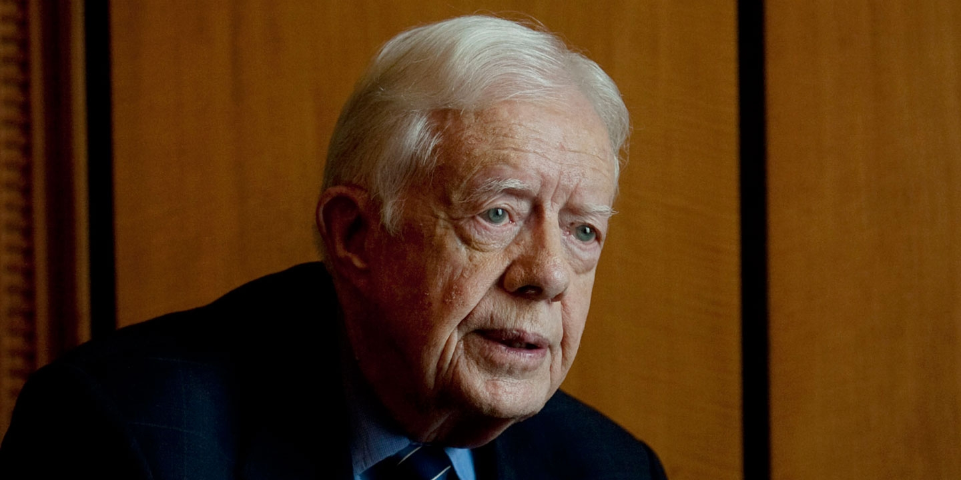
Now it’s just an oligarchy,
with unlimited political
bribery being the
essence of getting
the nominations
for president or
to elect the
president.
And the same thing
applies to governors,
and U.S. senators and congress members. Jimmy Carter,
former US President,
July 28, 2015.

Slide 47
The two greatest obstacles to democracy in the United States are, first, the widespread delusion
among the poor that we have a democracy, and second,
the chronic terror
among the rich,
lest we get it.
Edward Dowling,
1941.

Slide 51
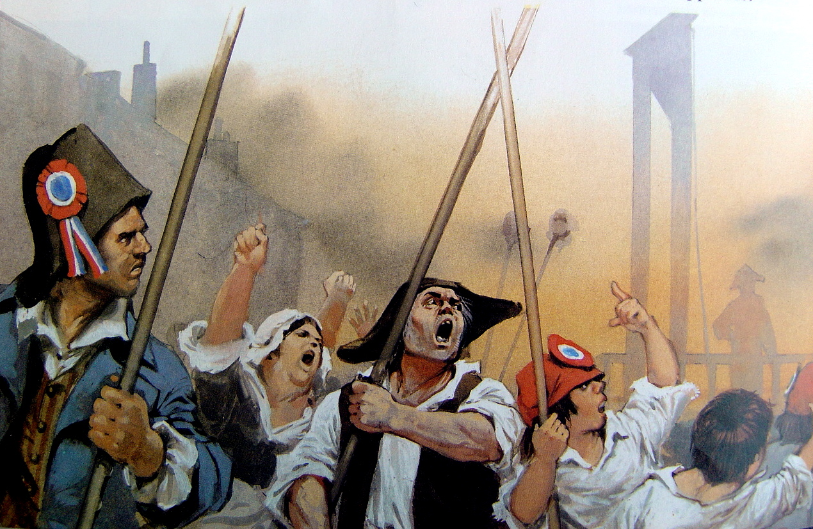

Slide 52
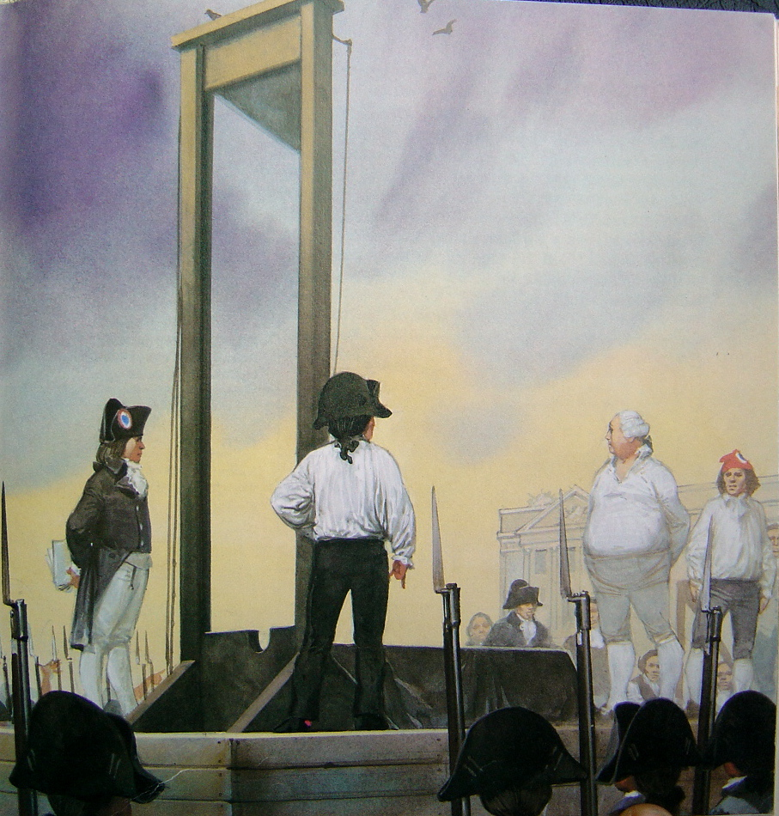

Slide 53
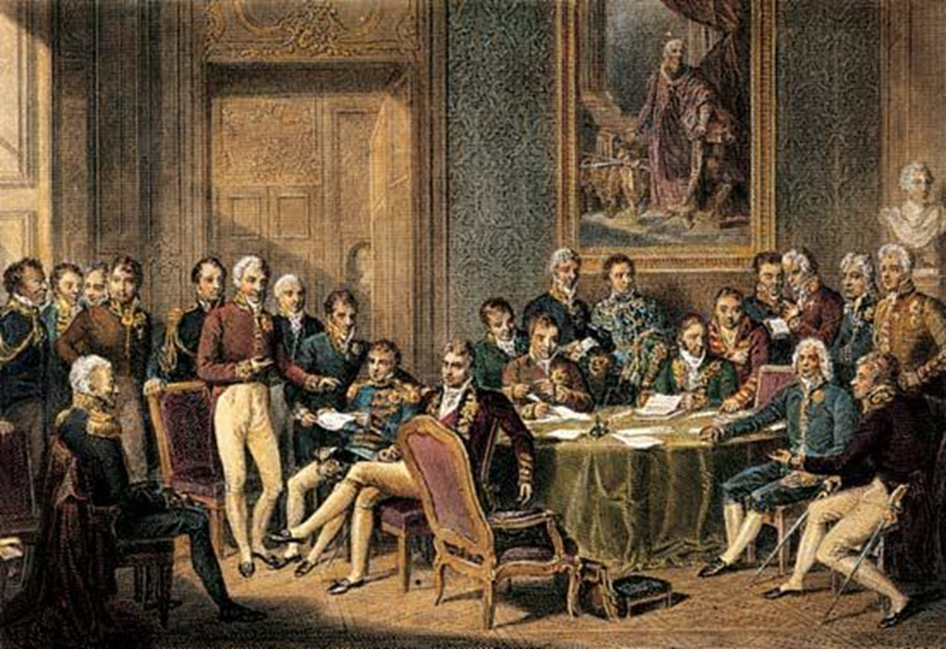
The Congress of Vienna
1814 - 1815

Slide 54
Wisdom required to understand elites agenda
Manuscript Releases vol. 18.
All need wisdom carefully to search out the mystery of iniquity that figures so largely in the winding up of this earth’s history. God’s presentation of the detestable works of the inhabitants of the ruling powers of the world who bind themselves into secret societies and conspiracies, not honoring the law of God,
should enable the people who have the light of
truth to keep clear of all these evils.

Slide 55
Wisdom required to understand elites agenda
Manuscript Releases vol. 18.
All need wisdom carefully to search out the mystery of iniquity that figures so largely in the winding up of this earth’s history. God’s presentation of the detestable works of the inhabitants of the ruling powers of the world who bind themselves into secret societies and conspiracies, not honoring the law of God, should enable the people who have the light of truth
to keep clear of all these evils.

Slide 56
Wisdom required to understand elites agenda
Manuscript Releases vol. 18.
All need wisdom carefully to search out the mystery of iniquity that figures so largely in the winding up of this earth’s history. God’s presentation of the detestable works of the inhabitants of the ruling powers of the world who bind themselves into secret societies and conspiracies, not honoring the law of God, should enable the people who have the light of truth
to keep clear of all these evils.

Slide 57
Wisdom required to understand elites agenda
Manuscript Releases vol. 18.
All need wisdom carefully to search out the mystery of iniquity that figures so largely in the winding up of this earth’s history. God’s presentation of the detestable works of the inhabitants of the ruling powers of the world who bind themselves into secret societies and conspiracies, not honoring the law of God, should enable the people who have the light of truth
to keep clear of all these evils.

Slide 58
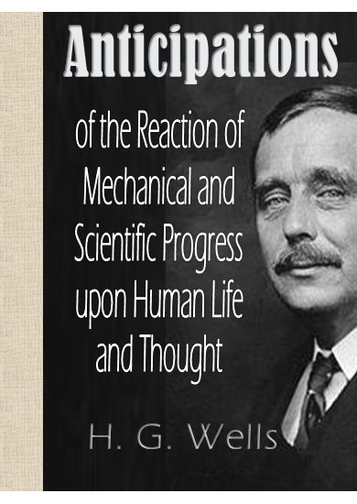
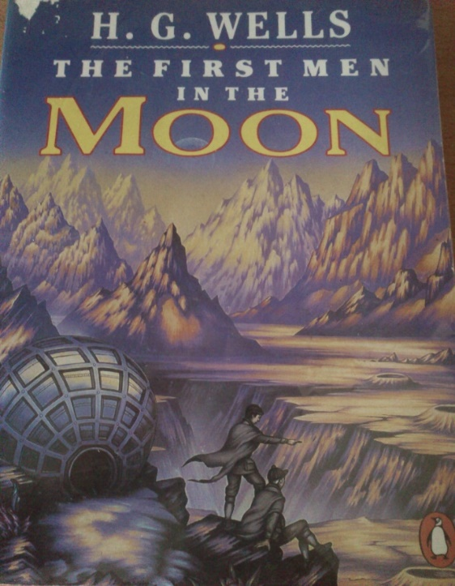
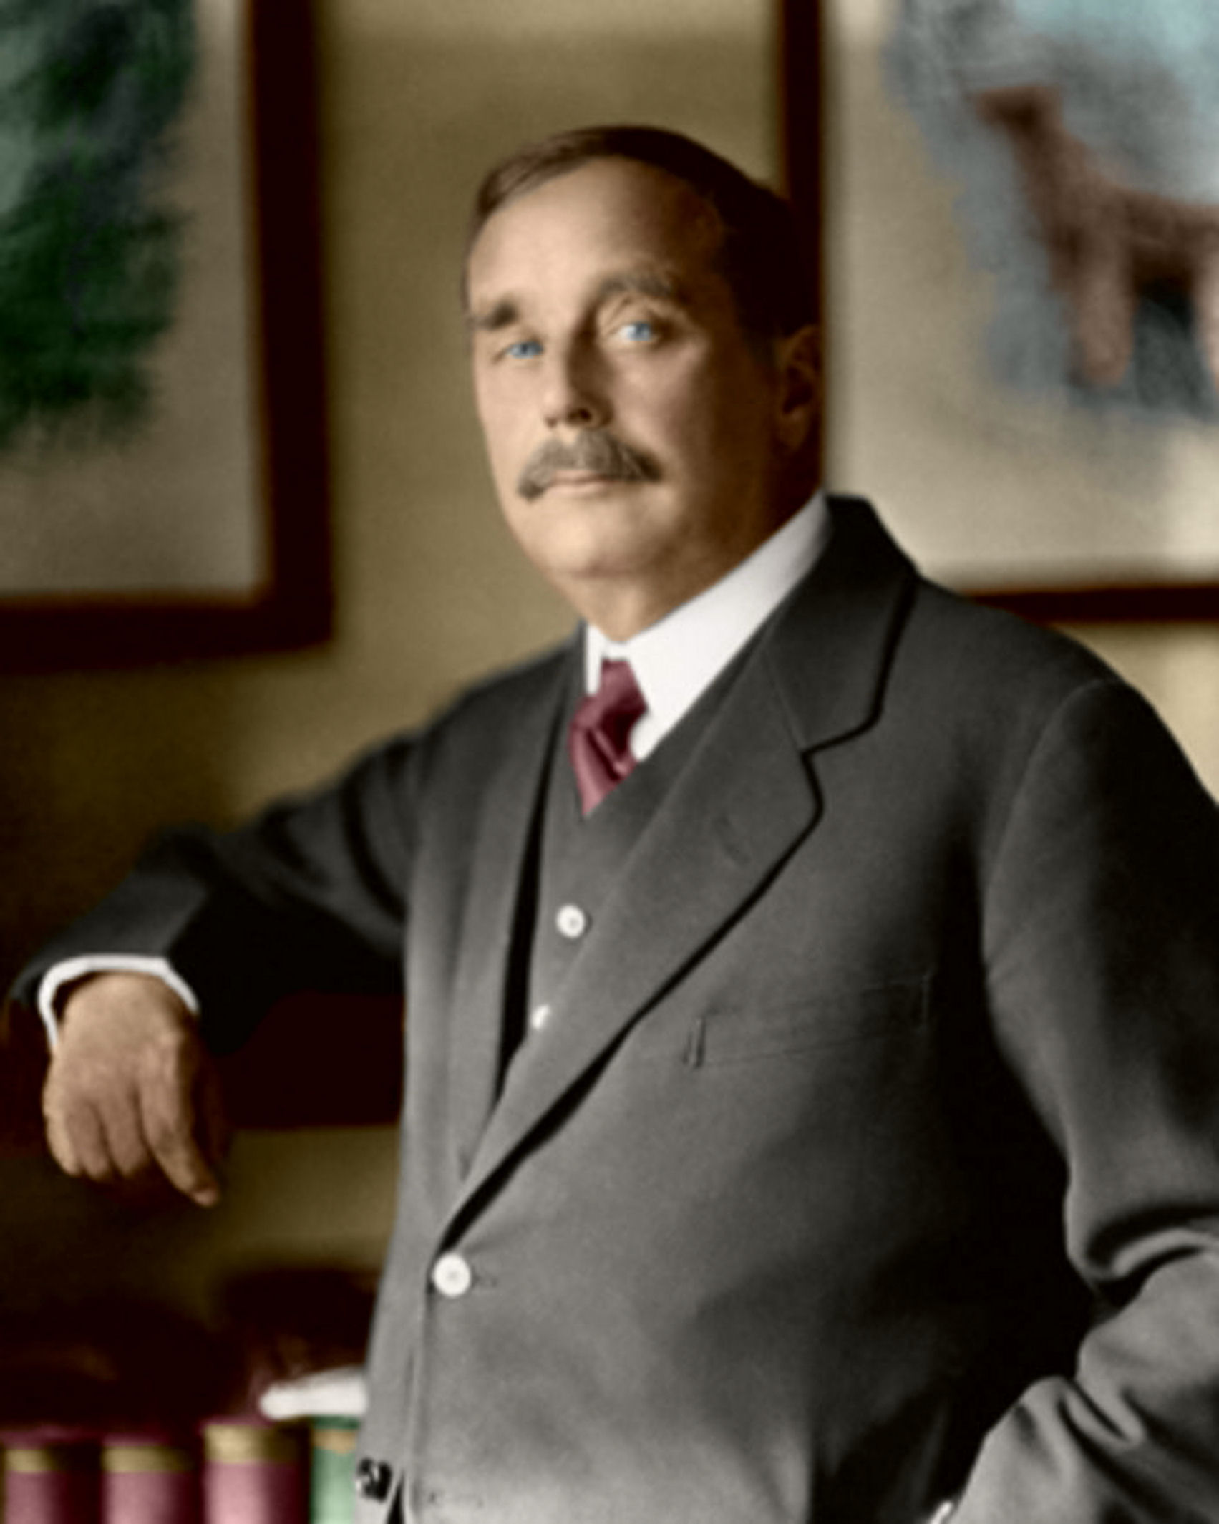

Slide 59
New World State
New Ethical System
…the ethical system which will dominate the world state, will be shaped primarily to favour the procreation of what is fine and efficient and beautiful in humanity--beautiful and strong bodies,
clear and powerful minds,
and a growing body of knowledge…
p. 114.

Slide 60
Reproduction carefully controlled
…the men of the New Republic will hold that the procreation of children who,
by the circumstances of their parentage, must be diseased bodily or mentally--I do not think it will be difficult for the medical science of the coming time to define such circumstances is absolutely the most loathsome of all conceivable sins.
p. 115.

Slide 61
Population Control through Social and Scientific Manipulation
…and to check the procreation of base
and servile types, of fear-driven and cowardly souls, of all that is mean
and ugly and bestial in the souls,
bodies, or habits of men. p. 114.

Slide 62
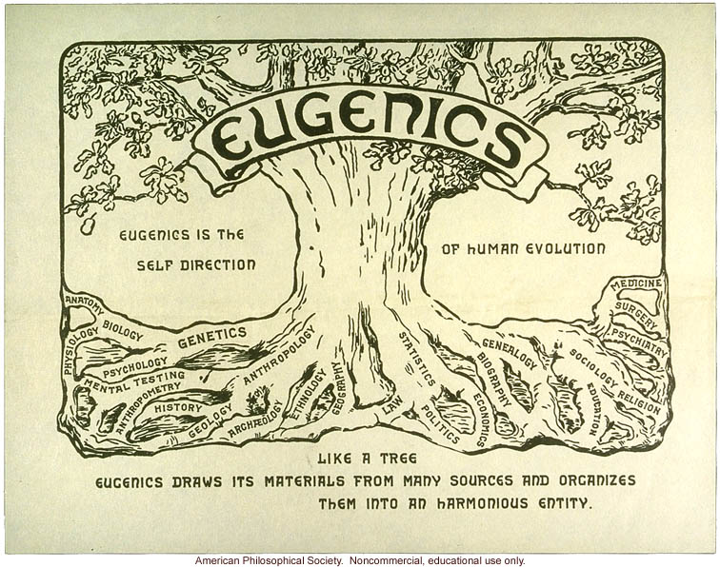
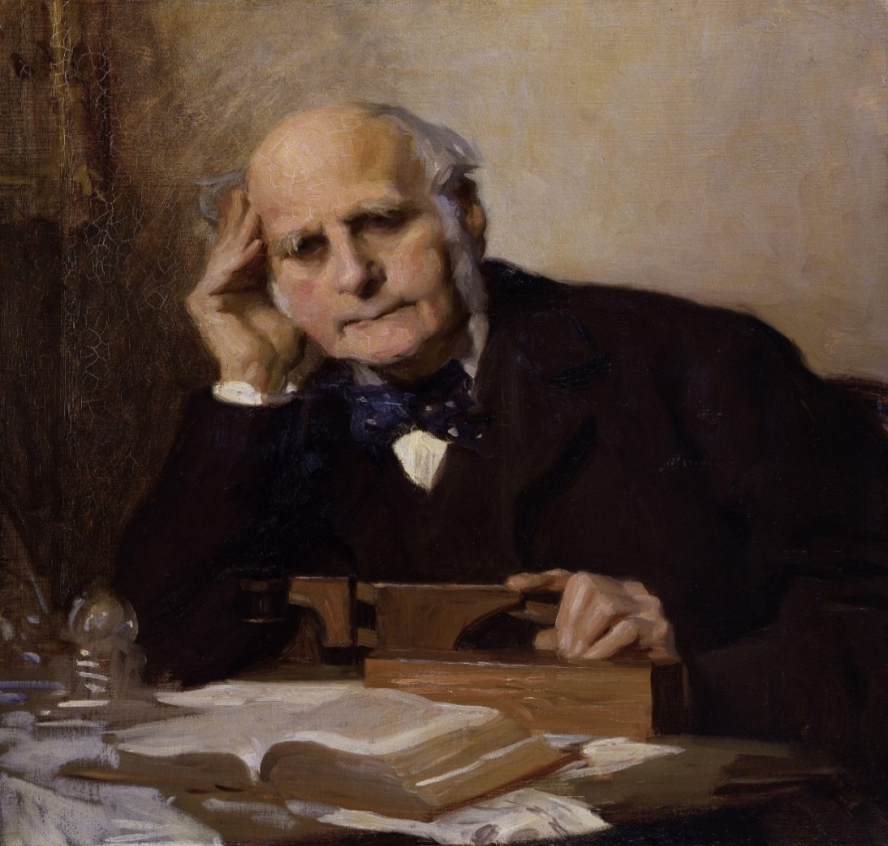
Francis Galton
Is the study of the agencies under social control,
that improve or impair
the racial qualities of
future generations either physically or mentally.

Slide 63
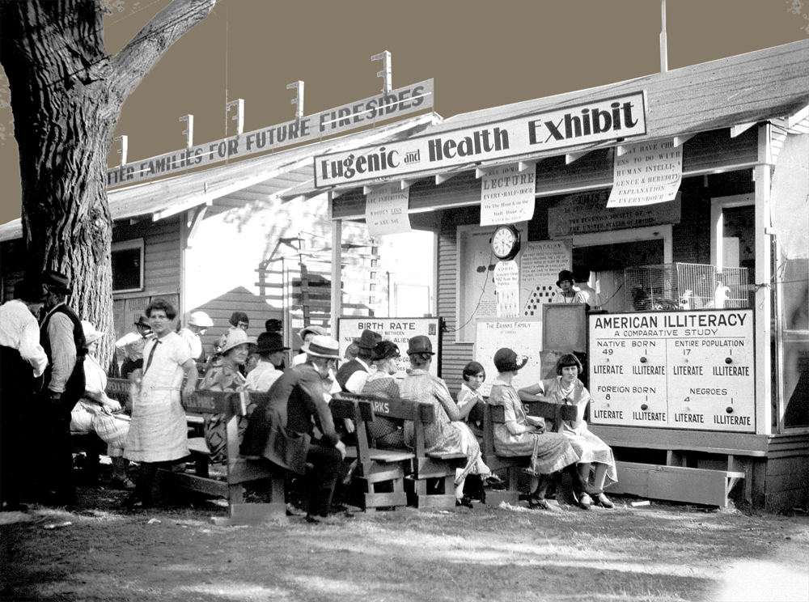

Slide 64
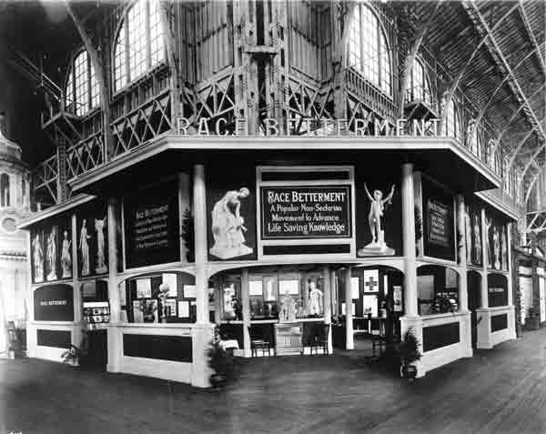

Slide 65
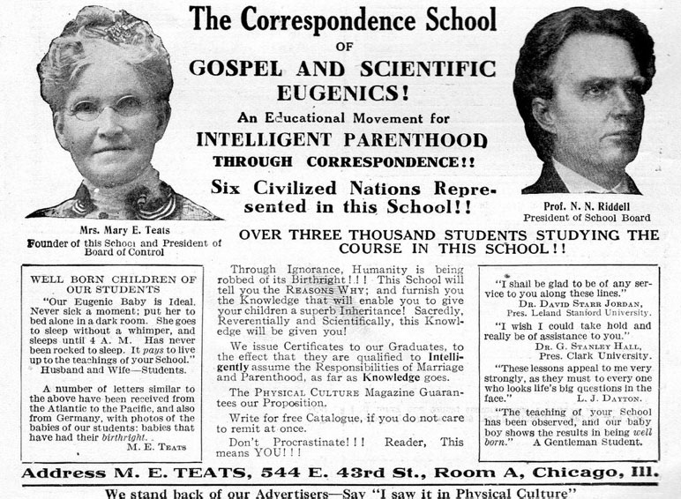

Slide 66
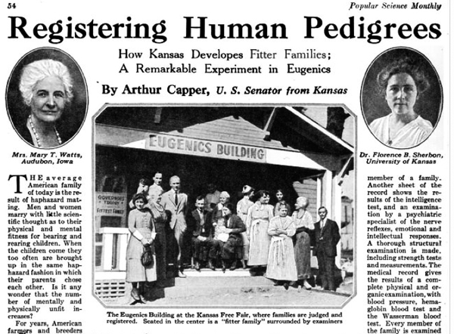

Slide 67
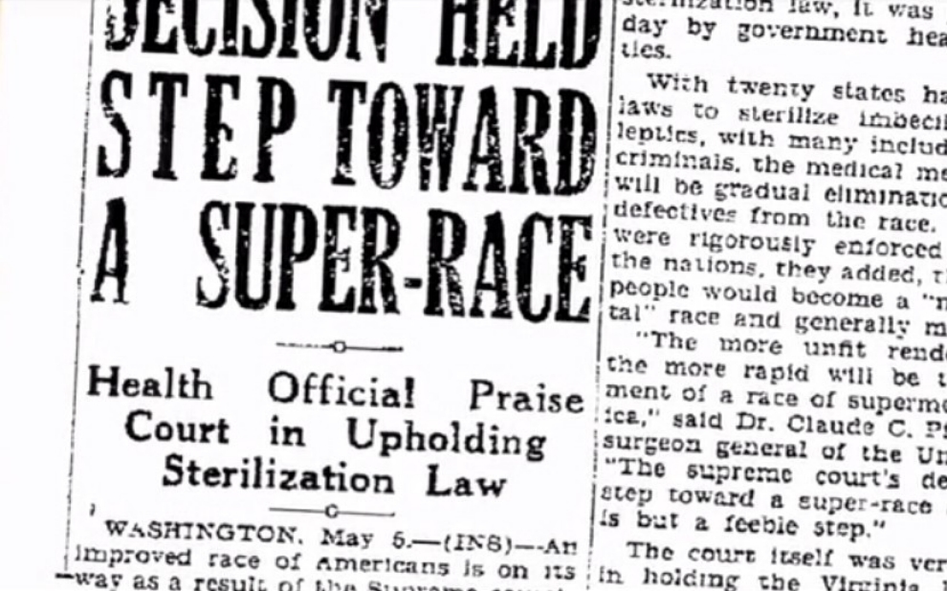

Slide 69
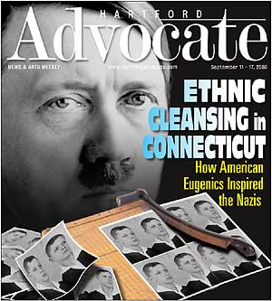

Slide 70
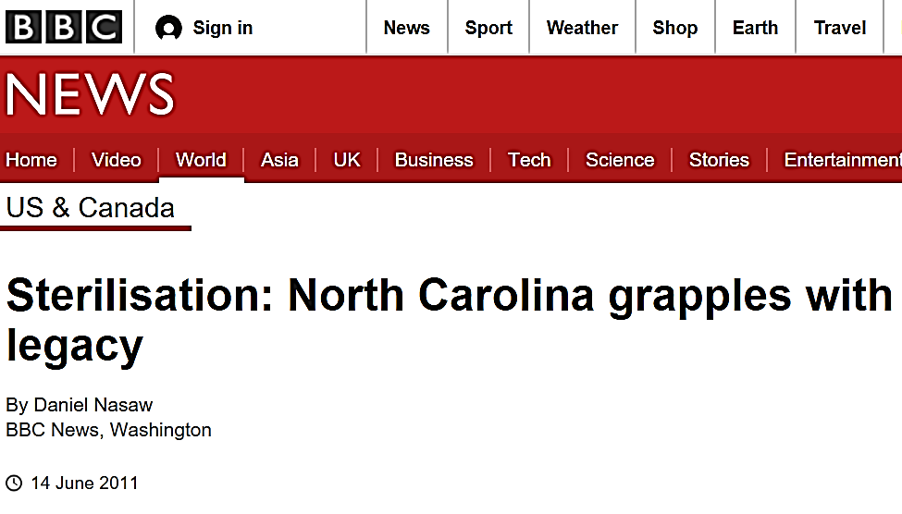

Slide 71
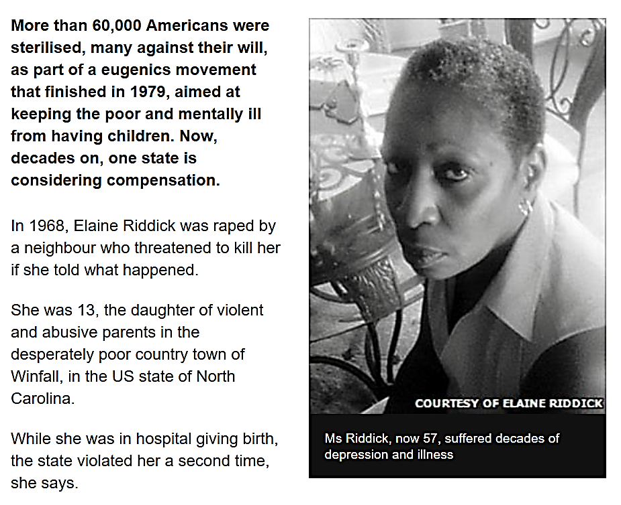

Slide 72
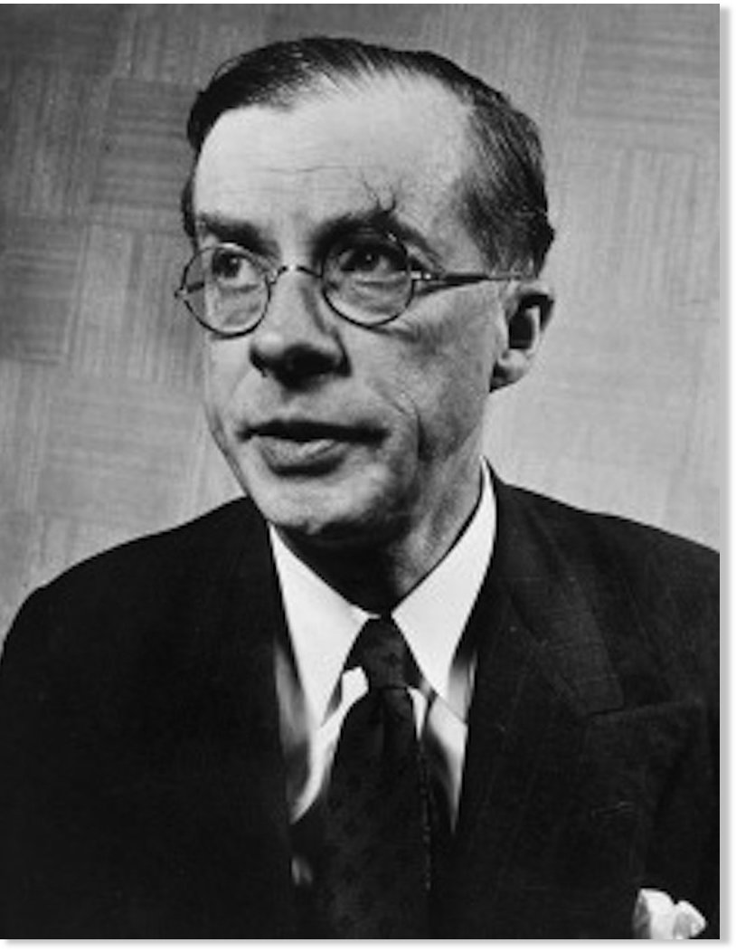
Eugenics at the UN
At the moment, it is probable that
the indirect effect of civilization is dysgenic instead of eugenic;
and in any case it seems likely that
the dead weight of genetic stupidity, physical weakness, mental instability, and disease-proneness, which already exist in the human species,
will prove too great a burden
for real progress to be achieved.
Julian Huxley
first director of UNESCO
1946-1948

Slide 73
Eugenics at the UN
At the moment, it is probable that
the indirect effect of civilization is dysgenic instead of eugenic;
and in any case it seems likely that
the dead weight of genetic stupidity, physical weakness, mental instability, and disease-proneness, which already exist in the human species,
will prove too great a burden
for real progress to be achieved.
Julian Huxley
first director of UNESCO
1946-1948

Slide 74
Thus even though it is quite true
that any radical eugenic policy will
be for many years politically and psychologically impossible,
it will be important for UNESCO to
see that the eugenic problem is examined with the greatest care,
and that the public mind is informed
of the issues at stake so that much
that now is unthinkable may
at least become thinkable.
Julian Huxley, UNESCO its purpose
and philosophy, 1946, p.21.
Julian Huxley
first director of UNESCO
1946-1948

Slide 75
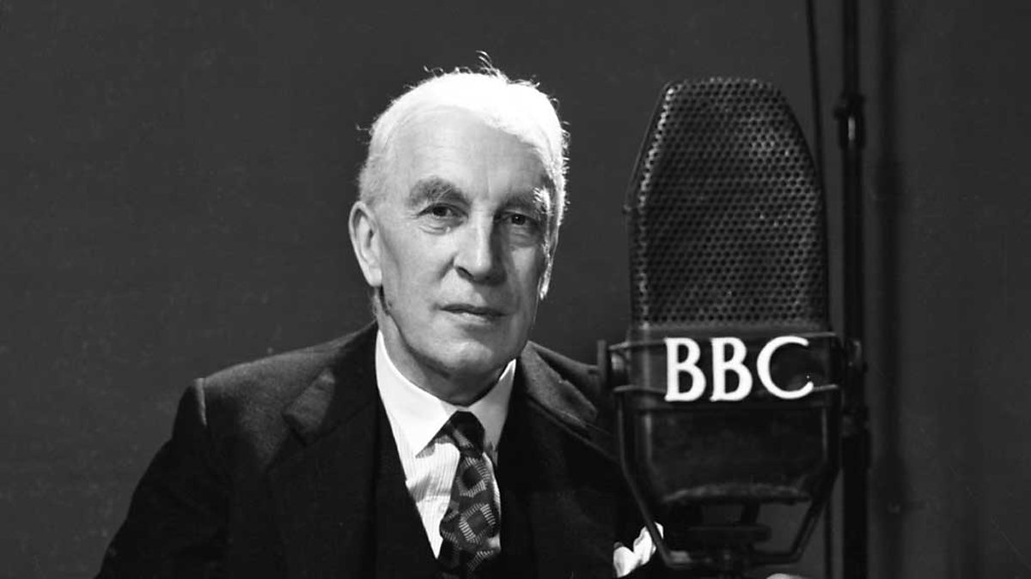
Arnold Toynbee historian philosopher professor

Slide 76
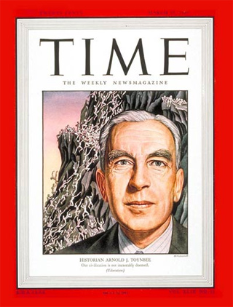
The Elite must decide who breeds and does not
Now that our progress in technology has armed us with annihilating weapons,
it is conceivable that we may come to the conclusion that we cannot any longer afford to let nature take its course in
the production of human beings;
that we cannot afford to
have anti-social behaviour…

Slide 77
Sterilize the young
We might decide that we must sterilize
all human males and females before the age of puberty and must breed children exclusively from test-tubes out of selected genes, from which we shall
have eliminated those genes that generate self-centredness, aggressiveness, pugnacity,
and anti-social behaviour of all kinds. Arnold Toynbee, Surviving the Future,
Oxford University Press, London,
1971, p. 113.

Slide 78
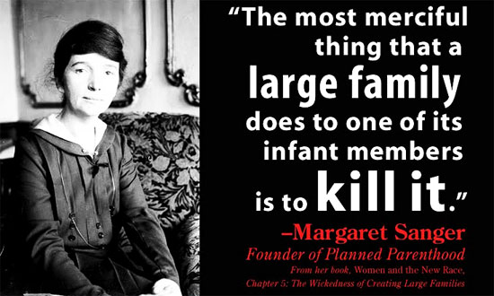

Slide 79
Death for the unwanted
…the method that must in some cases
still be called in to the help of man,
is death. In the new vision death is no inexplicable horror, no pointless terminal terror to the miseries of life,
it is the end of all the pain of life,
the end of the bitterness of failure,
the merciful obliteration of weak
and silly and pointless things....
p. 114, 115.

Slide 80
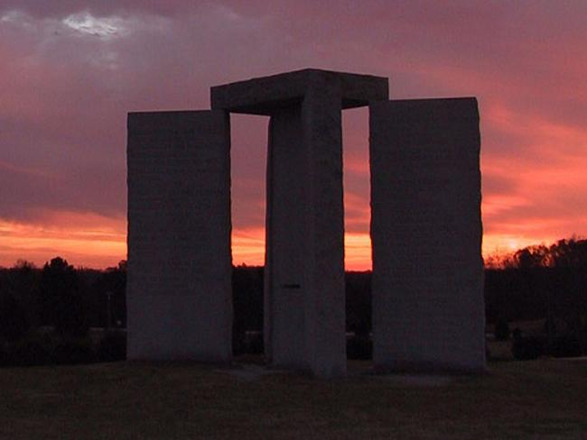
The Georgia Guide Stones

Slide 81
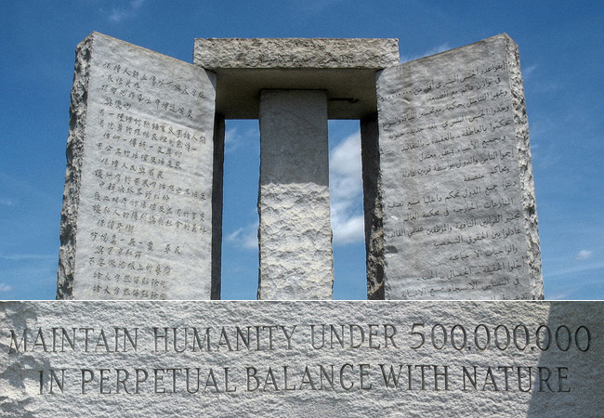

Slide 82
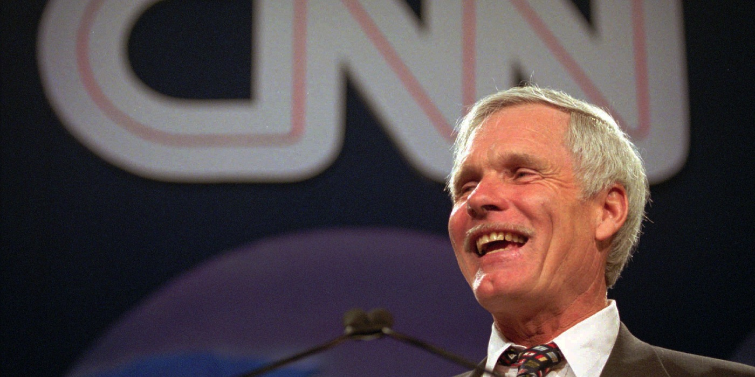
A total world population
of 250-300 million people,
a 95% decline from present
levels, would be ideal.
Ted Turner, founder of CNN

Slide 83
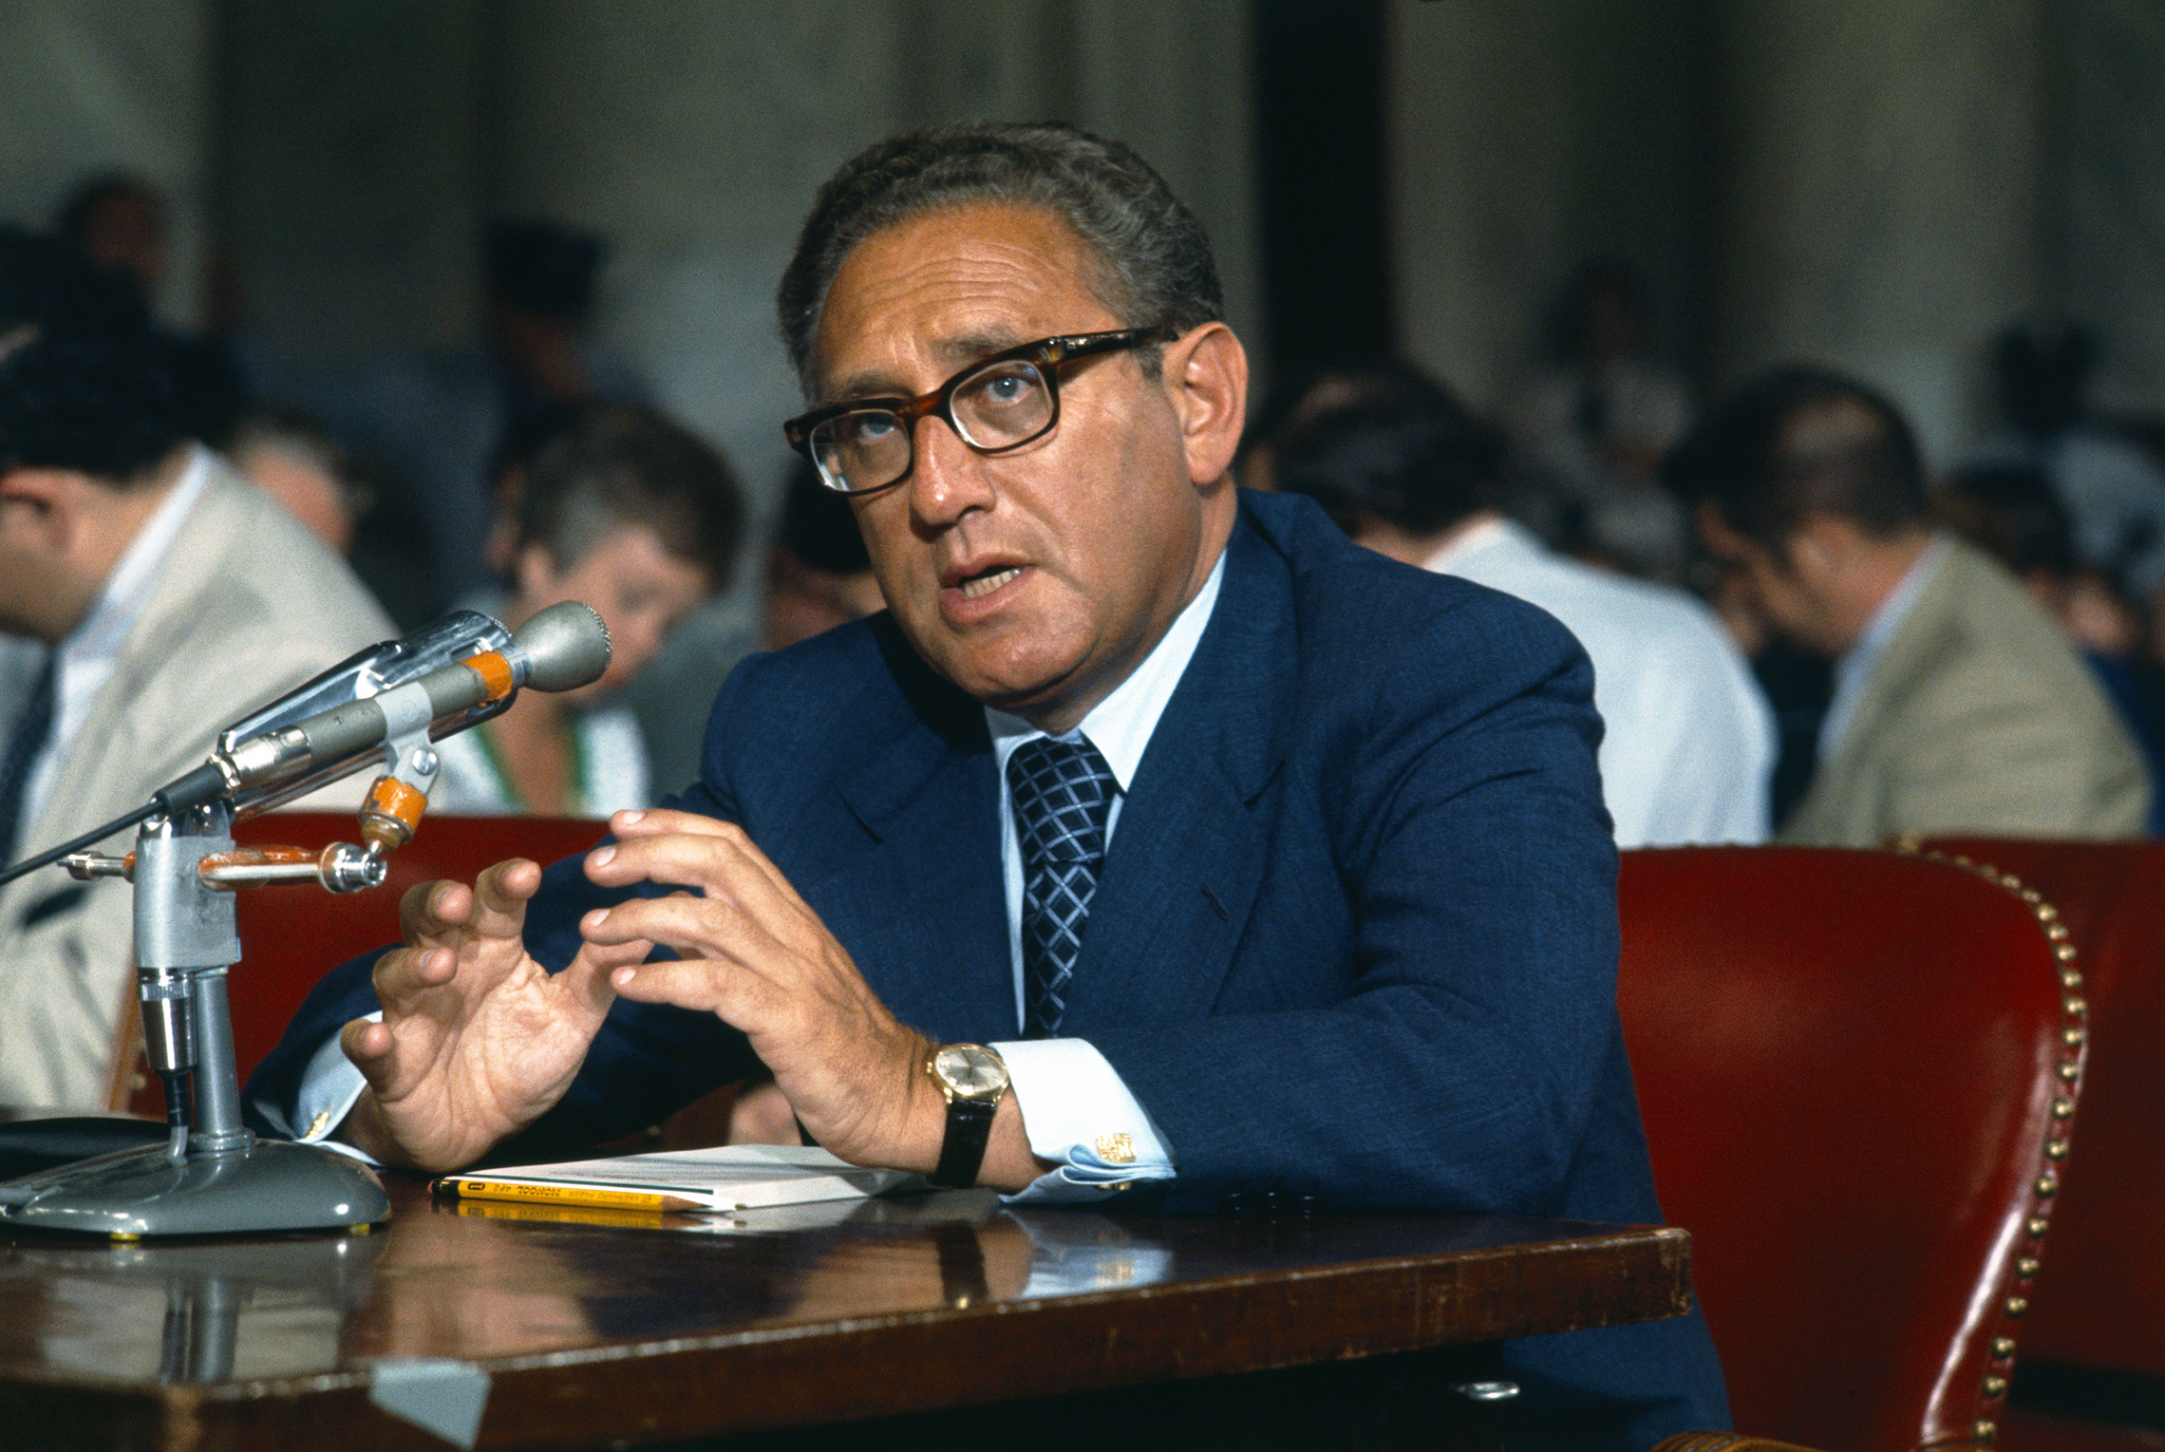
Depopulation should
be the highest priority
of U.S. foreign policy towards the
Third World
Henry Kissinger

Slide 84
I’m pro-choice, I’m for assisted suicide,
I’m for regular suicide, I’m for whatever gets the freeway moving – that’s what I’m for.
It’s too crowded, the planet is too crowded
and we need to promote death.
Bill Maher.

Slide 86
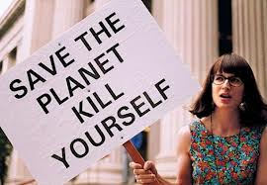
Billions of dollars is being poured into an effort to reduce population growth all over the world, and most people do not even know that it is happening.
These efforts are often promoted
under such labels as “family planning”, “abortion rights” and “public health programs”, but the primary goal is always to get women to have less children.
This population control agenda has millions upon millions of supporters all over the planet and it is gaining even more adherents with each passing day.
It is being taught in colleges, universities and schools all over the globe.
First the Propaganda

Slide 87
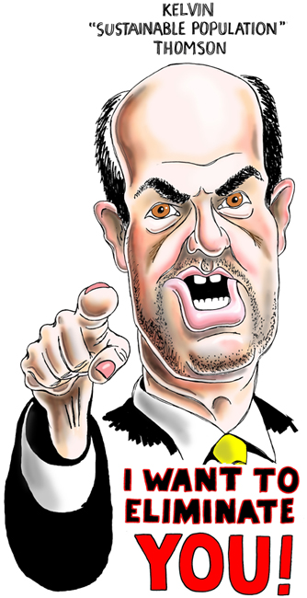
It is being promoted by radical humanists who are completely and totally convinced that the core crisis
that humanity is facing today is that there are way
too many people living on this planet.
They fully believe that overpopulation is the root cause of most of our economic, social, political and environmental problems. In fact, the truth is that many of them actually believe that they are literally in a “life or death” race to save the planet. Many of the “true believers” are entirely convinced that if human population numbers are not greatly reduced from where they are now, the planet
we are living on will be completely destroyed.
That is why many of these radical humanists
would absolutely love for you and I to die.
From their perspective, the less people the better.

Slide 88
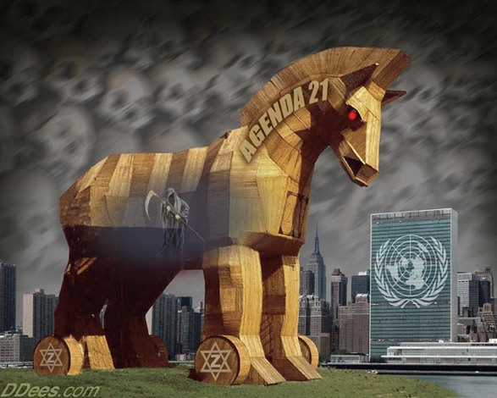
Many that write about the population control agenda make it sound as if there is just a “tiny elite” that is promoting this philosophy. Sadly, that is simply not accurate. The truth is that this twisted agenda is being taught at the majority of the colleges and universities in the United States.

Slide 89
It is being promoted in our television shows and in our movies. It is even being taught to elementary school children.
The Population Control Agenda
Of The Radical Humanists
Who Would Love For
You And I To Die,
Truther,
Oct. 15, 2012.

Slide 90
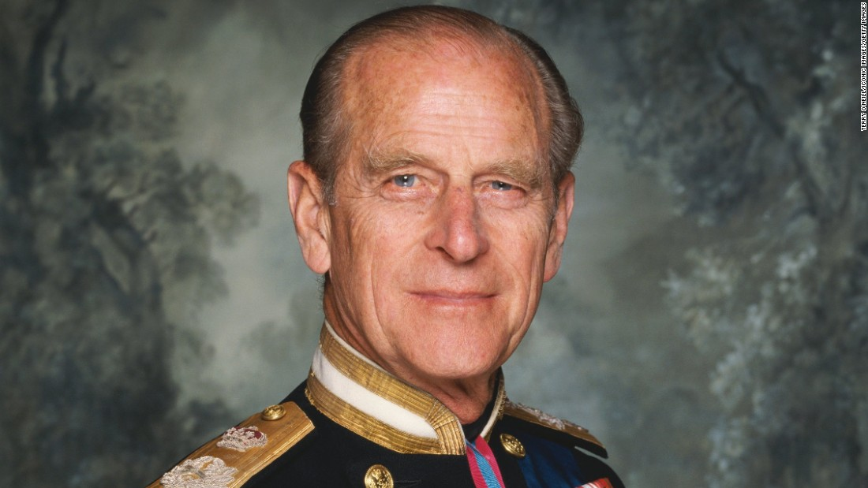
In the event that
I am reincarnated,
I would like to return as a
deadly virus,
to contribute something
to solving overpopulation.
Prince Philip of Great Britain

Slide 91
…in early times,
it was easier to control a million people, literally
it was easier to control a million people than physically to kill
a million people.
Today,
it is infinitely
easier to kill a
million people
than to control
a million people.
It is easier to kill
than to control.
Zbigniew Brzezinski, speech given at Chatham House,
England, Nov. 17, 2008.

Slide 92
An individuals
right to life
removed
The new ethics will hold life to be a privilege and a responsibility…
p. 115.

Slide 93
Government will be cruel and merciless
…the men of the New Republic will have
little pity and less benevolence.
p. 115.

Slide 94
They will hold, I anticipate, that a certain portion of the population…
with indisputably transmissible diseases,
with transmissible mental disorders,
with such hideous incurable habits of mind
as the craving for intoxication--exists only
on sufferance, out of pity and patience,
and on the understanding that they do
not propagate; and I do not foresee
any reason to suppose that they
will hesitate to kill when that
sufferance is abused.
p. 115.

Slide 95
Killing for the
Common Good
The men of the New Republic will
not be squeamish, either, in facing
or inflicting death, because they
will have a fuller sense of the
possibilities of life than we possess.
They will have an ideal that will
make killing worth the while.

Slide 96
Weaponization
of the Media

Slide 98
Who was Edward Bernays?
An Austrian-American pioneer
in the field of
public relations and propaganda,
referred to in his obituary as
"the father of public relations".
Bernays was named one of the
100 most influential Americans of
the 20th century by Life Magazine.
Wikipedia.

Slide 100
The conscious and intelligent manipulation of the organized habits and opinions of the masses is an important element in democratic society.
Those who manipulate this unseen mechanism of society constitute an invisible government which is the true ruling power of our country…
Invisible government manipulating society is true ruling power

Slide 101
Our job is to give people not what they want,
but what we decide
they ought to have.
Richard Salant,
former President
of CBS News.

Slide 102
Let them protest all they want as long as they pay their taxes. Alexander Haig, US Secretary of State.

Slide 103
…made drunk with the wine of her
fornication…
Rev. 17:2.

Slide 104
Political Correctness

Slide 118
We only have 12 years

Slide 119
I don’t want you to be hopeful.
I want you to panic.
I want you to feel the fear,
that I feel every day.
Greta Thunberg,
Swedish school strike activist,
speech at Davos,
Jan. 25, 2019.

Slide 120
Protestantism will not suit
the New Republic
…there will, I imagine,
be a steady decay in the
various Protestant congregations.
p. 122.

Slide 121
Roman Catholicism will suit the New Republic
The rich as a class and the people of the Abyss, so far as they move towards any existing religious body, will be attracted by the moral kindliness, the picturesque organization and venerable tradition
of the Roman Catholic Church.
We are only in the very beginning of a great Roman Catholic revival.
p.122.

Slide 122
Summary
Satan’s plan is to kill God’s people.
Satan’s allies are the elites of the earth.
Satan’s plan is to de-populate the earth.
His agenda motivated by fear.
Roman Catholicism best suited for this agenda.

Slide 123
Put on the whole armour of God, that ye may be able to stand against the wiles of the devil. For we wrestle not against flesh and blood,
but against principalities, against powers, against the rulers of the darkness of this
world, against spiritual wickedness
in high places. Eph. 6:11, 12.
Words to live by
in the Last Days

